Slide 1
ZEST: Using technology to support school-based teacher development
Mark Gaved, Rachel Hanson, Kris Stutchbury, Lore Gallastegi, Clare Woodward (The Open University, UK)
Misheck Mwanza, Charles Chibwika (World Vision Zambia)
Notes:
Hello, my name is Mark Gaved and I'm going to report on a project that has explored a novel approach to using technology to support school-based teacher development in Zambia. I’m part of the team, from the Open University in the United Kingdom along with Kris Stutchbury, Rachel Hanson, Lore Gallestegi and Clare Woodward; and we also have our colleagues Misheck Mwanza and Charles Chibwika from World Vision Zambia, our partner in this programme.

Slide 2
Invited by Zambian MoGE to enhance current School Based Teacher Development programme in line with revised primary school curriculum: a vision based on learner-centred education and inclusivity, which focuses on knowledge, skills and values
School based teacher development (SBTD) more effective than traditional cascade models
Key tenets of networking and building communities of practice: bringing people together
Provision of resources for teachers is a critical aspect
Notes:
ZEST is the Zambian Education School-based Training programme. Led by the Open University alongside World Vision Zambia it’s funded by the Scottish Government. We were invited to carry out this initiative by the Zambian Ministry of General Education in response to a revised national curriculum, which emphasizes learner centred education and inclusivity.
ZEST’s goal has been to enhance the provision of continuing professional development, to innovate teaching practice in schools, and to support this new approach to curriculum, building teacher capacity for its delivery. Key to this is co-designing a high-quality enhanced School-based Teacher Development Programme with and for teachers, school leaders, and Ministry of General Education officials.
Our colleagues Lore and Clare will talk to you more about the teaching approach in their DETA 2021 presentation on Thursday at 10:45 but in brief, it emphasizes a collaborate-practise-reflect learning approach by the teachers. Teachers are introduced to a pedagogic approach such as pair work, role play or formative assessment. They work in small groups – pairs or threes – to plan a classroom activity using that approach, in the context of what they need to teach. Each teacher then tries their activity in their own classroom. They come back together to reflect on how it went and to plan another activity, using the same approach, drawing on their collective experiences.
This is delivered by Teacher Group Meetings, supported by digital materials that were co designed in the country.
It is more effective than traditional cascade models because the traditional models provide training manuals for master trainers, but nothing for teachers – usually because the costs of printing and distributing resources at scale are prohibitive.

Slide 3
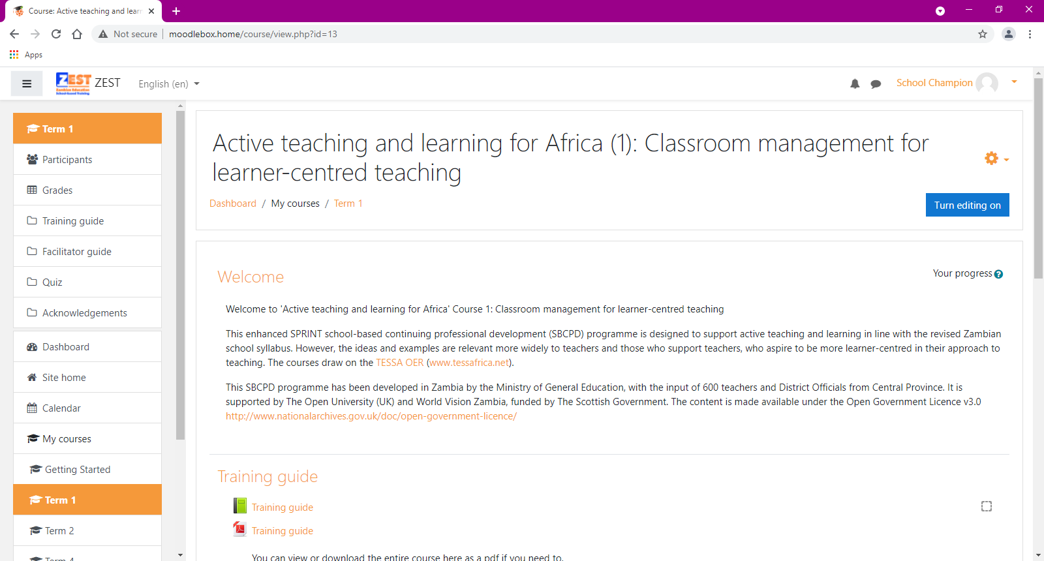
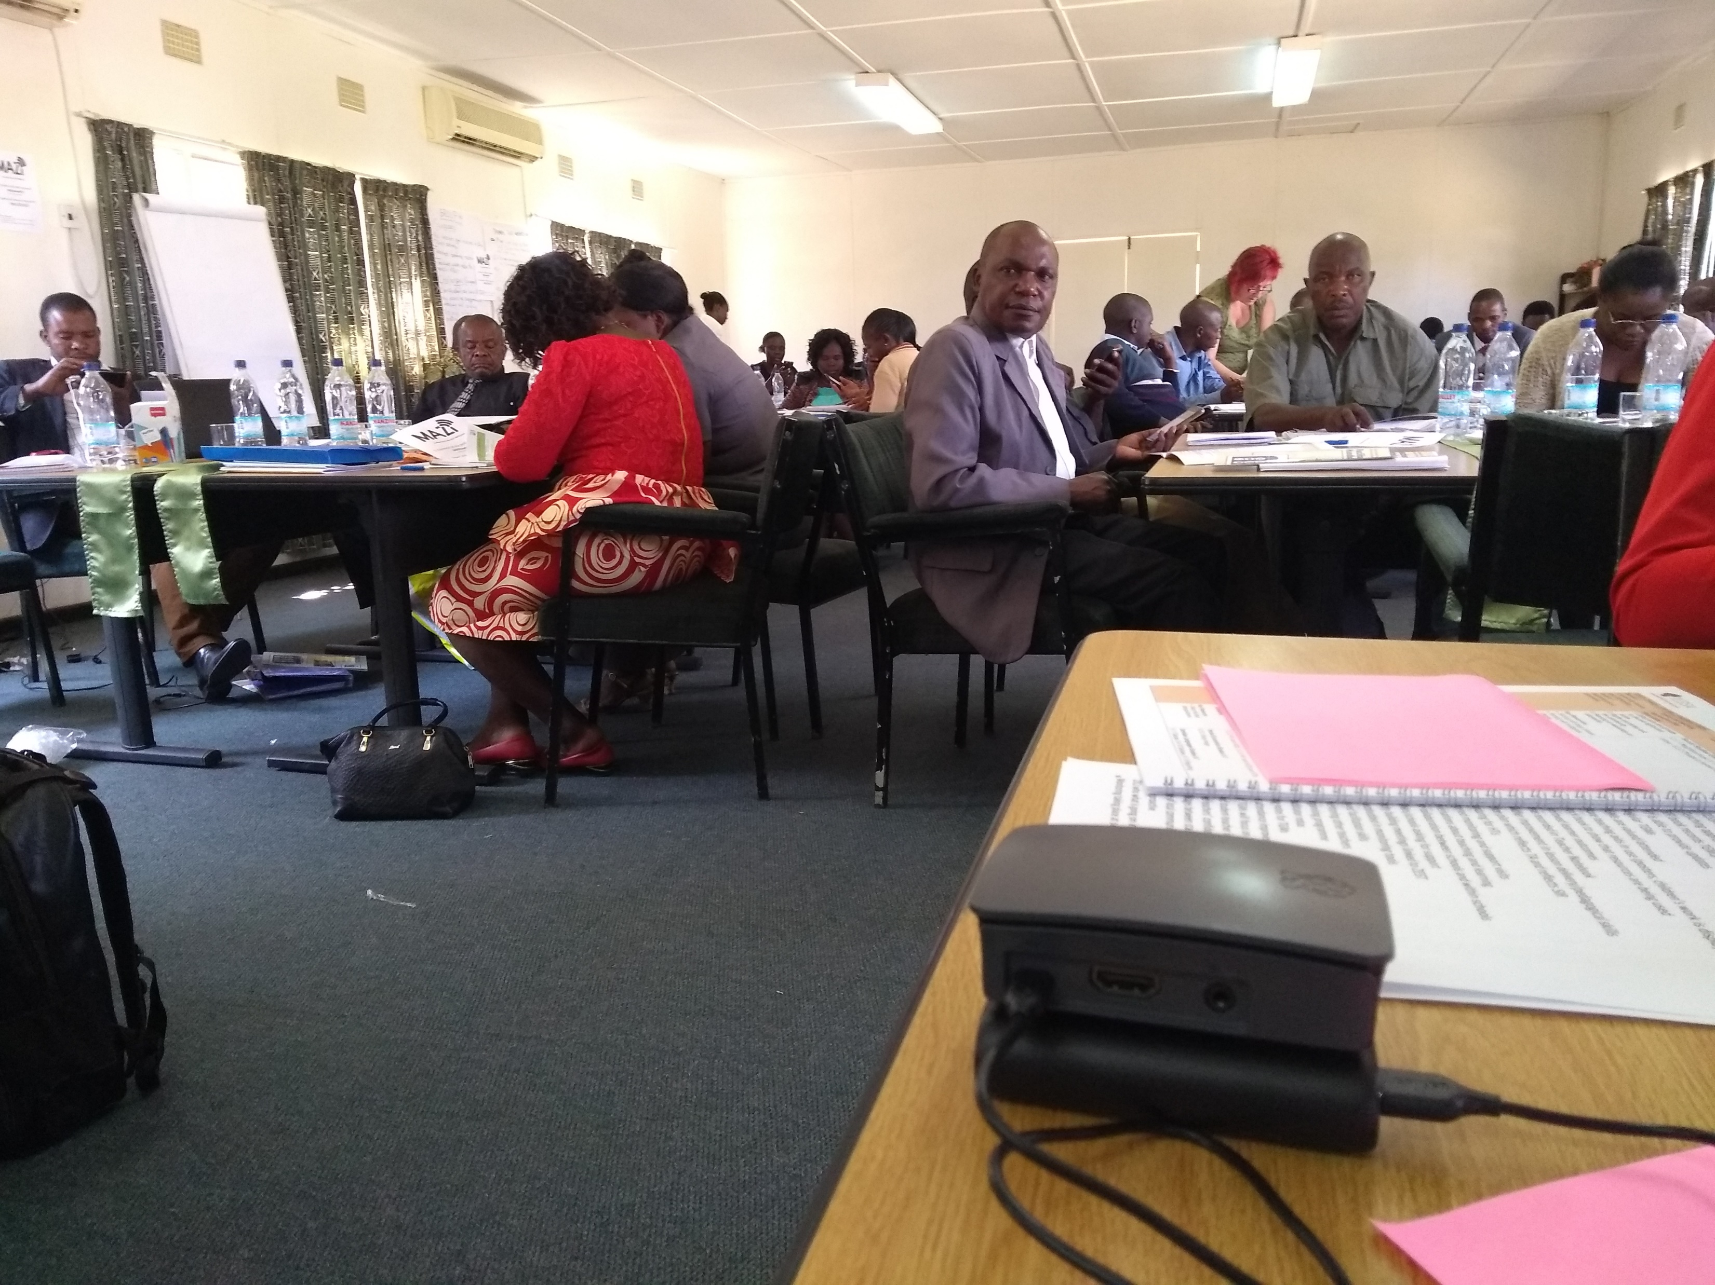
A technology enhanced approach
Delivering high-quality contextualised digital resources into the hands of teachers
Open Educational Resources: PDFs, audio and video
Lack of reliable, affordable internet but wide availability of smartphones: ‘offline networked learning’ approach using Raspberry Pis with web-based tools (including Moodle)
Training School Champions
Monitoring & Support via free data collection tool ‘KoBo’ – annual Evaluations; monthly District/School reports; regular project monitoring
Notes:
Given that a critical element of School-based teacher professional development is the provision of resources for teachers, and printing and distributing paper-based resources can be highly problematic, ZEST has taken a novel technology enhanced approach, where digital materials such as PDF documents, audio and video resources, are given to teachers to help enhance their training programme.
Initial plans sought to distribute paper-based guides, and digital open educational resources (including AV materials) via SD cards for teachers’ mobile phones. With the pedagogical emphasis on collaborative learning, though, a digital technology that enabled supported collaborative working and co-construction of knowledge was preferred.
However, because there is a lack of reliable affordable internet or cellphone access, we decided not to consider an internet-based approach. But there is widespread ownership of smartphones by teachers, so a networked learning approach was still seen as attractive.
We've taken what we call an offline networked learning approach, using small low cost, battery powered computers, Raspberry Pi's, to act as network hubs that allow teachers to work together, using web-based tools that may be familiar to them as smartphone users. These enable digital resources to be made available where the teachers need them, to travel with them if necessary, to access them on their own devices, and not require any internet access or reliable mains electricity.
The teachers’ experience in the Teacher Group Meetings is that they bring their personal devices, their smartphones, their laptops, or tablets, and they log in to the hubs via Wi Fi in the room where they're working. They access the web platform, which enables a web-based interface to a number of useful tools that teachers can use for accessing the OER training resources, Ministry of General Education documents, and also space where they themselves can upload their own materials. Our initial trial used a simple software suite developed on a European Union funded project, called MAZI, but we are now using the Raspberry Pi version of the widely used Virtual Learning Environment, Moodle. This has the advantage of not only allowing resources to be stored and shared, but also to recognise teachers’ engagement, which is valuable as engagement with CPD has to be evidenced by teachers to maintain their professional status in Zambia.
To support the new technological infrastructure, the project created the role of School Champions. Working through WVZ, who had the on the ground understanding of which teachers were most enthusiastic and active around using the Pis, they were identified during early 2020 but training was delayed until October 2020, due to Covid.
KoBo Toolbox is a free data collection tool which the project started off using during the Baseline Evaluation. This tool has continued to be used during the annual/Midline evaluations, and its use expanded so that schools and districts now use it to submit monthly project reports, and WVZ are due to start using it in their regular monitoring visits. KoBo is accessible on smartphones, tablets, laptops, can be used both online/offline and data shared with relevant colleagues for analysis/reporting.

Slide 4
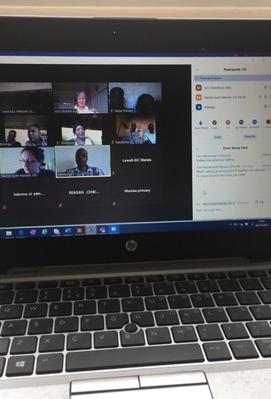
Covid-19
Covid Wave 1: March – September 2020
Schools close March-June; reopen for exam-grade classes only
Zoom and WhatsApp used to continue SBTD
11 schools connected regularly and engaged in discussions supported by WVZ in Lusaka and the Open University in the UK
WhatsApp: ‘domesticated’, familiar technology: Zoom was novel
Covid Wave 2: January – February 2021
Schools close; no access to Teachers
Covid Wave 3: June 2021 - ?
Schools close; access to school leaders
Microsoft Teams used for delivering virtual orientation workshops
Notes:
This approach was successfully piloted in 11 schools, and we were preparing to expand the rollout when the Covid-19 pandemic hit. Schools were closed in March 2020, pupils were sent home and teachers unable to meet. However, in December 2019, just before the pandemic, a WhatsApp group had been set up for the purposes of evaluating ZEST materials and Raspberry Pi use. Zambian school teachers are used to WhatsApp, it is a familiar technology. We might describe it as “domesticated” – already woven into everyday practices and ZEST was building on existing capabilities.
Schools reopened in June 2020 for exam-grade classes, which brought teachers back into schools. SBTD discussions resumed and the WhatsApp group was used regularly across 11 schools in one District, supported by World Vision Zambia in Lusaka and educators from The Open University in the UK.
Zoom meetings were also set up, these were novel to most schools and there were some challenges, but it worked and enabled the ZEST ideal of teachers working together for SBTPD to continue throughout the first wave of the pandemic. Examples of good practice were shared as videos and photographs, and support was provided for Teacher Group Meetings through professional reflection and discussions among participants.
Zambia was faced with a second wave of Covid in early 2021, resulting in a second round of school closures. Limited ZEST activity took place during this time due to the team having no access to teachers or school leaders. Schools reopened in February and effort was made to reach a total of 64 schools across 5 Districts during this time, with further Raspberry Pi training provided to newly identified school champions. The use of Zoom/WhatsApp continued amongst District/Province officials, WVZ and OU.
Zambia is now in a third Covid wave, with schools once again closed. Access to school leaders has been granted this time and lessons from Wave 1 have been incorporated into an enhanced approach. District Officials are being supported to facilitate virtual orientation workshops via Microsoft Teams with as many schools as possible, network connectivity allowing, and a WhatsApp Group has been created for the District & Province officials, WVZ and OU to enable the sharing of experiences and support.

Slide 5
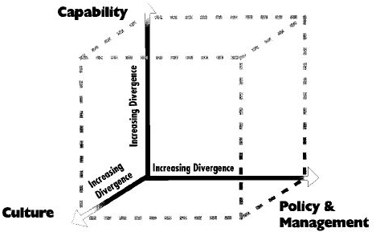
What have we learned?
Technology as enabler to support primary focus of project
Importance of established structures, roles, processes and resources in the school system
New techniques learned about use of technologies & social media for supporting SBTD
Zoom/WA/Teams: tools to enhance community of practice
Identification of role of RPi champions – harnessing existing hidden expertise
De-structuring resources into bite sized chunks of practice based on more regular contact
Blumenfeld et al. 2000: Creating Usable Innovations in Systemic Reform
Notes:
First and foremost, it is key to remember that technology in this case is an enabler, it is not a magic solution, and it develops from capacities and capabilities already in place. We are building on established structures, roles, processes and resources. Furthermore, it is important to keep in mind that it is simply there to allow access to the programme’s resources, and it is important that the technology/innovation doesn’t distract from the prime focus of the programme i.e. learner-centred education, active teaching and learning, teacher collaboration.
That said, we have learned that there is real excitement about technology, with people developing new digital skills – both technical (like using new tools) and also pedagogical (such as virtual workshop facilitation). This works particularly well when new technology (e.g. Pis, Zoom, Teams) is combined with familiar technology (smartphones, WhatsApp) so it is not as daunting.
The use of Zoom, WhatsApp and Teams helped to build a community of practice: they allowed educators to model the pedagogical approaches presented in the programme’s resources and provided a space for school leaders/officials to learn, reflect and critically question practices and experiences, before sharing with Teacher Group Meeting participants.
The introduction of Raspberry Pi Champions enabled the harnessing of existing hidden expertise within schools. By separating the technical from the pedagogical, it allowed a careful navigation of the school system which allowed school leaders to focus on the main objective of the programme (enhanced SBTD) whilst allowing IT teachers to take a lead on the Raspberry Pi activity. This approach successfully respected the existing hierarchies whilst also ensuring the relevant expertise were identified early and empowered to lead on tech support – their input was later expanded from Raspberry Pis to include Teams, Zoom and Kobo.
To adapt to the new way of working in the First Covid Wave – via the social media meetings, and with more regular content - resources were de-structured from how they were originally presented in the paper based handbook and used in face to face classroom based facilitated sessions, into bite sized chunks of practice. Two page PDF documents were shared through WhatsApp in advance, read in advance, and then discussed in meetings. As the meetings progressed and continued into the third wave, we saw a shift in facilitation from the UK team to local educators and this is something that will be explored with a sustainability mindset.
Working via screens rather than on paper had both positive and negative effects: the small screens could limit how the material was used, but equally, the functionality of smartphones allowed for zooming (screens), and the inclusion of audio/video materials, and in at least one case in one of the face to face TGMs before Covid, a visually impaired teacher noted how digital materials were easier for them to access than paper-based versions.
An encouraging sign of onward use is that World Vision Zambia have reported seeing local appropriations of the tools, schools uploading local resources not produced by ZEST onto the Raspberry Pis, a sign that schools have seen value in them above and beyond the specific remit of ZEST.
Our experiences resonate with Blumenfeld et al.’s model which suggests three dimensions that need to be considered when introducing technology at scale into an educational system: the divergence from current capacities, culture, and existing policies and management approaches. The greater the divergence, the greater the challenges, and more likely the introduced innovation might fail.
In our case, by building on existing capacities within the Zambian education system and respecting existing hierarchies and cultures, and using familiar technology and the motivation of teachers, leaders, and officials to learn and share new skills, has allowed technology (Pis, social media) and innovation to be gradually and successfully introduced into Zambia’s primary schools.
Phyllis Blumenfeld , Barry J. Fishman , Joseph Krajcik , Ronald W. Marx &
Elliot Soloway (2000) Creating Usable Innovations in Systemic Reform: Scaling Up Technology-
Embedded Project-Based Science in Urban Schools, Educational Psychologist, 35:3, 149-164,
DOI: 10.1207/S15326985EP3503_2

Slide 6
Examples from the field
Supporting primary focus of project: e.g. remote school enabled to access resources
Example of established practices/resources, e.g. Head Teacher who is promoting RPis
RPI Champions (e.g. Example of a particular champion who is uploading own resources (appropriation)
Appropriation: Range of ways in which used – possibility of schools themselves deciding how used

Slide 7
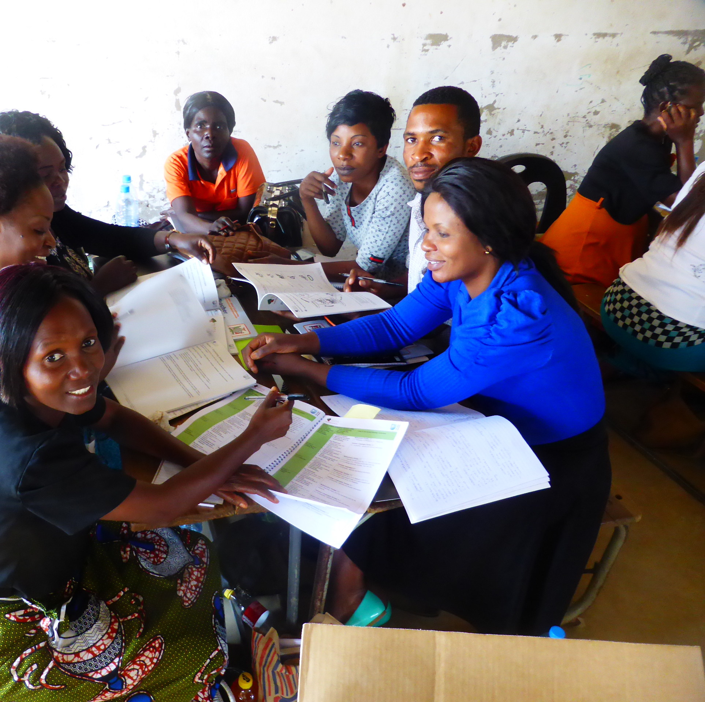
Where next?
Project scale-up - 420 schools / 4000 teachers
Blended engagement harnessing appetite for learning and lessons from Covid
Longer term sustainability of both resources and technology
Notes:
Throughout the programme we have seen an appetite for learning, both pedagogical and digital, which continues to grow even during the pandemic. Schools have shown a great commitment during a time when they have been very busy and we might not expect to see engagement, which shows promise for future sustainability.
The programme’s target is to reach 420 schools and 4000 teachers – this will be our prime focus when schools reopen after this current Covid wave.
Ways of working have evolved with each Covid Wave with the latest seeing the introduction of Teams and a move towards virtual workshop facilitation. The programme will therefore look to evolve in its final phase to incorporate lessons from Covid and encourage a blended engagement approach of both face to face and virtual workshop facilitation/support where possible.
There will also be a focus on the longer term sustainability, both with regards to use of the programme’s resources and the support for Raspberry Pis/social media. The programme will continue to engage with the Ministry of General Education about its longer term plans, and explore options for growing the skills and expertise.

Slide 8
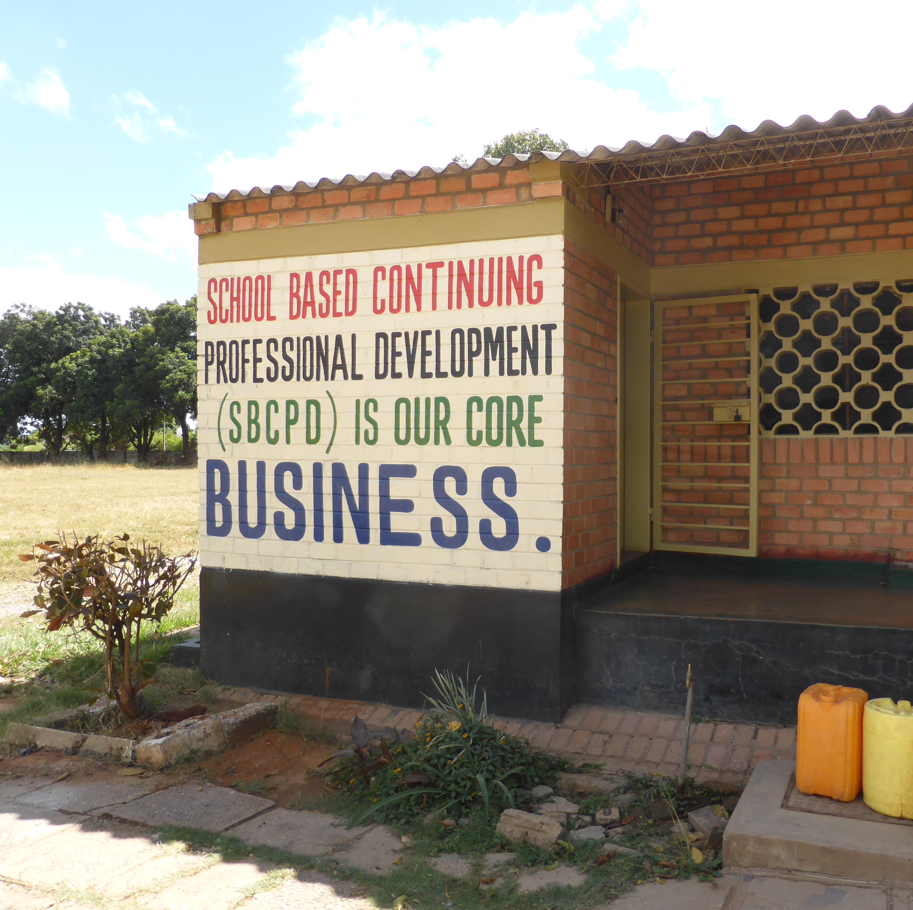
Thank you: over to you!
In your situation, do you see benefits or challenges in using technologies to support teachers?
Have you used technologies in different ways to help you support teaching and learning during Covid?
Contact Us:
Mark Gaved – mark.gaved@open.ac.uk
WORLD VISION
Learn more about ZEST | Access the ZEST resources
Notes:
Thank you. Please do get in contact, and we look forward to your questions

