Slide 1
Mobile offline networked learning for teacher Continuing Professional Development in Zambia
Mark Gaved, Rachel Hanson, Kris Stutchbury
The Open University, UK
mLearn2020 2nd November 2020 Practice Paper

Slide 2
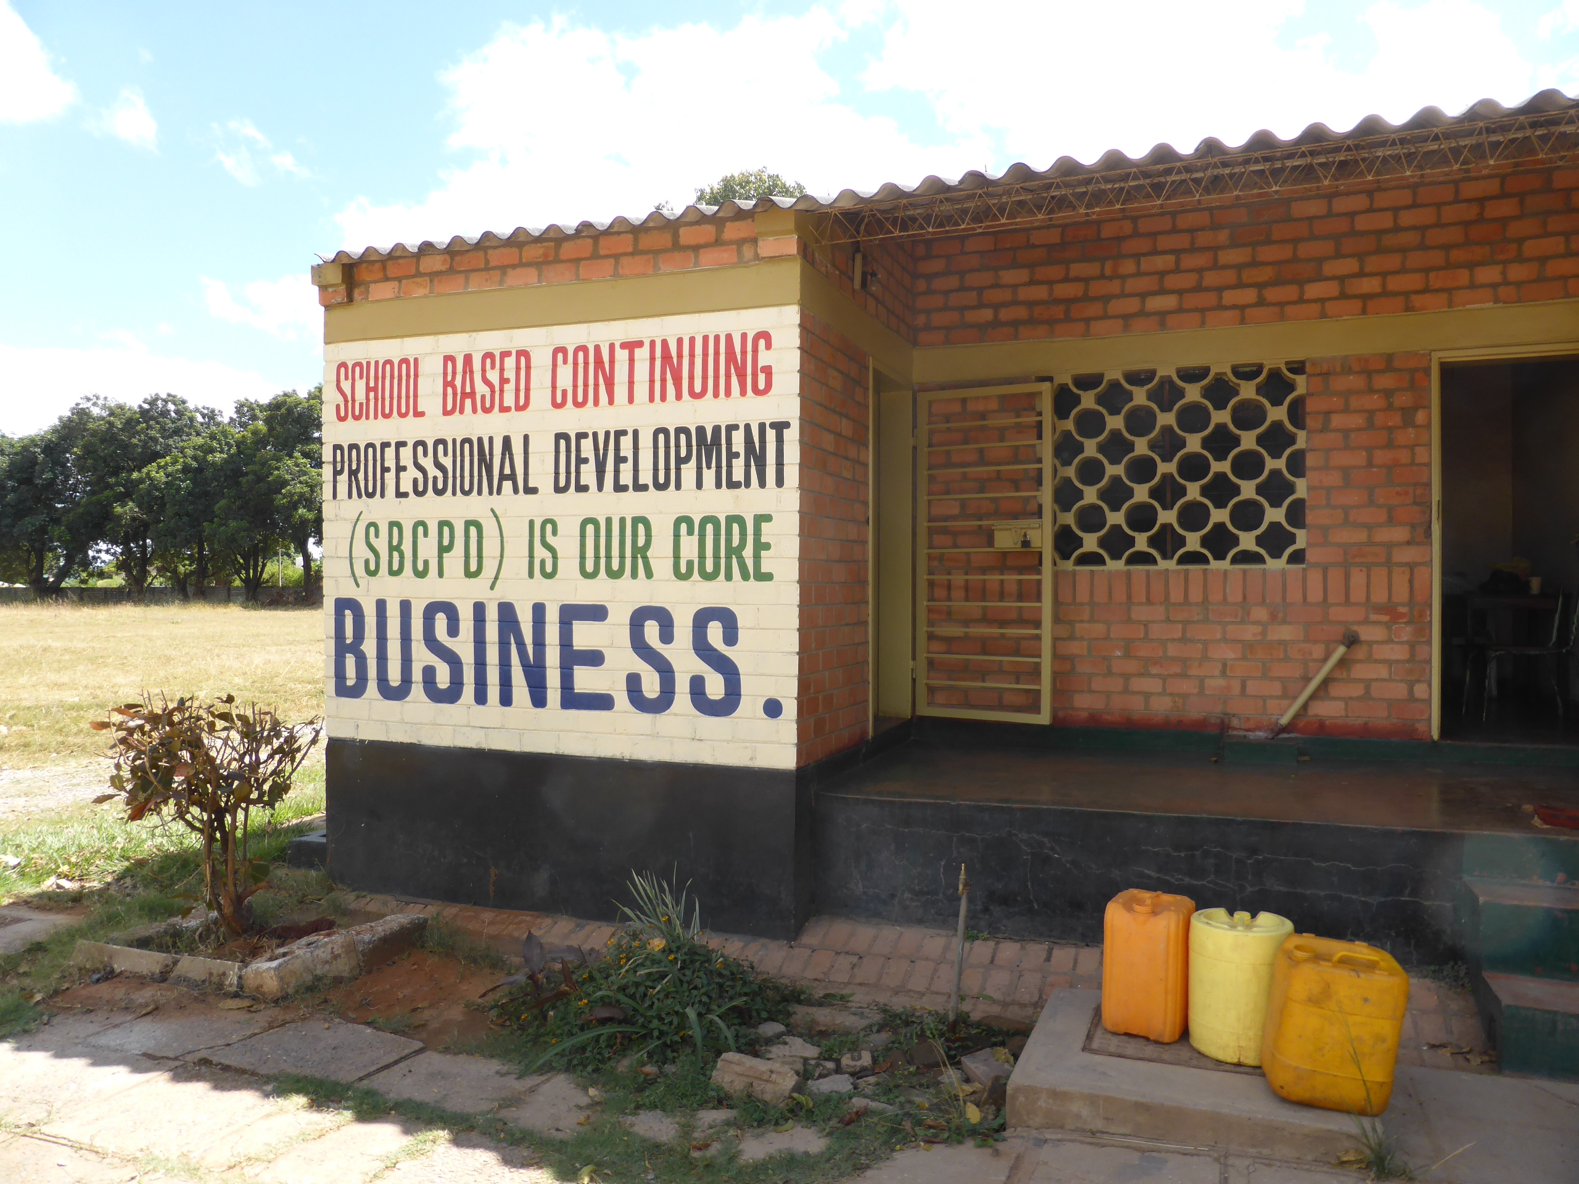
Response to revised national curriculum: learner-centred education and inclusivity
Enhancing CPD to innovate teaching practice
Collaborative learning through planning, practise, and reflection
Delivered via Teacher Group Meetings supported by digital materials co-designed in country (OERs)
Notes:
ZEST’s mission: The Zambian Education School-based Training project, known as ZEST, is led by the Open University, UK OU, in partnership with local technology company World Vision Zambia. ZEST responds to the Zambian Ministry of General Education's (MoGE) request for the OU to support teachers and school leaders to develop skills in active, learner-centred approaches, to operationalise Zambia’s revised Curriculum Framework (2013) and In-Service Strategy (2017).
It draws on a range of open educational resources (OER) including TESSA Zambia. At the end of the project the training programme and resources will be available online, free from copyright, to teachers and educators throughout Zambia, thus ensuring sustainability.
The project has been Co-designing a high-quality ENHANCED School-based Teacher Development Programme (SBTDP) with and for teachers, school leaders, and MoGE officials.
Implementing the SBTDP, building on existing systems and structures; and providing contextualised, freely accessible resources in print and in digital format
The programme will be piloted in Central Province in years 1-3 to develop a scalable model that can be rolled out across the rest of the province and the wider country in years 4-5, eventually aiming to reach 4000 teachers.
ZEST supports the UN’s Sustainable Development Goal 4 (Education)
(on screen text)
Response to revised national curriculum: learner-centred education and inclusivity
Providing CPD to innovate teaching practise
Collaborative learning through planning, practice, and reflection
Delivered via Teacher Group Meetings and dissemination of OU generated teacher training materials
[image of typical school in Zambia? Outside of building]
[logos for WVZ, ZEST, ScotGov]
[image of covers of teacher training materials]

Slide 3
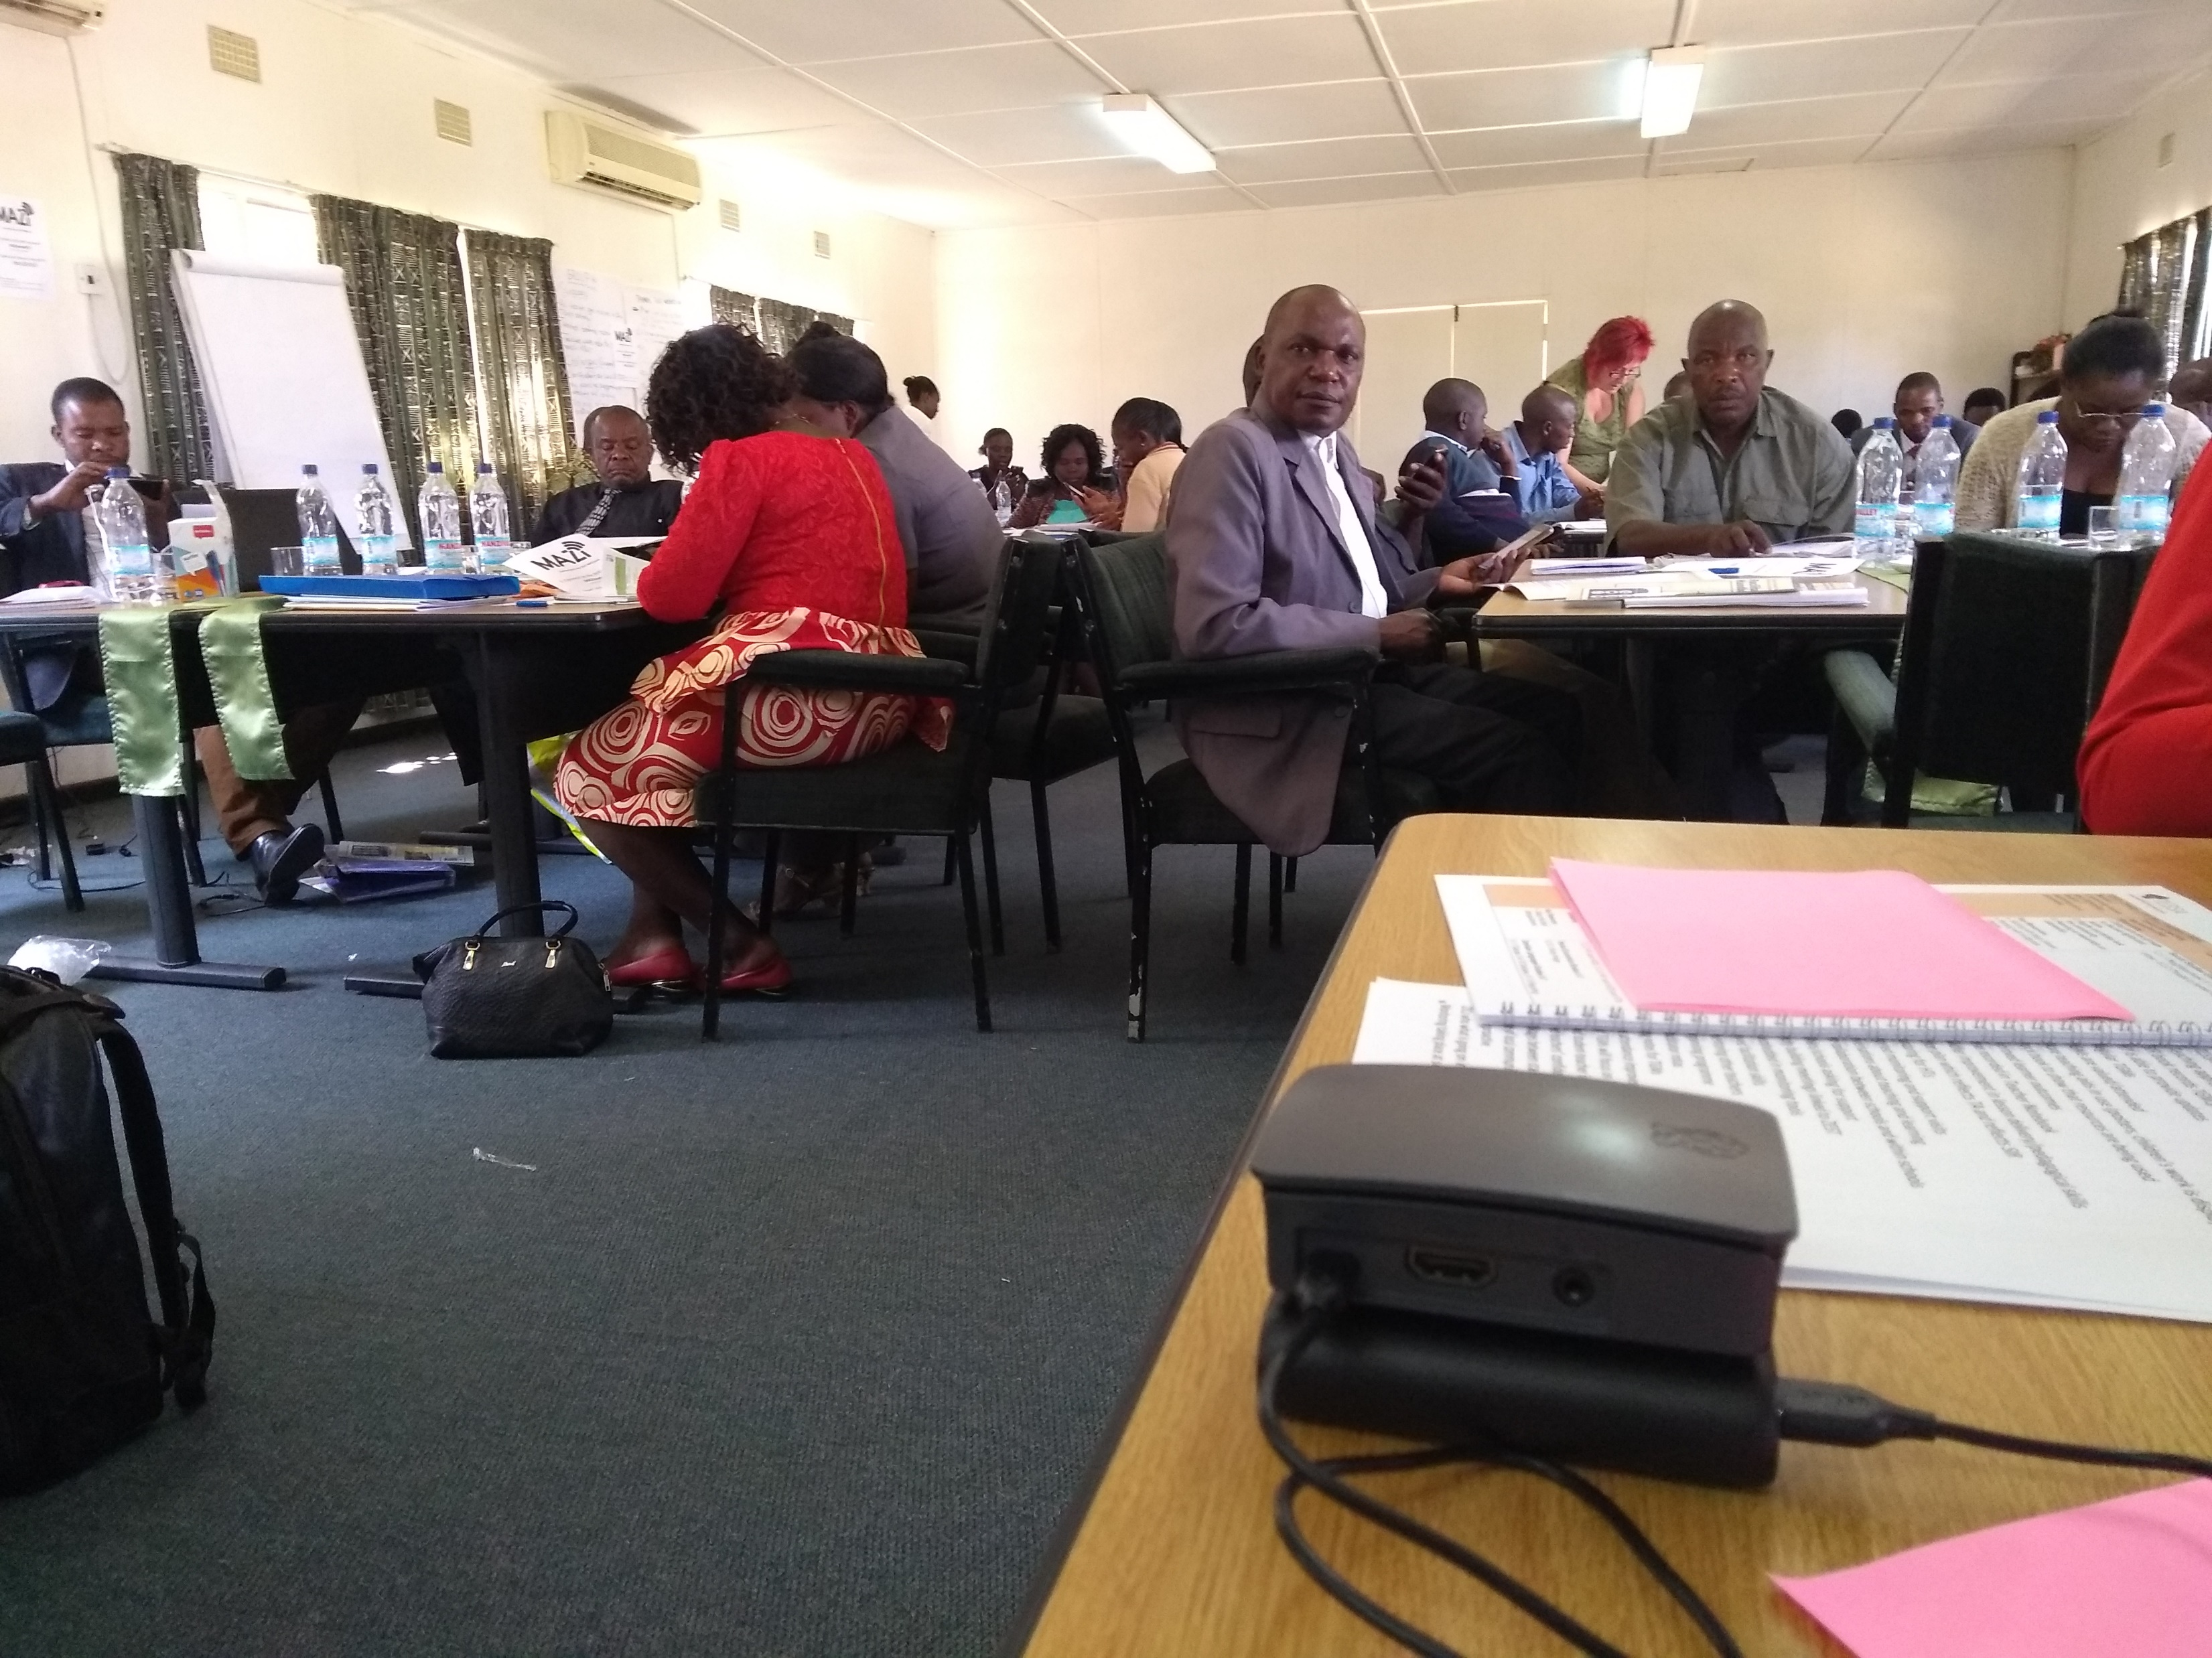
(Technology Enhanced) Approach
Pedagogy emphasises collaborative learning around knowledge of practice and knowledge in practice
Dissemination of PDFs, audio and video resources
Lack of reliable, affordable internet: but wide availability of smartphones
‘Offline networked learning’ using Raspberry Pis with web based tools
Notes:
How it has been operationalised:
Collaborative teacher education pedagogy suggested knowledge sharing technological approach
Lack of reliable / affordable internet /cellphone access
Original idea to distribute SD cards, discarded as complexity of supporting many types
Hyperlocal network tools as solution, because many teachers have access to smartphones not just basic phones, WiFi sharing is a standard function
Dissemination of PDFs, audio and video resources, but enable local appropriation (school use to share their own files)
Uses Raspberry Pi computers with software tools to aid non-expert management and access

Slide 4
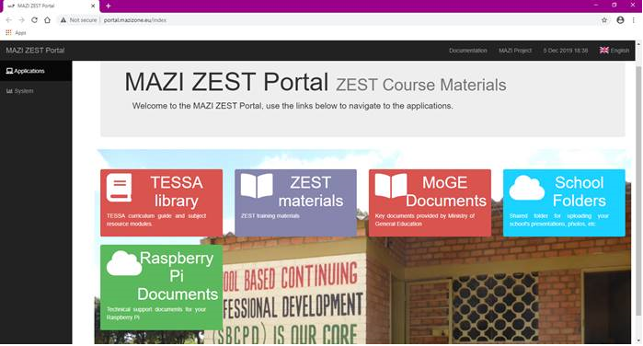
Notes:
Learners connect via their own devices to the networked hub, and access the ZEST portal with digital resources
Image credits:
Laptop by Evgeny Katz from the Noun Project
Smartphone by TenSheep from the Noun Project
Tablet by Jouk Fris from the Noun Project
wifi by Yana Bloch Okrent from the Noun Project

Slide 5
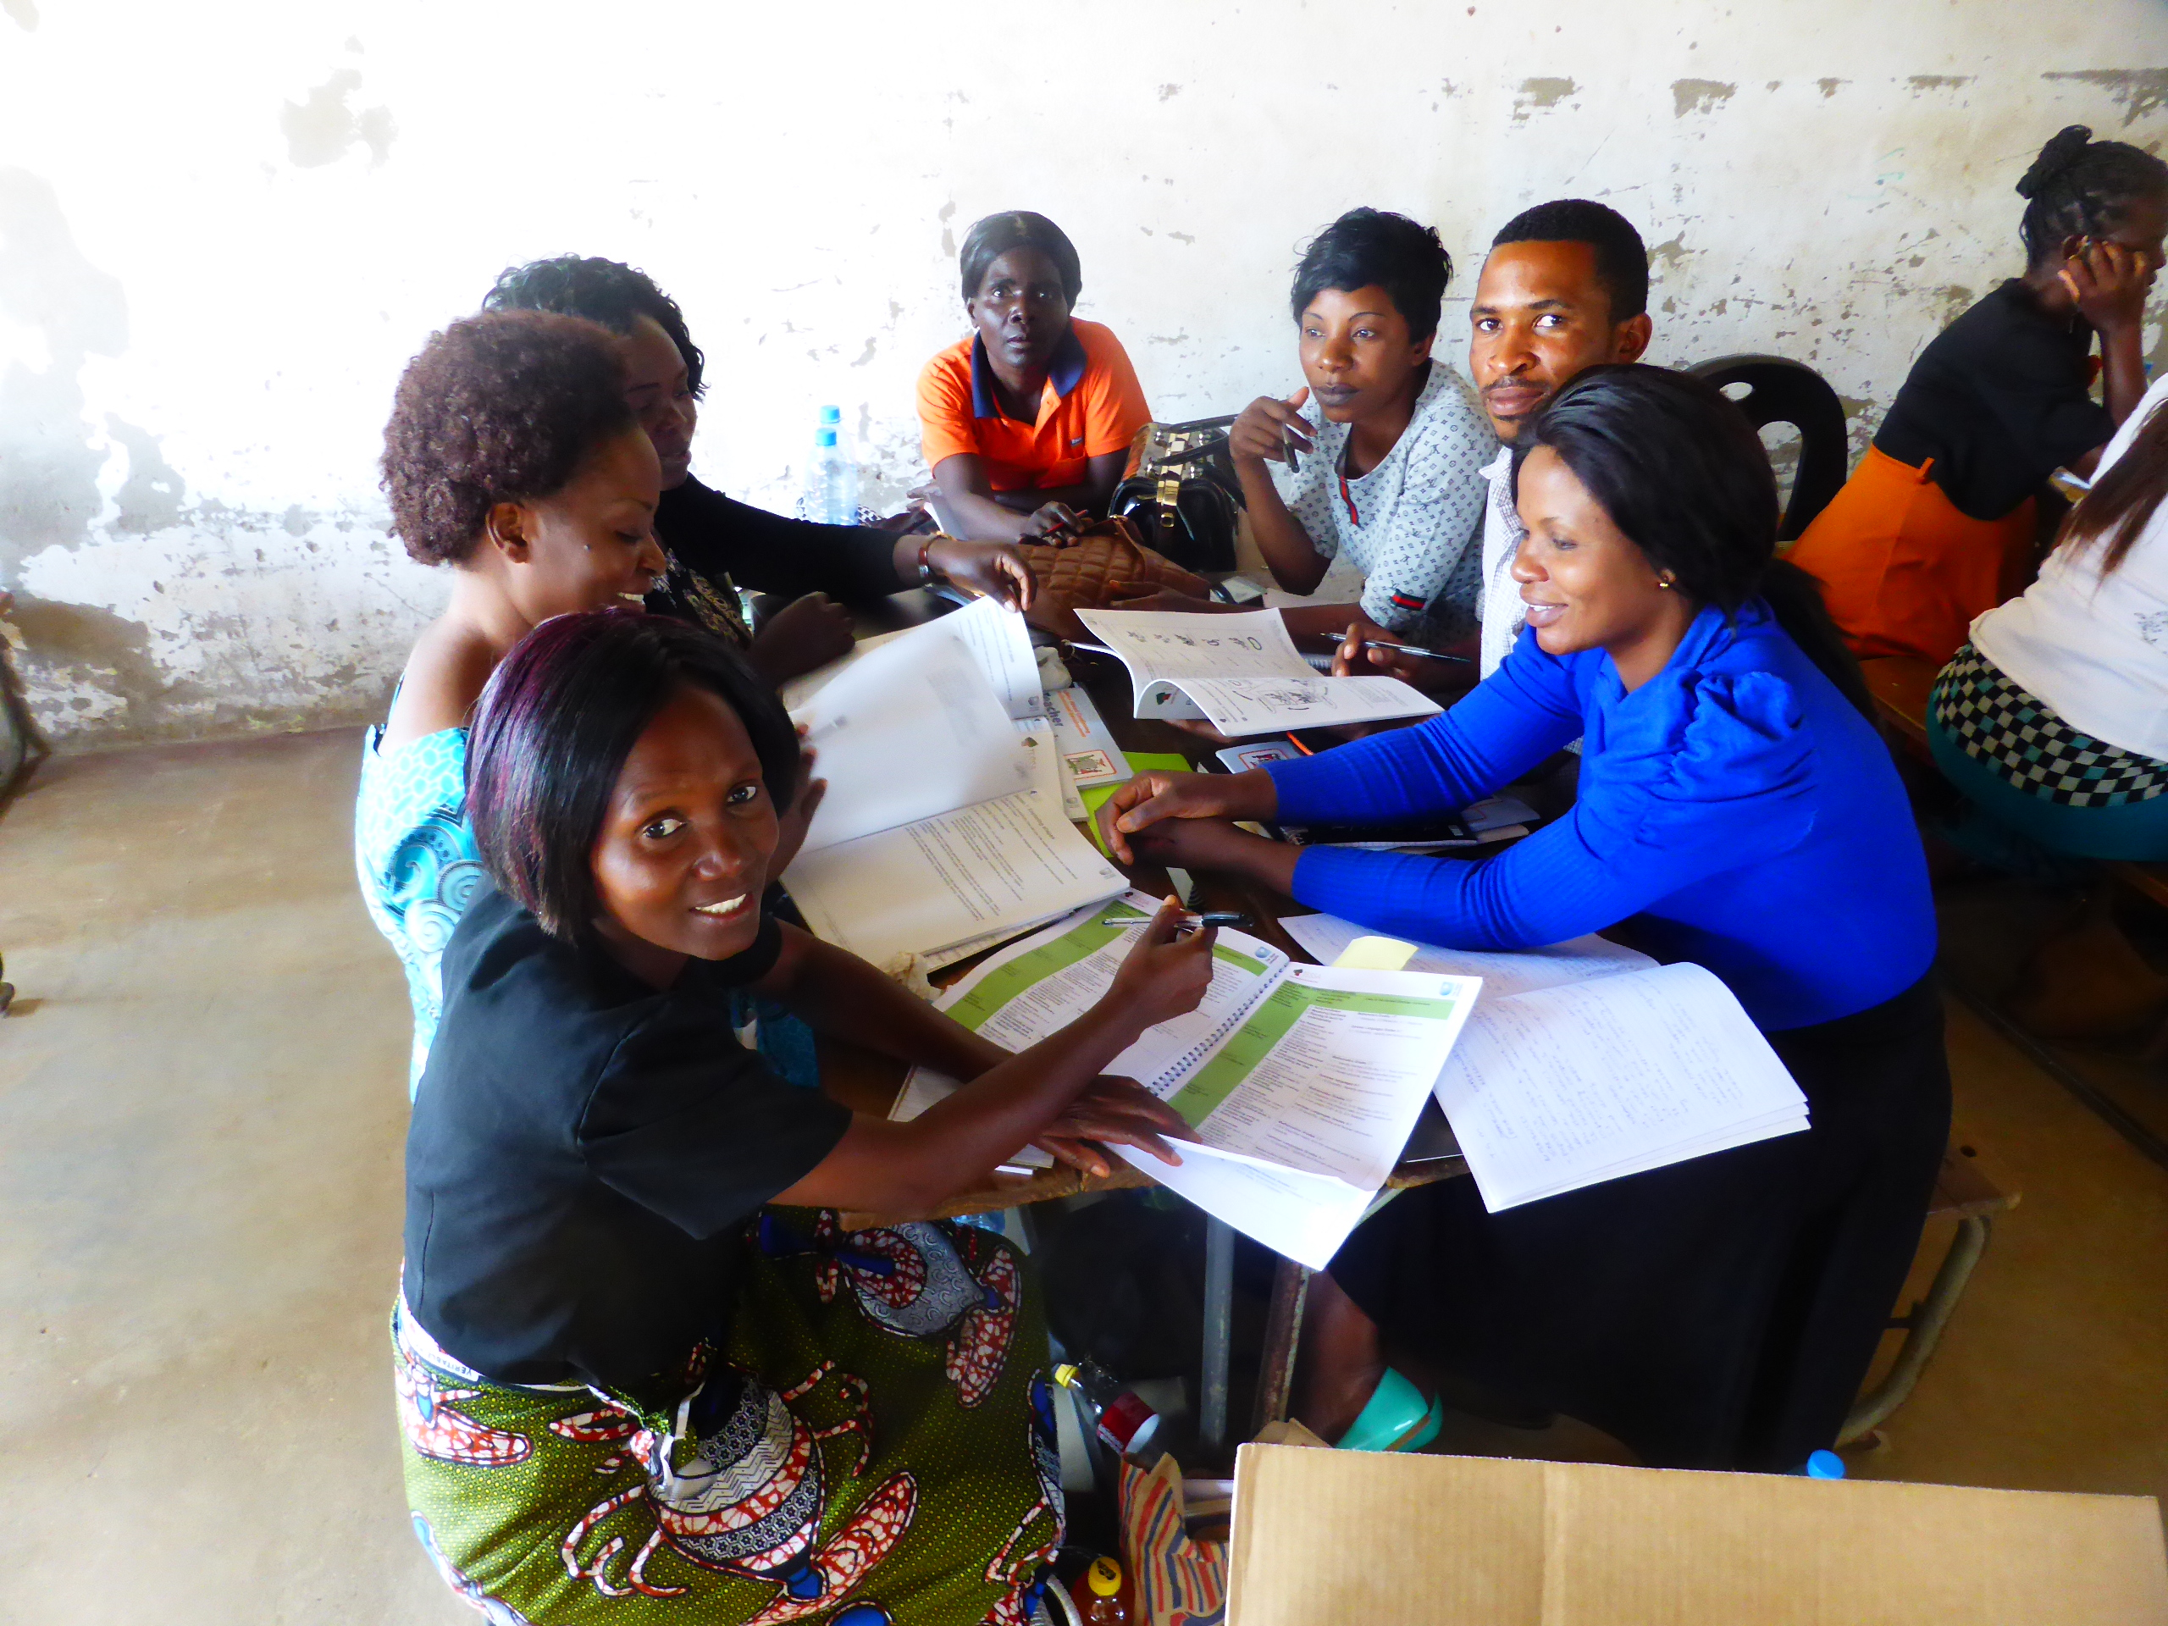
Findings
Successful pilot in 11 schools
Showed schools new ways of digital working
Local innovating: Schools uploading their own materials, workarounds for teachers without smartphones
District officials able to see what has been stored, a proxy for understanding engagement with CPD
Value of uploading additional OER as becomes available
Notes:
Findings
Successful deployment in 11 schools
Engagement of local technology partner, and participating schools. Generally successful method for distributing CPD materials, exposed schools to new ways of digital working
Local appropriation: schools uploading their own materials into the file sharing tool
Unexpected benefit of district officials being able to log in and see what has been stored, a proxy for understanding engagement with CPD
Benefit of being able to upload additional OER as becomes available

Slide 6
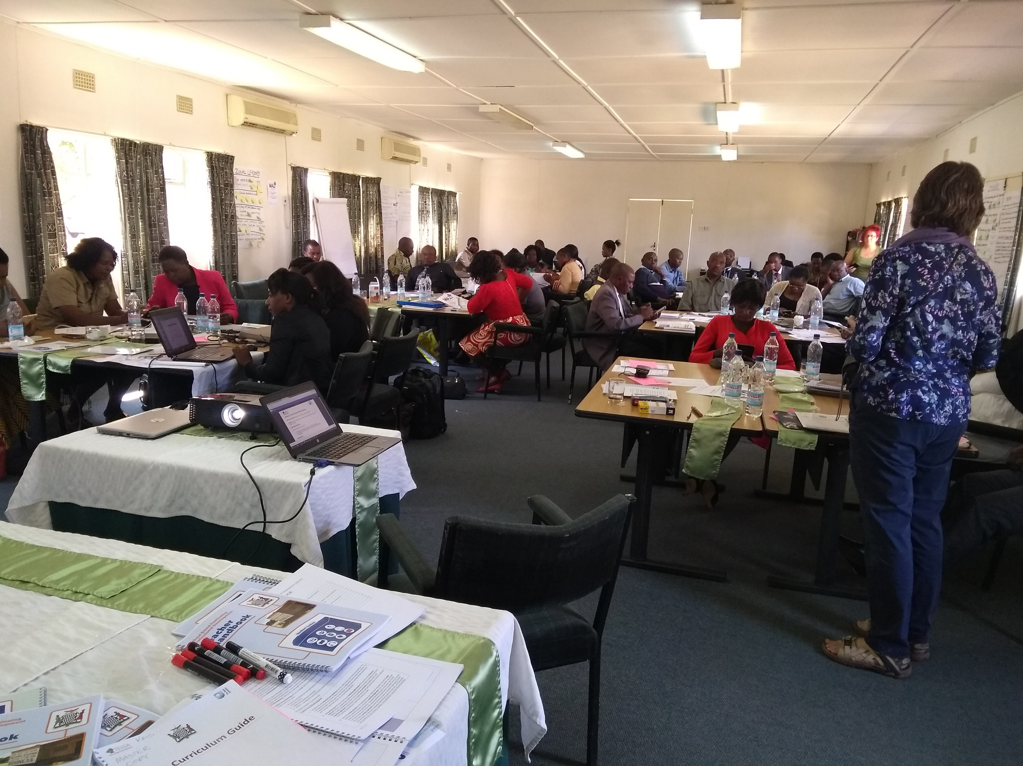
Challenges
Added complexity: digital skills, organisational and technical maintenance overhead for schools
Technical expectations need to be managed (WiFi range, streaming video, concurrent connections)
Guidance revised to reflect local prior experiences of digital tools
Changes in teaching are difficult and take time: may not return to materials when novelty wears off
Sustainability
Notes:
Challenges
-Required teacher training to increase digital skills
- (Cultural biases) Guides had to be improved as exposed UK expectations (e.g. “web browser” as unfamiliar term for those first experiencing the internet through smart phones)
-(Organisational level) Additional level of technical complexity for schools to manage: some difficulties (e.g. lost SD cards)
-(Technical expectations) Managing expectations of what the low cost small devices could do and how they work with phones (how far WiFi can travel, how many people can connect, capability to deal with audio/ video)
(Pedagogical reflections? Challenges around the teaching and learning process)
Kris: “The challenge is that the changes that teachers are being asked to make in their teaching are difficult and take time. IThey need to keep coming back to the materials and there is a danger that when the novelty wears off they might not do that.”
“The challenges they have around teaching and learning are not linked to the raspberry Pi , but rather to tghe materials themselves.”
Rachel: Worth adding something about challenges to do with sustainability? Not sure how to word it - we're intending to discuss with Ministry re. their technical support arrangements, if they exist, to help us identify who to handover to. Without someone to handover to, unless WVZ ar eable to continue supporting schools, then we run the risk of this not being sustainable longer term

Slide 7
Future Directions
Further use of networked hubs: a valid element of the larger ecology of tools used to support teacher training
More in-depth evaluation
Further teacher training
Consideration of structured learning environment (e.g. Moodlebox): evidence of engagement with CPD important for teacher professional accreditation
Importance of Ministry, schools and technical teams support to ensure onward sustainability
Notes:
[image?]
further use of Raspberry Pis: hyperlocal networked hubs have shown potential as valid element of larger ecology of tools used to support teacher training
More in-depth evaluation/analysis of effectiveness
consideration of structured learning environment on Pis (e.g. Moodlebox): evidence of engagement with CPD important for teacher professional accreditation
Importance of Ministry, schools and technical teams buy-ins to ensure onward sustainability
Informing other projects using hyperlocal networking as a means to knowledge share, create, curate, disseminate, e.g. MiadeNet in Togo
Kris: “Importance of Ministry, schools and technical teams buy-ins to ensure onward sustainability” – “This is really important. The advantage of the Raspberry Pi computers is the low cost. MOGE should be able to fund at least one for each skill - but the political will is not always there.”

Slide 8
THANK YOU
mark.gaved@open.ac.uk

