Slide 1
How do we reach learners in environments with limited connectivity?
Kris Stutchbury, Mark Gaved (The Open University, UK)
Notes:
Hello, my name is Mark Gaved and I'm going to report on a project that has explored using technology to support school-based teacher development in Zambia. I’m part of the team from the Open University in the United Kingdom along with Kris Stutchbury, Rachel Hanson, Lore Gallestegi and Clare Woodward; and we also have our colleagues Misheck Mwanza and Charles Chibwika from World Vision Zambia, our partner in this programme.

Slide 2
Not everybody is connected
Lack of reliable, affordable internet, cellphone coverage, and electricity supplies
Legal as well as technological constraints (migrants/ refugees may not be able to own SIM cards due to legal status)
But:
Widespread ownership of smartphones and appetite for digital engagement
Digital materials can overcome the challenges of printing and distributing paper-based resources to enhance teacher training
These can be shared by local, battery powered hubs that work independently of the internet enabling sharing to learners own network capable devices smartphones, laptops, tablets)
The hubs enable ‘hyperlocal networking’ of learners in proximity
Hubs can be extended to wider local areas
Open Educational Resources: PDFs, audio and video
Lack of reliable, affordable internet but wide availability of smartphones: ‘offline networked learning’ approach using Raspberry Pis with web-based tools (including Moodle)
Training School Champions
Monitoring & Support via free data collection tool ‘KoBo’ – annual Evaluations; monthly District/School reports; regular project monitoring
Delivering high-quality contextualised digital resources into the hands of teachers
Notes:
Given that a critical element is the provision of resources for teachers, and printing and distributing paper-based resources can be highly problematic, ZEST has taken a novel technology enhanced approach, where digital materials are given to teachers to help enhance their training programme.
Initial plans sought to distribute digital resources via SD cards for teachers’ mobile phones. With the pedagogical emphasis on collaborative learning, though, an approach that supported collaborative working was preferred.
There is a lack of reliable affordable internet, but there is widespread ownership of smartphones by teachers.
So we've taken what we call an offline networked learning approach, using small low cost, battery powered computers, Raspberry Pi's, to act as portable network hubs that allow teachers to work together, using web-based tools that may be familiar to them as smartphone users. These enable digital resources to be made available where the teachers need them, to access them on their own devices, and not require any internet access or mains electricity.
Teachers bring their personal devices to the Teacher Group Meetings, and they log in to the hubs via WiFi. They use the web platform to access the training resources and Ministry of General Education documents. In the bottom right hand photo, you can see the Pi on the desk in the foreground, about the same size as a pack of cards, and the teachers in the room connecting to it via their phones using the Pi’s WiFi.
Our initial trial used a simple software suite called MAZI, but we are now using a version of the Virtual Learning Environment, Moodle. This not only allows resources to be stored and shared, but also recognises teachers’ engagement, which is important as continuing professional development has to be evidenced by teachers to maintain their professional status in Zambia.
To support the new technological infrastructure, the project created the role of School Champions. Working through World Vison Zambia who had the on the ground understanding of which teachers were most enthusiastic and active around using the Pis.
For monitoring and support, we are using, KoBo Toolbox, a free data collection tool which the project started off using during the Baseline Evaluation. This tool has continued to be used during the annual/Midline evaluations, and its use expanded so that schools and districts now use it to submit monthly project reports, and WVZ are due to start using it in their regular monitoring visits. KoBo is accessible on smartphones, tablets, and laptops, can be used both online/offline and data shared with relevant colleagues for analysis/reporting.

Slide 3
Invited by Zambian MoGE to enhance current School Based Teacher Development programme in line with revised primary school curriculum: a vision based on learner-centred education and inclusivity, which focuses on knowledge, skills and values
School based teacher development (SBTD) more effective than traditional cascade models
Key tenets of networking and building communities of practice: bringing people together
Provision of resources for teachers is a critical aspect
Notes:
ZEST is the Zambian Education School Based Training programme. It is led by the Open University alongside World Vision Zambia and funded by the Scottish Government. We were invited to carry out this initiative by the Zambian Ministry of General Education in response to a revised national curriculum, which emphasizes learner centred education and inclusivity.
ZEST’s goal has been to enhance the provision of continuing professional development, to innovate teaching practice in schools, and to support the new approach to curriculum by building teacher capacity for its delivery. Key to this is co-designing a high-quality enhanced School Based Teacher Development programme with and for teachers, school leaders, and Ministry of General Education officials.
Our colleagues Lore and Clare will talk to you more about the teaching approach in their DETA 2021 presentation on Thursday at 10:45 but in brief, it emphasizes a collaborate-practise-reflect learning method. Teachers are introduced to a pedagogic approach such as pair work or role play. They work in small groups to plan a classroom activity using that approach, in the context of what they need to teach. Each teacher then tries their activity in their own classroom. They come back together to reflect on how it went and to plan another activity, using the same approach, drawing on their collective experiences.
This is delivered through Teacher Group Meetings, supported by digital materials that were co designed in the country.
This is more effective than traditional cascade models of professional development, which only provide training manuals for master trainers, but nothing for teachers – usually because the costs of printing and distributing resources at scale are prohibitive.

Slide 4
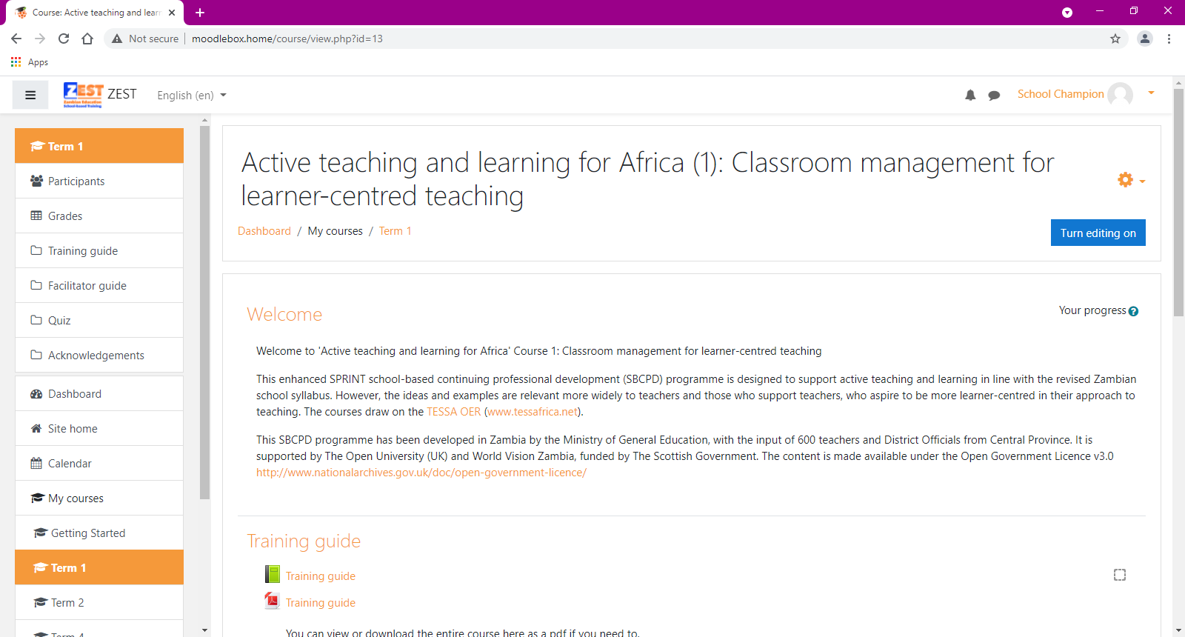
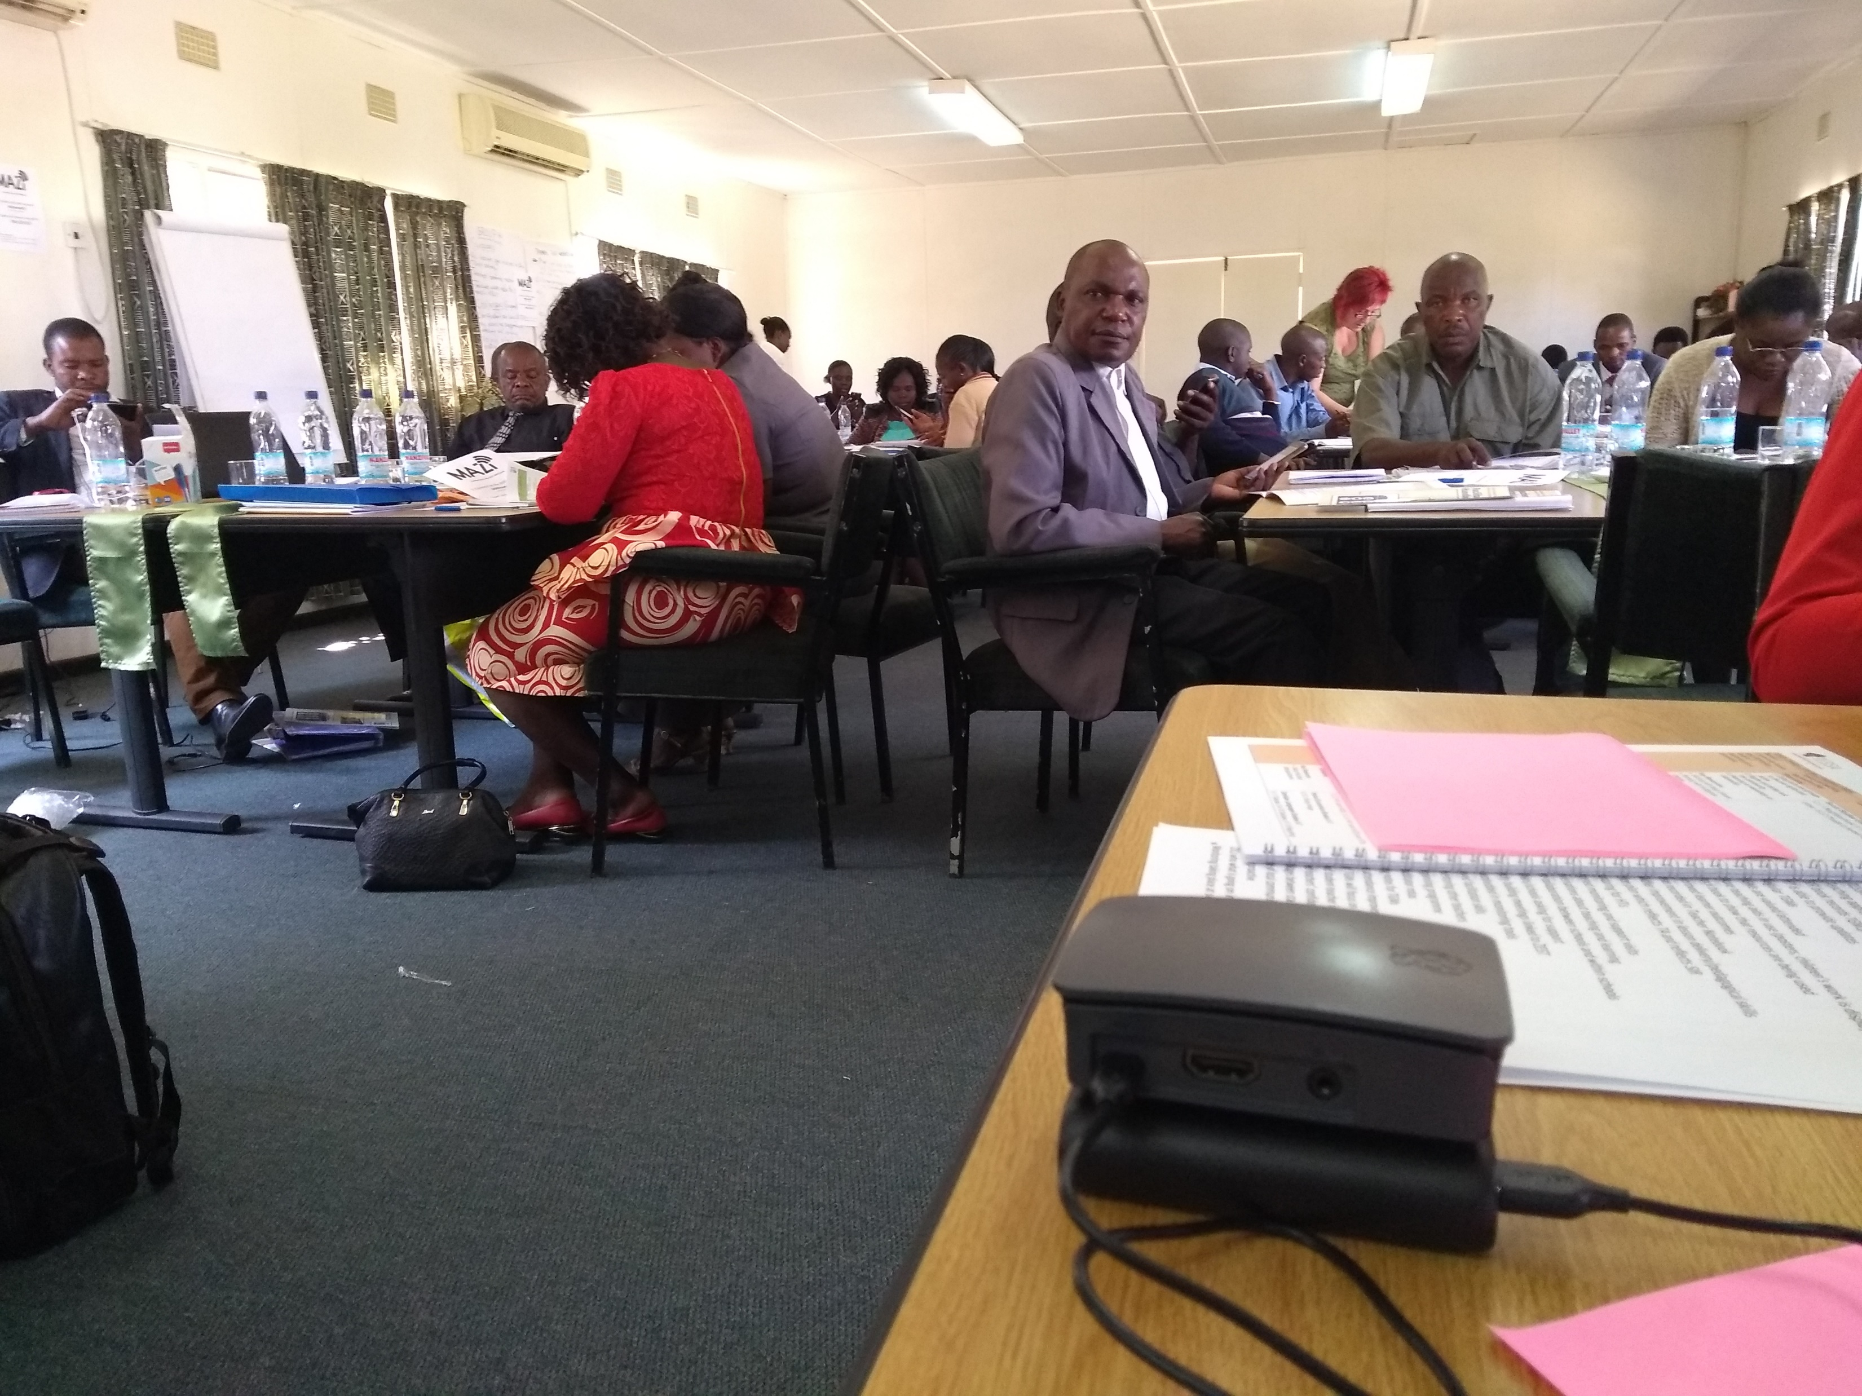
A technology enhanced approach
Delivering high-quality contextualised digital resources into the hands of teachers
Open Educational Resources: PDFs, audio and video
Lack of reliable, affordable internet but wide availability of smartphones: ‘offline networked learning’ approach using Raspberry Pis with web-based tools (including Moodle)
Training School Champions
Monitoring & Support via free data collection tool ‘KoBo’ – annual Evaluations; monthly District/School reports; regular project monitoring
Notes:
Given that a critical element is the provision of resources for teachers, and printing and distributing paper-based resources can be highly problematic, ZEST has taken a novel technology enhanced approach, where digital materials are given to teachers to help enhance their training programme.
Initial plans sought to distribute digital resources via SD cards for teachers’ mobile phones. With the pedagogical emphasis on collaborative learning, though, an approach that supported collaborative working was preferred.
There is a lack of reliable affordable internet, but there is widespread ownership of smartphones by teachers.
So we've taken what we call an offline networked learning approach, using small low cost, battery powered computers, Raspberry Pi's, to act as portable network hubs that allow teachers to work together, using web-based tools that may be familiar to them as smartphone users. These enable digital resources to be made available where the teachers need them, to access them on their own devices, and not require any internet access or mains electricity.
Teachers bring their personal devices to the Teacher Group Meetings, and they log in to the hubs via WiFi. They use the web platform to access the training resources and Ministry of General Education documents. In the bottom right hand photo, you can see the Pi on the desk in the foreground, about the same size as a pack of cards, and the teachers in the room connecting to it via their phones using the Pi’s WiFi.
Our initial trial used a simple software suite called MAZI, but we are now using a version of the Virtual Learning Environment, Moodle. This not only allows resources to be stored and shared, but also recognises teachers’ engagement, which is important as continuing professional development has to be evidenced by teachers to maintain their professional status in Zambia.
To support the new technological infrastructure, the project created the role of School Champions. Working through World Vison Zambia who had the on the ground understanding of which teachers were most enthusiastic and active around using the Pis.
For monitoring and support, we are using, KoBo Toolbox, a free data collection tool which the project started off using during the Baseline Evaluation. This tool has continued to be used during the annual/Midline evaluations, and its use expanded so that schools and districts now use it to submit monthly project reports, and WVZ are due to start using it in their regular monitoring visits. KoBo is accessible on smartphones, tablets, and laptops, can be used both online/offline and data shared with relevant colleagues for analysis/reporting.

Slide 5
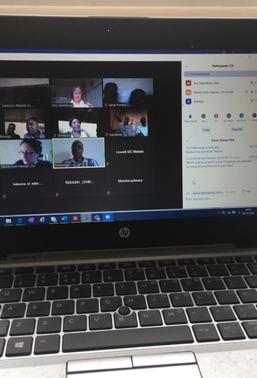
Covid-19
Covid Wave 1: March – September 2020
Schools close March-June; reopen for exam-grade classes only
Zoom and WhatsApp used to continue SBTD
11 schools connected regularly and engaged in discussions supported by WVZ in Lusaka and the Open University in the UK
WhatsApp: ‘domesticated’, familiar technology: Zoom was novel
Covid Wave 2: January – February 2021
Schools close; no access to Teachers
Covid Wave 3: June 2021 - ?
Schools close; access to school leaders
Microsoft Teams used for delivering virtual orientation workshops
Notes:
This approach was successfully piloted in 11 schools, and we were preparing to expand the rollout when the Covid-19 pandemic hit. Schools were closed in March 2020, pupils were sent home and teachers unable to meet. However, just before the pandemic, a WhatsApp group had been set up for the purposes of evaluating ZEST materials and Raspberry Pi use. Zambian school teachers are used to WhatsApp: ZEST has built on existing capabilities.
Schools reopened in June 2020 for exam-grade classes, which brought teachers back into schools. School Based Teacher Development discussions resumed and the WhatsApp group was used regularly across 11 schools in one District, supported by World Vision Zambia in Lusaka and educators from The Open University.
Zoom meetings were also set up, these were novel to most schools but it enabled the ZEST ideal of teachers working together for professional development to continue throughout the first wave of the pandemic. Examples of good practice were shared as videos and photographs, and support was provided for Teacher Group Meetings through professional reflection and discussions among participants.
Zambia was faced with a second wave of Covid in early 2021, resulting in another round of school closures. Limited ZEST activity took place during this time due to the team having no access to teachers or school leaders. Schools reopened in February and effort was made to reach a total of 64 schools across 5 Districts, with further Raspberry Pi training provided to newly identified school champions and the use of Zoom/WhatsApp continued amongst District/Province officials, WVZ and OU.
Zambia is now in a third Covid wave, with schools once again closed. Access to school leaders has been granted this time and lessons from Wave 1 have been incorporated into an enhanced approach. District Officials are being supported to facilitate virtual orientation workshops via Microsoft Teams with as many schools as possible, network connectivity allowing, and a WhatsApp Group has been created for the District & Province officials to enable the sharing of experiences and support.

Slide 6
What have we learned?
Technology as enabler to support primary focus of project: not a magic solution
Importance of established structures, roles, processes and resources in the school system
New techniques learned about use of technologies & social media for supporting SBTD
Zoom/WA/Teams: tools to enhance community of practice
Identification of role of RPi champions – harnessing existing hidden expertise
De-structuring resources into bite sized chunks of practice based on more regular contact
Capability
Increasing
Divergence
Increasing
Divergence
Increasing Divergence
Policy &
Management
Culture
Blumenfeld et al. (2000) Creating Usable Innovations in Systemic Reform
Notes:
What have we learned? It is key to remember that technology is an enabler, it is not a magic solution, it is simply there to allow access to the programme’s resources, and it is important that the technology innovation doesn’t distract from the prime focus of the programme. To help us reflect, we have considered Blumenfeld et al.’s framework for considering challenges in introducing innovations at scale in educational systems. They identify that there are three dimensions that need to be considered: the divergence from current capacities, culture, and existing policies and management approaches. The greater the divergence, the greater the challenges, and more likely the introduced innovation might stumble.
First, we can see that the ZEST technology enhanced approach develops from capacities and capabilities already in place. We are building on established structures, roles, processes and resources.
We have learned that there is real excitement about technology, with people developing new digital skills – both technical (like using new tools) and also pedagogical (such as virtual workshop facilitation). This works particularly well when new technology (such as Pis, Zoom and Teams) is combined with familiar technology (like smartphones, WhatsApp) so it is not as daunting.
The introduction of Raspberry Pi Champions enabled the harnessing of existing hidden expertise within schools: building on existing capabilities. By separating the technical from the pedagogical, it allowed a careful navigation of the school system which allowed school leaders to focus on the main objective of the programme (teacher professional development) whilst allowing IT teachers to take a lead on the Raspberry Pi activity. This approach successfully respected the existing hierarchies, working within an existing culture, whilst also ensuring the relevant expertise were identified early and empowered to lead on tech support.
The use of Zoom, WhatsApp and Teams helped to build a community of practice: they allowed educators to model the pedagogical approaches presented in the programme’s resources and provided a space for school leaders and officials to learn, reflect and critically question practices and experiences, before sharing with Teacher Group Meeting participants.
To adapt to the new way of working in the pandemic – via the social media meetings, and with more regular content - resources were de-structured from how they were originally presented in the paper based handbook and intended for classroom based sessions, into bite sized chunks of practice. Short PDF documents were shared through WhatsApp and read in advance, and then discussed in meetings. As the meetings progressed and continued into the third wave, we saw a shift in facilitation from the UK team to local educators and this is something that will be explored with a sustainability mindset moving forwards.
Working via screens rather than on paper had both positive and negative effects: the small screens could limit how the material was used, but equally, the functionality of smartphones allowed for zooming (screens), and the inclusion of audio/video materials. Using familiar technology and the motivation of teachers, leaders, and officials has enabled learning and sharing of new skills.
By building on existing capacities within the Zambian education system and respecting existing hierarchies, policy and management practices and cultures, innovation has been gradually and successfully introduced into Zambia’s primary schools.
Phyllis Blumenfeld , Barry J. Fishman , Joseph Krajcik , Ronald W. Marx & Elliot Soloway (2000) Creating Usable Innovations in Systemic Reform: Scaling Up Technology-Embedded Project-Based Science in Urban Schools, Educational Psychologist, 35:3, 149-164,DOI: 10.1207/S15326985EP3503_2
I will now hand over to my colleague Mishek who will provide some insights into World Vision Zambia’s experience of what has happened in practice

Slide 7
Insights from Schools
Schools enabled to access resources despite infrastructure constraints
Established practices and leadership supporting innovation
Diverse use of digital tools: unexpected uses and appropriation
School Champions enhancing sustainability
Notes:
The use of Technology in Zambia comes with its own challenges among them unstable/no electricity in rural communities and Technological knowhow. The project has supported schools like Shimbizhi and Mukulaikwa primary schools that have no access to electricity with power banks supported by solar.
Instructional leaderships is important for improved learners’ outcomes in a school. Hence the project is working with Head teachers closely in the use of the Pis in schools and one practical example are head teachers from Nampundwe and Shimbizhi primary schools who are very supportive in their teachers using the Pis.
Some of the resources uploaded to the Pi schools include. Sample lesson videos, sample lesson plans, uploading SBCPD minutes, uploading tests for supervisors to check, Timetables, National Curriculum and literacy framework.
We also have schools like Mumba and Chisamba primary schools that have done something different with the Pis. Other than using it to access SBCPD materials, they are using it for (i) Interactions through the chat provision, (ii) sharing other work related information to members of their schools and also (iii) for monitoring and other management related activities.
For sustainability beyond the project for sustainability, project has trained Champions who are providing technical (i) support to other teachers on the use of the pi in schools, (ii) orienting new teachers joining schools from other non-implementing schools, (iii) ensure safety of the Pis and SD cards by working together with head teachers, (iv) tracking the progress of all teachers in the courses and (v) manage the data on the pi by ensuring that files are kept in the right folders. Example of particular champions who are uploading own resources include those from Kalaluka Nawa of Mumba Primary school in Mumbwa
I now hand over to Mark

Slide 8
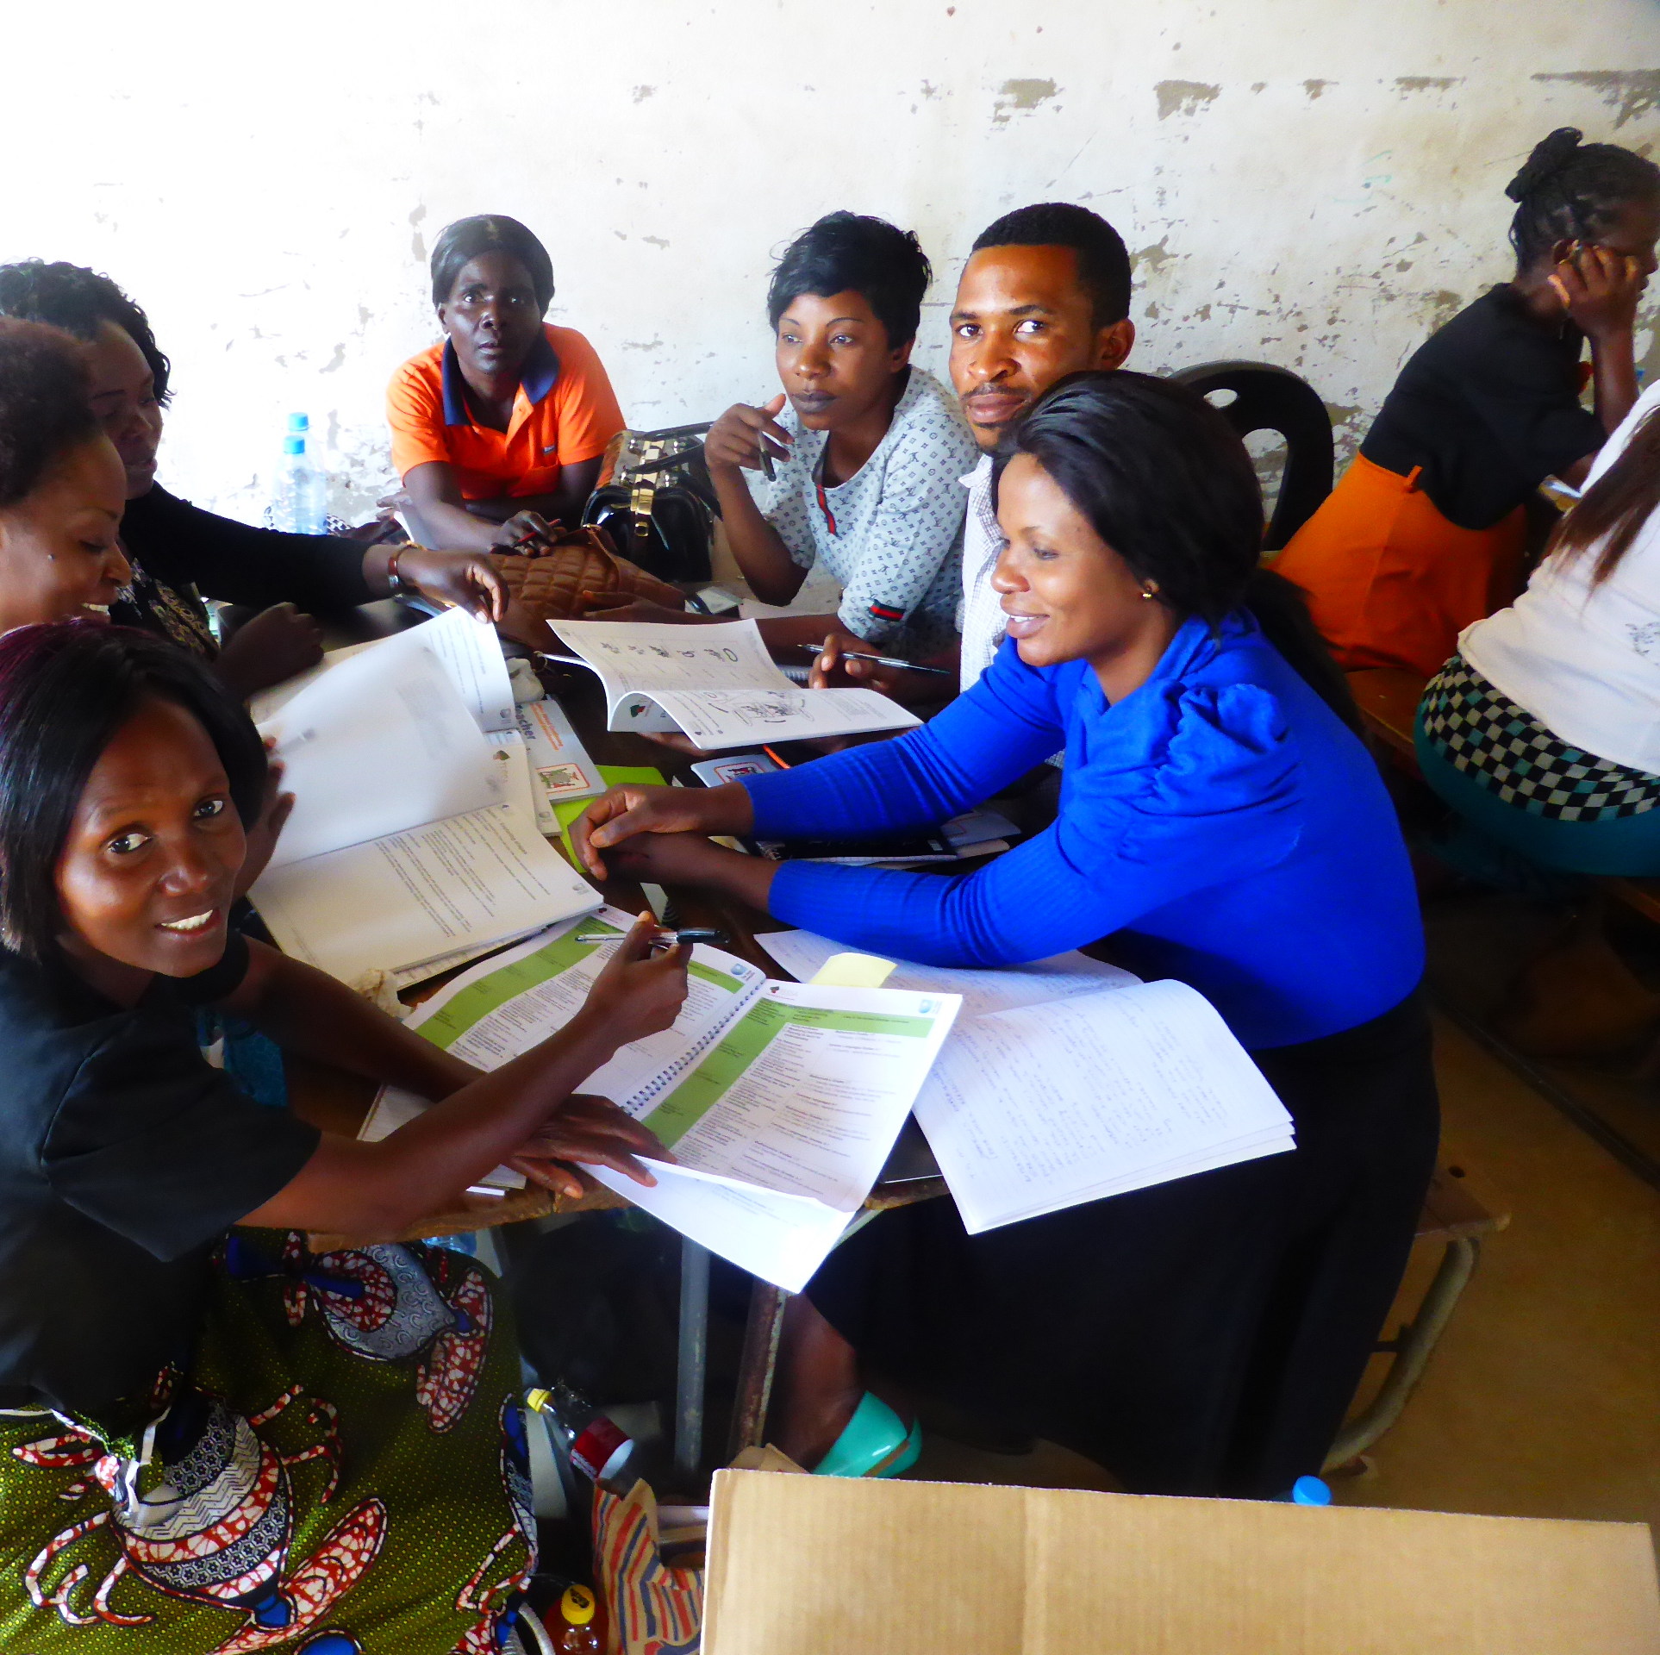
Where next?
Project scale-up - 420 schools / 4000 teachers
Blended engagement harnessing appetite for learning and lessons from Covid
Longer term sustainability of both resources and technology
Notes:
Throughout the programme we have seen an appetite for learning, both pedagogical and digital, which continues to grow even during the pandemic. Schools have shown a great commitment during a time when they have been very busy and we might not expect to see engagement, which shows promise for future sustainability.
The programme’s target is to reach 420 schools and 4000 teachers – this will be our prime focus when schools reopen after this current Covid wave.
Ways of working have evolved with each Covid Wave with the latest seeing the introduction of Teams and a move towards virtual workshop facilitation. The programme will therefore look to evolve in its final phase to incorporate lessons from the pandemic and encourage a blended engagement approach of both face to face and virtual workshop facilitation/support where possible.
There will also be a focus on the longer term sustainability, both with regards to use of the programme’s resources and the support for technologies in enhancing delivery. The programme will continue to engage with the Ministry of General Education about its longer term plans, and explore options for growing the skills and expertise.

Slide 9
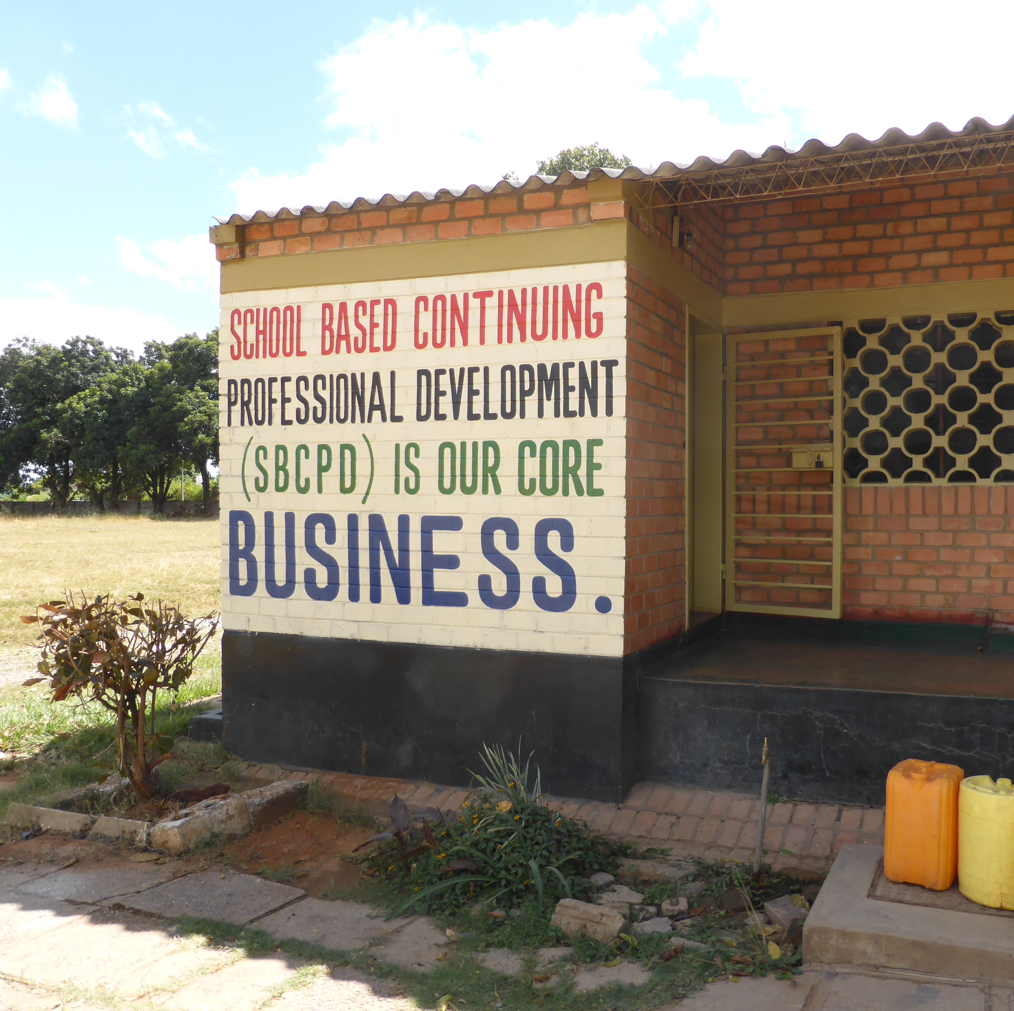
Thank you: over to you!
In your situation, do you see benefits or challenges in using technologies to support teachers?
Have you used technologies in different ways to help you support teaching and learning during Covid?
Contact Us:
Mark Gaved: mark.gaved@open.ac.uk
Learn more about ZEST | Access the ZEST resources
Notes:
Thank you. Please do get in contact, and we look forward to your questions

