Slide 1
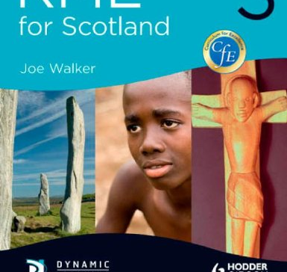
Alternative Standard English tasks – work through your choice of tasks p62-64 for two lessons.

Slide 2
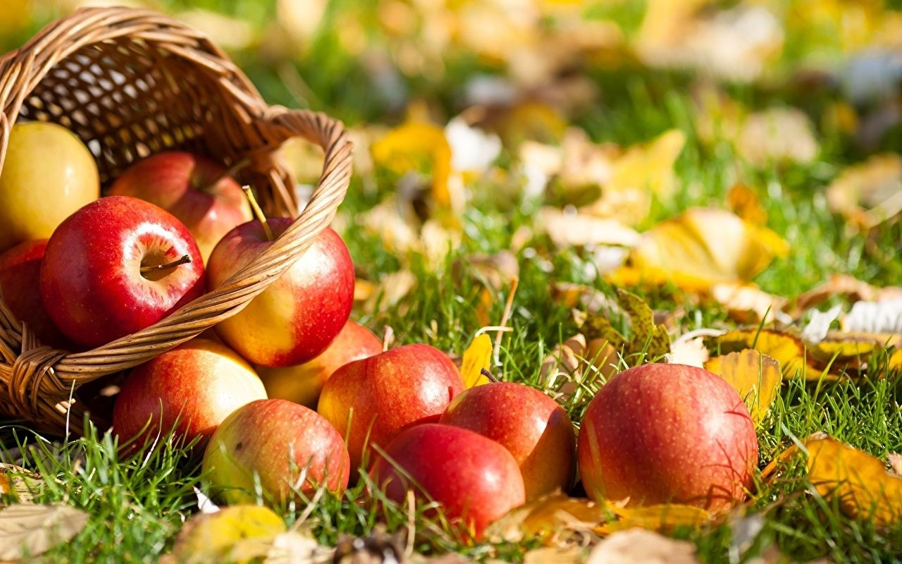
Winter Festivals Hallowe'en / Samhain

Slide 3
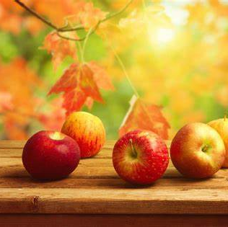
In this unit I can:
Explore the tradition of Hallowe'en / Samhain in Scottish culture. (RME)
Enjoy learning to understand / make use of some Scots wirds. (Lit)
Develop my skimming and scanning skills to answer questions. (Lit)

Slide 4
Scots Language: listening, reading , blethering & scriving )
Scots is a Language and many of you will know or speak some Scots already.
As this unit is exploring the winter festival in Scotland called Hallowe'en, or Samhain, we will make use of some Scots words as we learn.

Slide 5
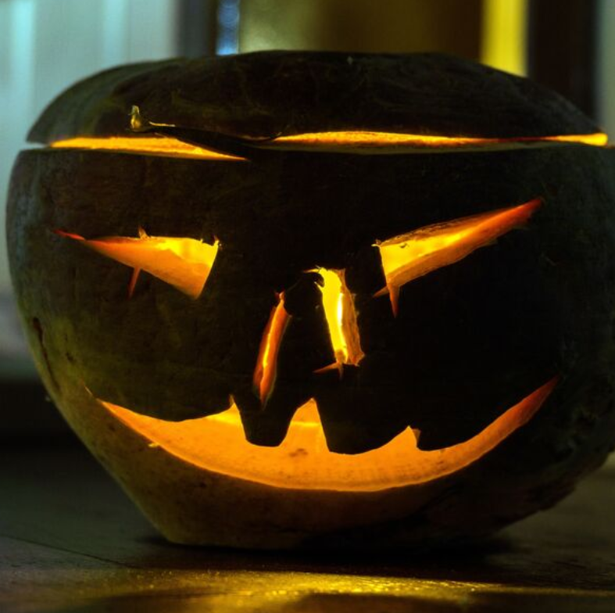
Collect a task sheet
We will read aboot Hallowe'en / Samhain customs in Scotland.
(Ony wirds ye dinna ken? Or do ye say it differently?)

Slide 6
Think-Pair-Share (5 minutes max)
Whit dae ye dae at Halloween / Samhain?
Dae ye think the deid are ‘still aroond’ in ony way?
Hoo easy is it tae remember the summer months when winter has arrived?
Are ony pairts o Samhain celebrated where ye live?

Slide 7
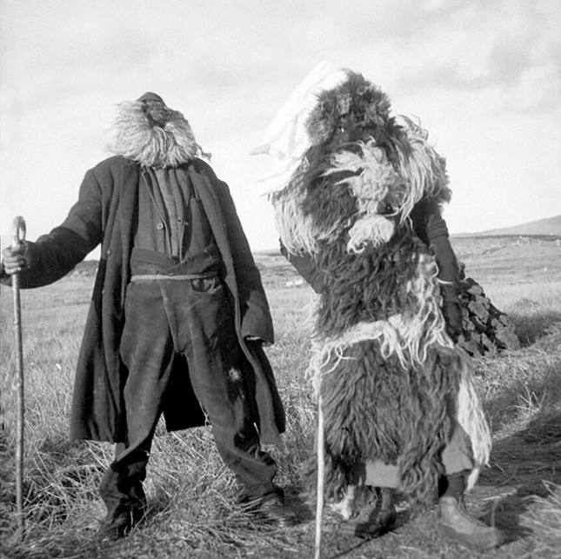
Oidhche nan Cleas (‘Night of Tricks’ on South Uist)
Oidhche Shamhna – a South Uist Halloween | National Trust for Scotland (nts.org.uk)
Why did the visitor to the island record the event?
What were the costumes made from?

Slide 8
Samhain
In your booklet we will read together aboot the origins of some of oor Hallowe'en customs
Then try the Reading and scriving (writing) task frae the booklet.

Slide 9
Scots Language Review (scrive this heading)
Although it can be a wee bit hard trying new words / a new language – did ye enjoy trying oot a few Scot wirds in this lesson?
Gie a smiley face review then explain.

Slide 10
Lesson Twa

Slide 11
Guising poems / songs
Scrive the heading under your last work. Then Think- Pair Share.
If ye hiv ever been guising:
Whit did ye go as?
2) Did ye do a turn at the hooses?
3) Whit did folk gie ye?

Slide 12
Collect a booklet and try oot the poems, even makin yer own!

Slide 13
Recap Quiz
Write 1-7 down your margin.
Which Hallowe'en custom is being shown in each picture?

Slide 14

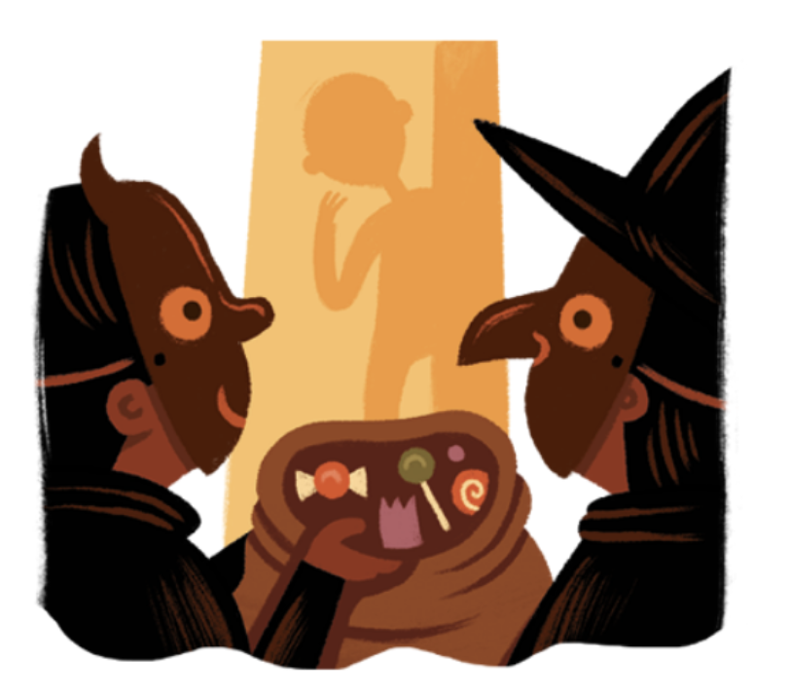
1

Slide 15
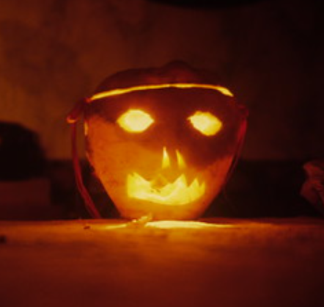
2

Slide 16
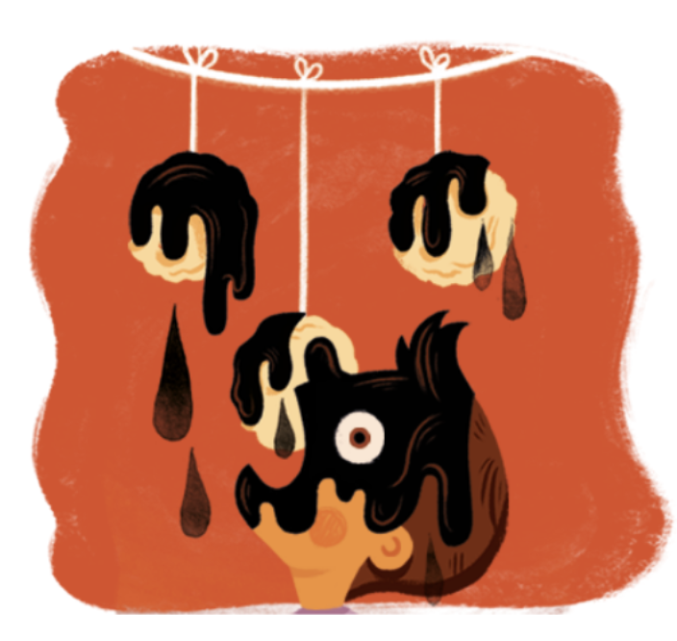
3

Slide 17
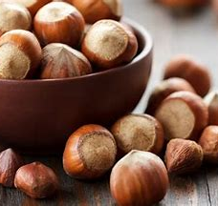
4

Slide 18
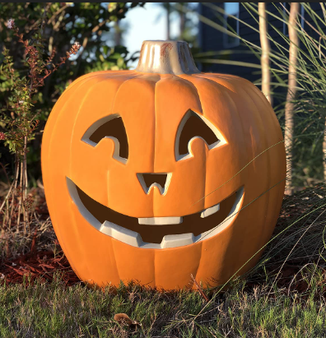
5

Slide 19
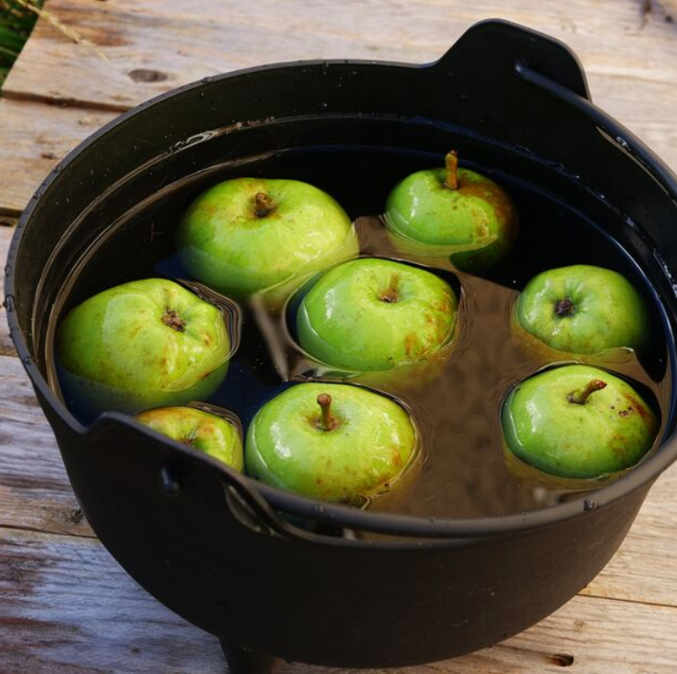
6

Slide 20
7
Which one was the odd one out + why?

Slide 21
Answers:
Guising
Neep lantern (bonus mark if you say neep rather than turnip!)
Treacle scones
Roasting nuts - to tell the future of a new couple
Jack o lantern- (Pumpkin)
Dookin' for apples
Number 5 – it is American

Slide 22
In record grid
Scottish Hallowe'en Customs /7

Slide 23
Pupil Review (scrive this heading, then copy & complete)
Folk should / should not learn about Scots traditions at school because …...

