Slide 1
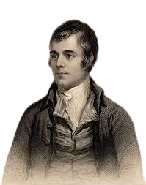

Robert Burns
L3 Scots language

Slide 2
Teacher notes
These resources have been gathered from online resources to support the learning of Scots language.
In this unit we will look at:
The life of Robert Burns
His poetry
His songs
Some slides might look like they are duplicated but are there to support differentiation (teacher’s judgment to be used), just duplicate them to add to google classroom. Some of the answers are in the speaker notes.

Slide 3

Who was
?

Slide 4
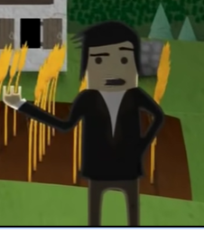
Activity 1: Who was Robert Burns?
Watch the video and put the events in Robert Burns’ life in order. You could share the slide or got to live worksheet here.
You could also use this worksheet
to test students’ knowledge.
Notes:
https://www.liveworksheets.com/w/en/english-second-language-esl/58059

Slide 5
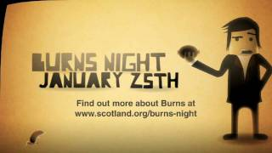
Notes:
https://youtu.be/qMxIBqpryG0?si=LAYMOZGmn4yTUPth

Slide 6
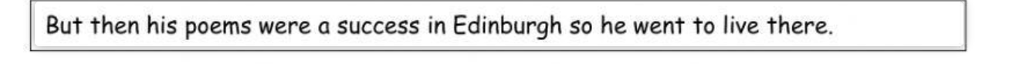
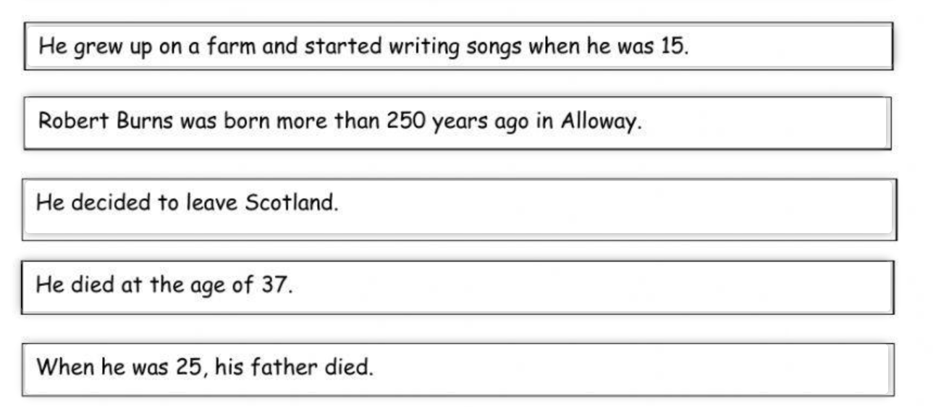
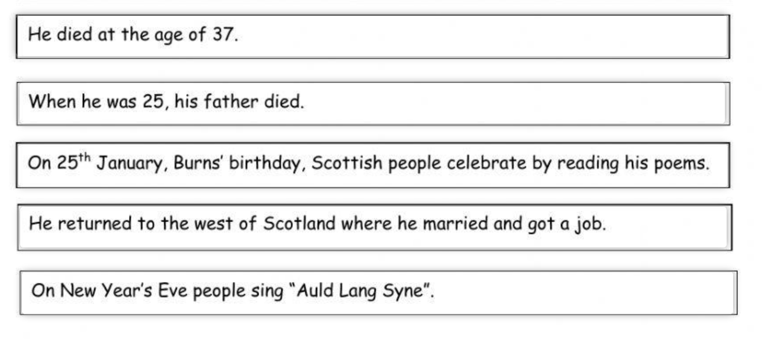

Slide 7
Activity 2: The Life of Robert Burns
Using Scots retell the life of Rabbie.
Use the East Central South Scots 100 words resource or the online dictionary here.
You can find other Scots dialects here.

Slide 8
Es&Os
With support, I am beginning to experiment with writing in the language I am learning. MLAN 1-13 I have opportunities to express myself in writing, exploring and experimenting with words and phrases using resources, to ensure my writing makes sense. MLAN 2-13a I use my knowledge about language and success criteria to help me, and I can check that I have written familiar words and phrases accurately. MLAN 2-14a

Slide 9
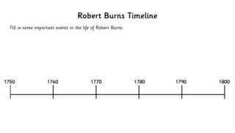
Extension tasks
Make Rabbie Burns braw and bricht! (colouring in)
Robert Burns wordsearch
Create a timeline of his life (online support here)

Slide 10
’ poetry

Slide 11
Burn’s Poetry
Burns is famous for writing in Scots dialect - that means the poems are written on the page exactly as they sound when spoken in a Scottish accent, and contain some words that were just used in Scotland 250 years ago!
Have a go at saying the extracts from Robert Burns’ poem “to a Loose”.
If you don’t know some of the Scots dialect words, don’t worry - have a guess! We’ve given some clues in brackets to help.

Slide 12

To a Louse *(extract)
Ha! whare ye gaun (going), ye crowlan ferlie!
Your impudence protects you sairly (barely):
I canna say but ye strunt rarely,
Owre (over) gawze and lace;
Tho’ faith, I fear ye dine but sparely,
On sic (such) a place.
Ye ugly, creepan, blastet wonner (wonder),
Detested, shunn’d, by saunt (saint) an’ sinner,
How daur (dare) ye set your fit upon her,
Sae fine a Lady!
Gae somewhere else and seek your dinner,
On some poor body.
Notes:
Use the sound file to check pronunciation

Slide 13
Robert Burns’ poems
“To a moose”
(Level 1)
“Address to a Haggis”
(Level 1)
“Up in the morning early”
(Level 2)
“Tam O’Shanter”
(Level 2)
Reference to violence

Slide 14
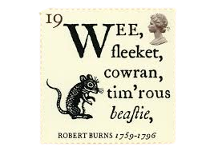

Poem “to a moose”
Robert Burns was a farmer. One day he accidentally destroyed a mouse’s nest with his plough.
The poem he wrote about the mouse is one of the world’s most famous poems.
Fill in the gaps worksheet.

Slide 15
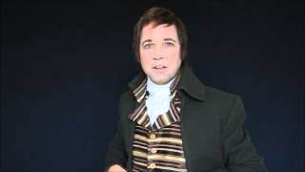
Poem “to a moose”

Slide 16
Activity 1: What do the underlined words mean? (verse 1)
Wee, sleeket, cowrin, tim’rous beastie,
O, what a panic’s in thy breastie!
Thou need na start awa sae hasty,
Wi’ bickerin brattle!
I wad be laith to rin an’ chase thee
Wi’ murd’ring pattle!

Slide 17
Activity 1 What do the underlined words mean?
Wee, sleeket, cowrin, tim’rous beastie,
O, what a panic’s in thy breastie!
Thou need na start awa sae hasty,
Wi’ bickerin brattle!
I wad be laith to rin an’ chase thee
Wi’ murd’ring pattle!
breast
loathed
quick scurry
sneaky
run
away
cowering
murderous plough

Slide 18
(Answer) Verse 1: What do the underlined words mean?
Wee, sleeket, cowrin, tim’rous beastie,
O, what a panic’s in thy breastie!
Thou need na start awa sae hasty,
Wi’ bickerin brattle!
I wad be laith to rin an’ chase thee
Wi’ murd’ring pattle!
sneaky
cowering
breast
away
quick scurry
loathed
run
murderous plough

Slide 19
Activity 2: Match the words.
dominion
sudden fright
ill opinion
rule
startle
friend
companion
living creature
mortal
negative view

Slide 20
Answer : Match the words.
dominion
rule
ill opinion
negative view
startle
sudden fright
companion
friend
mortal
living creature

Slide 21
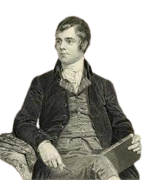
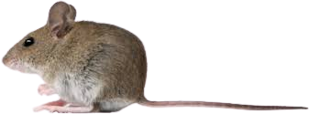
Activity 3: Describe the farmer and mouse’s relationship (verse 2).
Notes:
The farmer has dominion over all creatures,which disrupts nature’s harmony, but sees himself as a friend and just another living creature, just like the mouse.

Slide 22
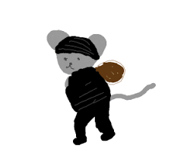
Activity 3: In the 3rd verse, Robert Burns acknowledges that the mouse steals food. How does it impact him and his farm?
Wordbank:
maun = must
damien-icker in a thrave = small piece of wheat from the stock
the lave = leftovers
miss’t = missed
Notes:
The mouse must live, and it steals food to do so. The amount of corn is not much, the farmer has plenty leftovers and will not notice what the mouse has taken.

Slide 23
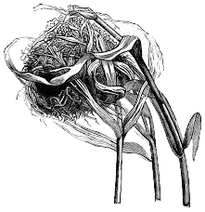
Activity 4: Looking at verse 4, are these statements true or false?
He describe the mouse’s home as small.
Its wall are strong and thick.
It is made of sticks and grass.
There is nothing left to build another one.
January’s winds are coming.
The winds are described as smelly and strong.
You could use the online dictionary here.

Slide 24
Answers
True: wee-bit housie
He describe the mouse’s home as small.
Its wall are strong and thick.
It is made of sticks and grass.
There is nothing left to build another one.
January’s winds are coming.
The winds are described as smelly and strong.
False: It’s silly wa’s (weak walls)
False: grass only (o’ foggage green)
True: An’ naething, now, to big a new ane
False: An’ bleak December’s winds
False: snell an’ keen means both biting and sharp

Slide 25
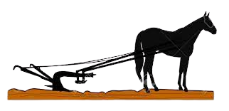
Activity 5: How did the plough affect the mouse (verse 5)?
Wordbank:
blast = wind
dwell = live
coulter = plough
thy cell = your home
Notes:
Mouse was ready for winter in its house sheltering from it and the winds. Until the plough destroyed it.

Slide 26
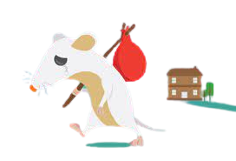
Activity 6: Re-sequence the sentences (verse 6).
No house and property.
And frosty cold!
Has cost you many a tired nibble!
Now you are turned out for all your trouble,
That small heap of leaves and stubble,
To shelter you from the winter sleet,

Slide 27
Answer
That small heap of leaves and stubble,
Has cost you many a tired nibble!
Now you are turned out for all your trouble,
No house and property.
To shelter you from the winter sleet,
And frosty cold!

Slide 28
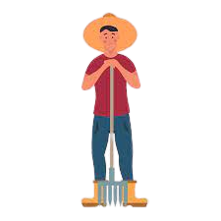

Activity 7: In the last two verses, how does the farmer compare himself to the mouse?
Notes:
For both planning for the future can be useless and that some of the best plans often go wrong and can lead to grief and pain. However the mouse is only affected by the present, however the farmer can feel the pain of past memories and look ahead to the future with fear.

Slide 29
Activity 9: What is the moral of this story?
"The best-laid schemes of mice and men go oft awry".
Notes:
Robert Burns might have been a successful poet and ladies' man, but he still knew all about rejection, failure, and disappointment.

Slide 30
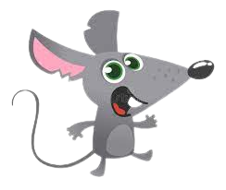
Activity 8: Retell the story from the mouse’s point of view.
Write It Doon!
Ken whit happened?
Scots words for creative writing.worksheet.

Slide 31
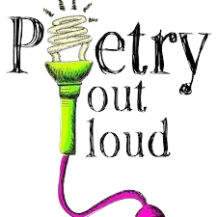
Activity 10: Burn’s Poems
Choose one of Robert Burns’ poem to recite (list here).
You could read a verse each for longer poems.

Slide 32
Extension activities.
Mouse maze.
To a mouse wordsearch
Make a mouse bookmark

Slide 33
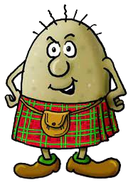
Poem: “Address to a haggis”
This poem was written by Burns to celebrate his appreciation of the Haggis. As a result Burns and Haggis have been forever linked.
The first Burns Supper was organised by Robert Burns’ friends at his birthplace cottage in Alloway, Ayrshire in July 1801 – only five years after his death at the tender age of 37.

Slide 34
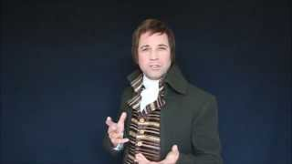
Notes:
https://youtu.be/2XifuHP2RnE?si=Rm9NPuETiwMvBms3

Slide 35
Activity 1: What are the following parts mentioned in the poem.
hurdies
stomach
face
bellies
painch
buttocks
belyve
intestines
thairm
leg
shank
fist
arm
face
nieve
arm

Slide 36
Answers
face
face
hurdies
buttocks
painch
stomach
belyve
bellies
thairm
intestines
shank
leg
arm
arm
nieve
fist

Slide 37
Activity 2: What do the underlined words mean?
Fair fa’ your honest, sonsie face,
Great chieftain o’ the pudding-race!
Aboon them a’ ye tak your place,
Painch, tripe, or thairm :
Weel are ye wordy o’a grace
As lang’s my arm.

Slide 38
Activity 2: What do the underlined words mean?
above them
Fair fa’ your honest, sonsie face,
Great chieftain o’ the pudding-race!
Aboon them a’ ye tak your place,
Painch, tripe, or thairm :
Weel are ye wordy o’a grace
As lang’s my arm.
as long as my arm
well
sausage
plump
intestine

Slide 39
Answers
plump
Fair fa’ your honest, sonsie face,
Great chieftain o’ the pudding-race!
Aboon them a’ ye tak your place,
Painch, tripe, or thairm :
Weel are ye wordy o’a grace
As lang’s my arm.
sausage
above them
intestine
well
as long as my arm

Slide 40
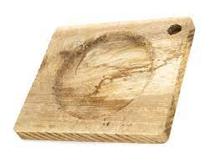
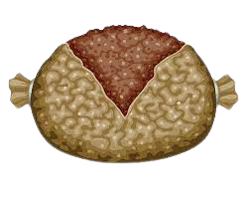
Activity 3: In the 2nd verse how is the Haggis described?
A trencher (dish)

Slide 41

Activity 4: In the poem, find the following words:
you
would
of
and
with
take
vomit
such

Slide 42
Activity 4: In the poem, find the following words:
you (verse 1)
would (verse 2)
of (verse 2)
and (verse 3)
with (verse 3)
take (verse 4)
vomit (verse 5)
such (verse 5)

Slide 43
Activity 4: In the poem, find the following words:
you (verse 1)
would (verse 2)
of (verse 2)
and (verse 3)
with (verse 3)
take (verse 4)
vomit (verse 5)
such (verse 5)
ye
wad
o’
an’
wi’
tak
spew
sic

Slide 44
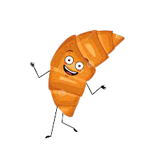
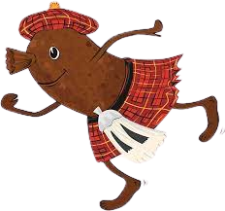
Activity 4: How does Burn feel about … (Explain your answers)
Haggis?
3. French food?
Notes:
Robert Burns loves haggis because he wrote a poem all about it and calls it the chief of puddings.
Burns is criticising different French dishes (verse 5 ): disgusting, makes people vomit…

Slide 45
Activity 5: Find the words that describe:
the trencher
the haggis’ entrails
how he feels about see the inside of the haggis (sight)
the bellies
the disgust to some foods.
what stuff Scotland does not want

Slide 46
Activity 5: Find the words that describe:
the trencher
the haggis’ entrails
how he feels about see the inside of the haggis (sight)
the bellies
the disgust to some foods (Verse 4).
what stuff Scotland does not want
groaning
perfect
glorious
bricht
weel-swall’d
gushing
skinkin

Slide 47
Activity 5: Find the words that describe:
groaning
the trencher
the haggis’ entrails
how he feels about see the inside of the haggis (sight)
the bellies
the disgust to some foods.
what stuff Scotland does not want
gushing
bricht
glorious
weel-swall’d
perfect
skinkin

Slide 48
Activity 6: Haggis or no haggis?
“The trembling earth resounds his tread” is used to describe someone who eats haggis. What do you think it means? (verse 7)
How does he describe someone who does not eat haggis? (Verse 6)
Notes:
1. when he walks, the earth shakes due to his size and strength
2. as weak, thin and unfit

Slide 49
Activity 7: Re-order these sentences.
But mark the Rustic, haggis-fed,
And cut you up with ready slight,
Give her [Scotland] a Haggis!
The groaning trencher there you fill
Then old head of the table, most like to burst,

Slide 50
Answers
The groaning trencher there you fill
And cut you up with ready slight,
Then old head of the table, most like to burst,
But mark the Rustic, haggis-fed,
Give her [Scotland] a Haggis!

Slide 51
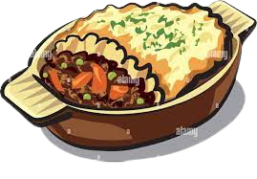
Activity 8: Writing
Write a poem, in Scots, dedicated to your favourite food.
I dinna like hail tatties Pit on my plate o mince For when I tak my denner I eat them baith at yince.
Sae mash and mix the tatties Wi mince into the mashin, And sic a tasty denner Will aye be voted ‘Smashin!’
J. K. Annand
from A Wale o Rhymes (Macdonald Publishers, 1989).
Scots words for creative writing worksheet.

Slide 52
Activity 8: Burn’s Poems
Choose one of Robert Burns’ poem to recite (list here).
You could read a verse each for longer poems.

Slide 53
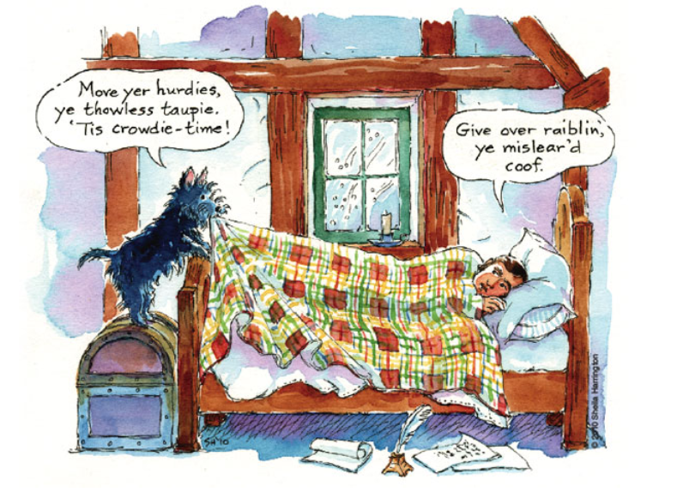
Poem: “Up in the morning early”
Notes:
Teaching resources based on the following

Slide 54
Activity 1: Fill in the gap task (worksheet).
Watch the video and try to complete the poem as you hear the words.
snaw
morn
fare
sairly
winter
Cauld
chittering
winter
no’
winter
loud

Slide 55
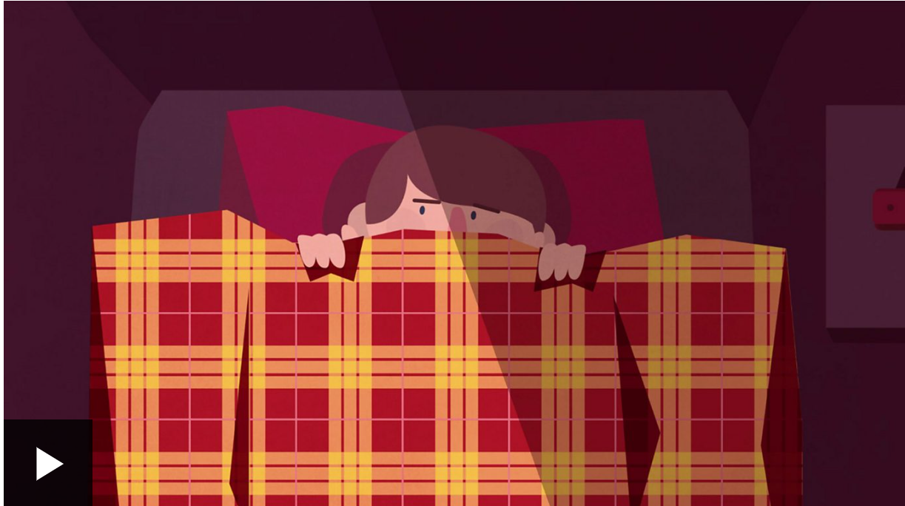
Notes:
https://www.bbc.co.uk/bitesize/topics/zdt2382/articles/zxtx2nb

Slide 56
Cauld
____ blaws the wind frae east to west,
The drift is driving _____;
Sae _____ and shrill’s I hear the blast,
I’m sure it’s ______ fairly.
Up in the morning’s _____ for me,
Up in the morning early;
When a’ the hills are covered wi’ _____,
I’m sure its _______ fairly.
The birds sit _______ in the thorn,
A’ day they ___ but sparely;
And lang’s the night frae e’en to ______,
I’m sure it’s ______ fairly.
chittering
sairly
sairly
loud
winter
morn
winter
no’
snaw
fare
snaw
Cauld
winter
winter
chittering
winter
no’
fare
loud
morn
winter

Slide 57
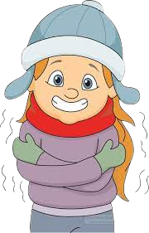
Activity 2: Working in pairs, highlight 10 Scots words in the poem and work out the meaning in modern English.
Ex: cauld an chittering

Slide 58
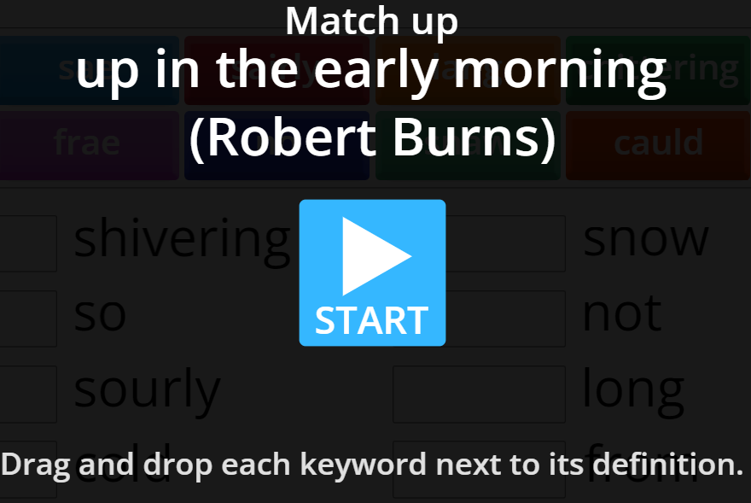
Activity 3: How quickly can you match the Scots to the English meaning.
Notes:
https://wordwall.net/resource/63567226

Slide 59
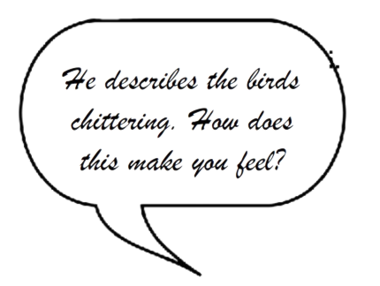
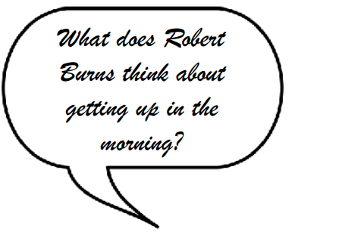
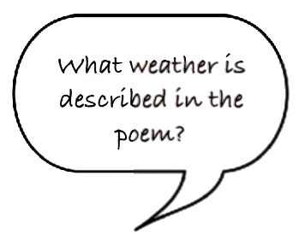
Activity 4: Answer the following questions. How do you know?

Slide 60
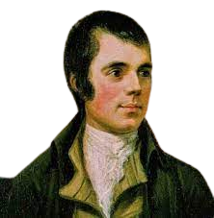
Activity 4: In your own word, write what the poem is about.
Ken whit its abowt?
Notes:
It is a poem that describes the poet's dislike of getting up early on a Winter's morning. Burns describes a cold, windy and snowy landscape, where the birds are shivering and the hours of darkness are long. Given the living and working conditions as a farmer that Burns had to endure in the 18th century, we can understand why getting up early on a winter's morning is not to his liking!

Slide 61

Activity 5: Now time for you to write about how you feel about getting up in the morning early in the winter.
Write It Doon!
Scots words for creative writing.worksheet.

Slide 62

Notes:
https://youtu.be/7GaENqCG2U8

Slide 63
Activity 6: Burn’s Poems
Choose one of Robert Burns’ poem to recite (list here).
You could read a verse each for longer poems.

Slide 64
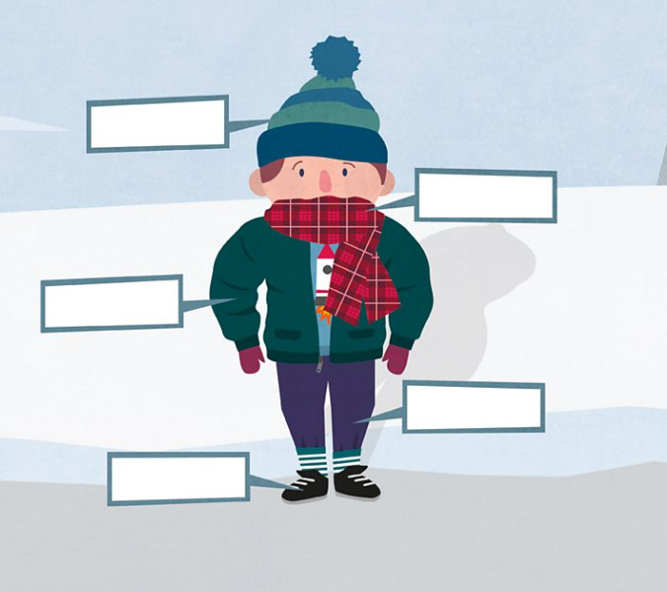
Extension: Ken whit ya need for the winter?
Notes:
https://wordwall.net/resource/63596102

Slide 65
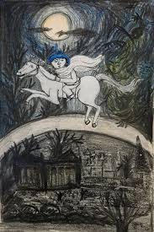
Poem “Tam O’Shanter”
The poem describes Tam, who is riding home on his horse late at night after drinking in a local pub. He rides past the Kirk o’ Alloway and his horse (Maggie) stops, amazed. Burns describes the sight that Tam sees.
Tam o’ Shanter was written in 1791. Tam o’ Shanter is actually written in a mix of two languages. Robert Burns is famous for having written in both English and Scots, and this poem is a prime example of how he blends the two together.
Notes:
(Please note that the poem 'Tam O'Shanter' makes reference to
Violence and heavy drinking, and so it is advisable to ensure that you use your
judgement when sharing this text)

Slide 66
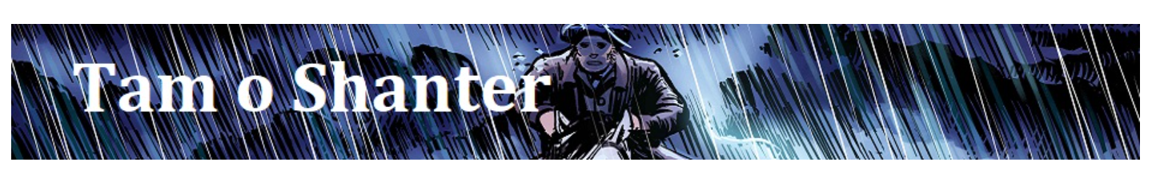
Watch the video of this dramatic recital of Tam O’Shanter of the poem (find the poem here)
or
Watch the comic strip version (find the Comic book here).
In this unit of work, we will use the comic strip version. For learners who struggle to read the comic books you will find supported resources here.
Notes:
Robert Burns’ original poem is illustrated by comic artist Gary Welsh and read by writer and actor Hamish MacDonald. It is a Scots Hoose production.

Slide 67
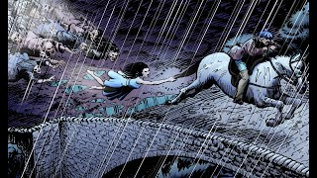
Notes:
https://youtu.be/GAqVwCa_x5o

Slide 68
The opening stanza captures the atmosphere at the end of a busy market day.
The first six lines create the sense of relaxed relief that follows a working day, but an ominous turning point comes in Line 7,
“We think na on… “
splitting the stanza in two.

Slide 69
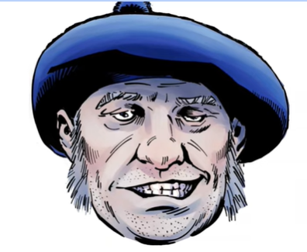
Activity 1 Tam
Tam is a farmer who travelled into Ayr to go to the market, but after he sold his goods, he ended up staying a while longer than he intended. Looking at this picture find some Scots adjectives to describe him.

Slide 70
Activity 2: What do the following words mean?
droughty
Someone who talks a lot
naig
darkness
mirk
a black dog
blellum
a (strong) beer
nappy
horse
groaning
very drunk
unco happy
thirsty
(for alcohol)
towzie tyke
move quickly

Slide 71
Answers
droughty
thirsty
(for alcohol)
naig
horse
mirk
darkness
blellum
Someone who talks a lot
nappy
a (strong) beer
groaning
move quickly
unco happy
very drunk
towzie tyke
a black dog

Slide 72
The narrator then provides a list of the obstacles, put out of Tam's mind because he has been drinking, between the inn and home.
“The mosses, waters, slaps, and styles. “
There follows a portrait of the archetypal neglected and indignant wife, which shows a disconnection between the carousing male and the sober, reliable, isolated wife.

Slide 73
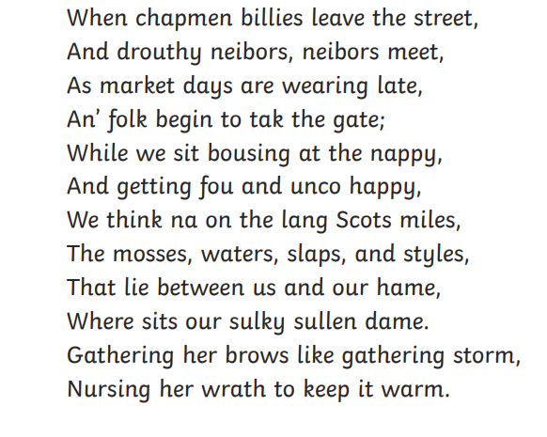
Activity 3: Tam’s wife
Tam is away in town drinking. He was meant to be home long ago. How do we know?
What do we learn about his wife?
chapmen = people
billies = peddler
tak the gate = take the road home
the mosses = the marshes
slaps = steps
styles = stiles

Slide 74
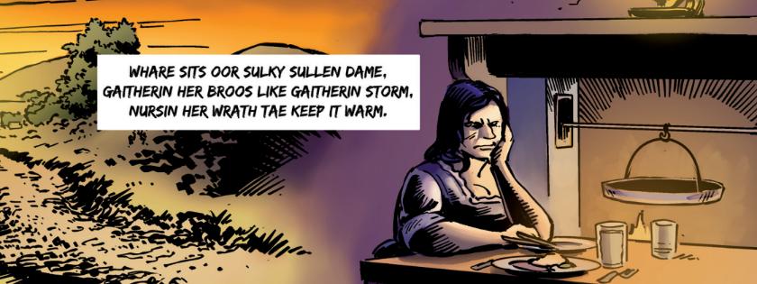
Answer:
Poet refers to her as sulky and sullen. She’s not too fond of her husband’s drinking as she is frowning (gathering her brows, like a thundering storm) and angry (nursing her wrath).
Tam was meant to be home hours ago.

Slide 75
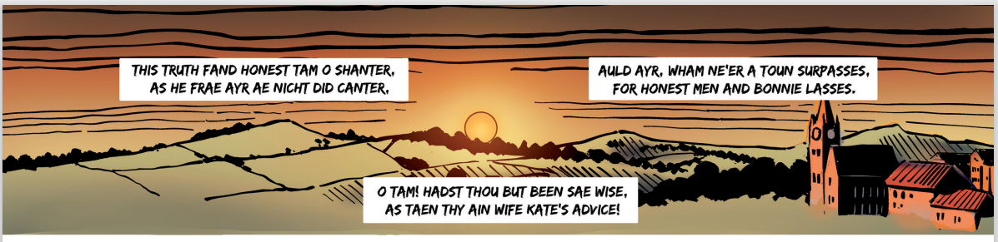
Activity 3: How is Tam described?
worksheet
Notes:
honest

Slide 76
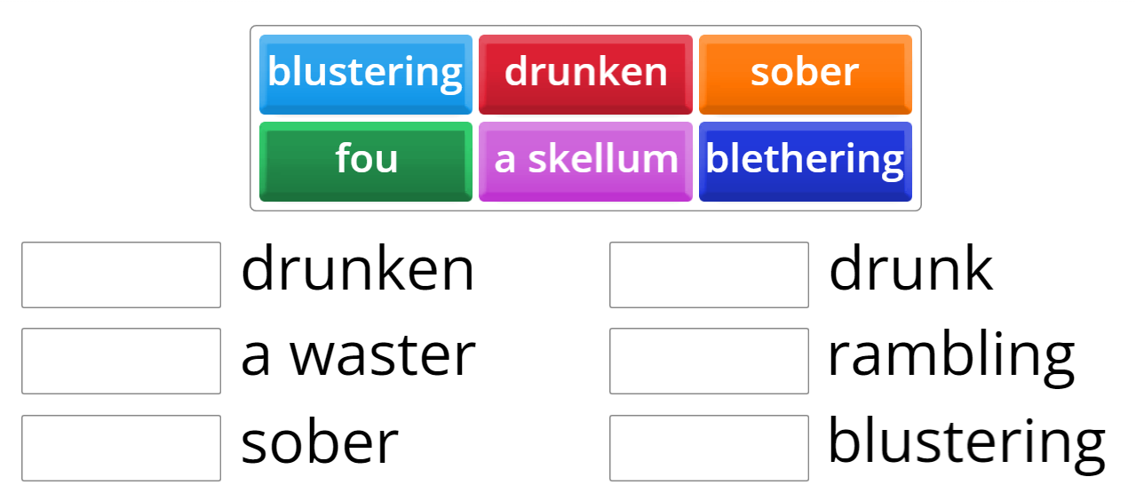
Match the Scots to the English (link in worksheet too)
Notes:
https://wordwall.net/resource/63629675

Slide 77
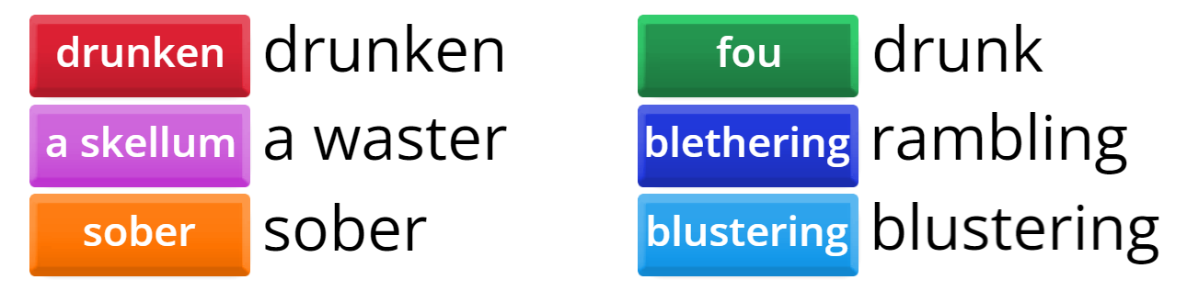
Answer:

Slide 78
The combination of alliteration, onomatopoeic heavy sounds and assonance convey her dismissal of Tam as a clumsy and self-deluding oaf.

Slide 79
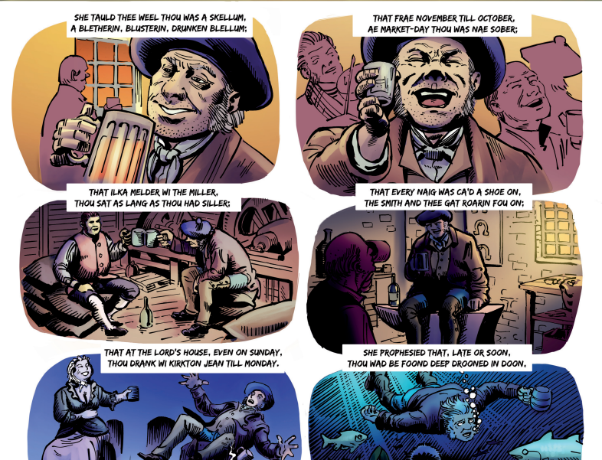
How does Kate, Tam’s wife, describe him?

Slide 80
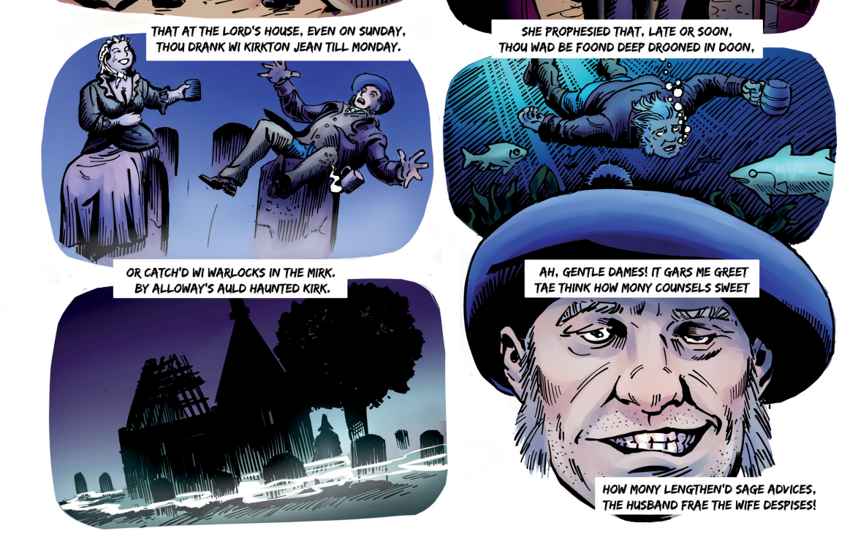
Finally she predicts what is going to happen to Tam. What does she see ahead of him?

Slide 81
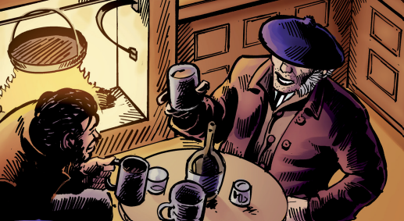
Activity 4: Who is Souter Johnnie? (worksheet)
How is he being described? What do Tam and him like to do together? How do you know?
planted =seated
an ingle = a fireplace
reaming swats = creamy ales
drouthy = thirsty
vera = very
Notes:
Souter Johnnie is one of Tam o’ Shanter’s best friends and drinking partners.
At the start of the poem, he’s described the following way:
“And at his elbow, Souter Johnie, His ancient, trusty, drouthy crony; Tam lo’ed him like a very brither, They had been fou for weeks thegither”
Souter Johnnie likes to say jokes.

Slide 82
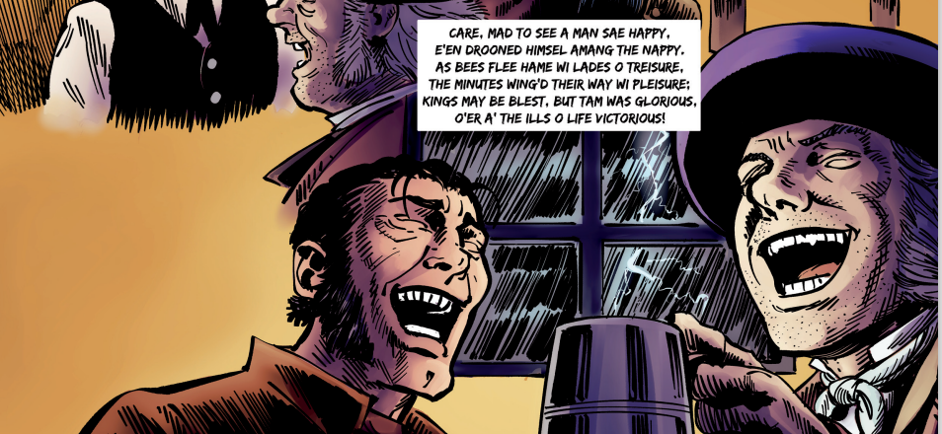
How did he feel after his night out?

Slide 83
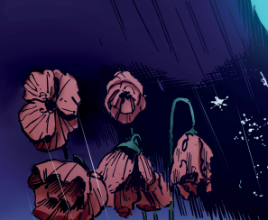
Activity 5: How does Robert Burns describe life's pleasures?
worksheet
race = rays
flit = move
ere = before
maun = must
sic = such
ne’er = never
was abroad in = had been our in
twad = it had
Deil = devil

Slide 84
The speaker provides a list of similes in ‘poetical’ English, rather than Scots, advising that pleasures pass quickly: the rainbow’s lovely form/Evanishing amid the storm. The tone changes suddenly with the fateful metaphor:
“Nae man can tether time nor tide
The hour approaches Tam maun ride”

Slide 85
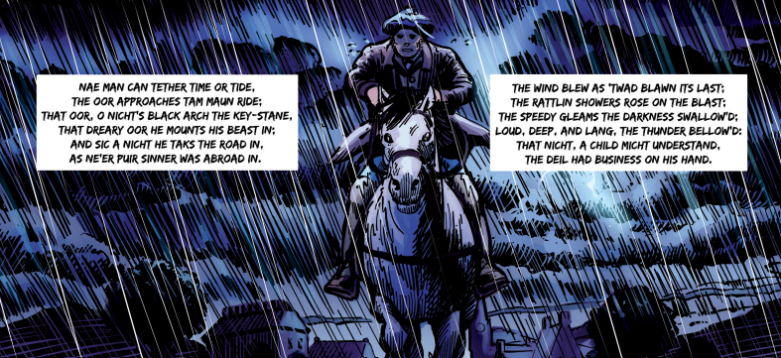
How is the night being described?
Notes:
Alliteration ties tether, time, tide and Tam together and there is a feeling of monosyllabic doom of Tam maun ride.

Slide 86
Burns’ main task in the next section is to maintain momentum while building up horror.
The storm is terrible but, once Meg the horse, is into her stride, she and Tam seem to outdo it. Word choice of “skelpit” captures their fearless approach and the galloping rhythm of “Despisin' wind, and rain, and fire” show Tam’s energy and control. The repetition of “Whiles holding fast…Whiles crooning o’er…Whiles glow’ring…” builds momentum further, at the same time suggesting a certain nervousness, as Tam sings and looks around him.

Slide 87
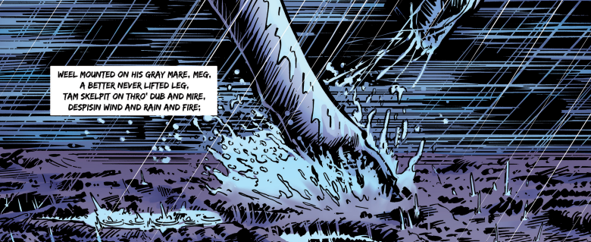
Activity 6: How is Meg described? (worksheet)
Notes:
PLease note that it is a gruesome part of the poem

Slide 88


Tam was holding on to his good hat, but why was he looking back?
Because of bogles and ghaits!

Slide 89
Burns intensifies the Gothic folk-tale horror of the journey.
It is in two parts:
first a helter-skelter gallop past scenes of gruesome death,
then a description of the worsening storm.
We sense a climax approaching and it takes the form of a mystery.

Slide 90
Reorder what he passes as he travels.
the birch trees and the huge stone
the river Doon
the monument
the well
the ford
Alloway’s Church

Slide 91
Answers
the ford
the birch trees and the huge stone
the monument
the well
the river Doon
Alloway’s Church

Slide 92

How is the storm described?

Slide 93

How is the Church being depicted in contrast to the storm?
Glimmerin
Seem’d in a bleeze
The beams were dancing
loud
Notes:
the beams were glancin

Slide 94
Light and mirth and dancing provide a contrast to the powers of nature.
The speaker immediately reminds us that Tam is drunk:
“The swats sae ream'd in Tammie’s noddle
Fair play, he car’d na deils a boddle”
The comical word choice of Tammie’s, noddle and boddle suggest a kind of carefree drunken courage. Tam is ready for adventure. Maggie is unwilling and one little descriptive touch - “stood richt sair astonished” adds an essential development to her character. She is a sensible, cautious animal, wiser than Tam.

Slide 95

Activity 7: How did Tam and Maggie react to seeing the church?
Notes:
bold John Barleycorn! (whisky)

Slide 96

The next lines contain a description of dancing, interrupted in the middle by a ghoulish description of the sacrilegious use of the holy table.
Auld Nick is present as musician.

Slide 97

Activity 8: As Meg moved forward towards the church, what did Tam see?
Read through the text and take the quiz.
Notes:
Sound file of extract to support learners.

Slide 98

Click on the image to access the activity.
Notes:
https://www.scotslanguage.com/learning?activity=5367

Slide 99

Looking at the text again, how would you describe the mood in the church? Justify your answer.
Notes:
Appropriate word choice captures the power of pipe music- screw'd and skirl alliterate to show a ferocious jollity and the building resonates in reply: Till roof and rafters a’ did dirl. Here the alliteration and consonance of 'r' conveys the energy of the dance.
The description of the witches dancing captures their movement and wildness brilliantly. The dancing rhythm is conveyed in pairings of words – from amaz'd and curious to swat and reekit. There is alliteration on fun, fast and furious; repetition in The piper…The dancers… suggesting the coming and going of partners, followed by the simple and very effective line : They reel’d, they set, they cross’d, they cleekit. Each figure of the dance is named separately, to indicate there is a sense of order amongst the wild movement.

Slide 100

Activity 9: The Witch! (worksheet)
The witch in Tam o’ Shanter’s real name isn’t Cutty Sark.
A “cutty-sark” was a term for a short, revealing dress or an undergarment, so Tam was being rather rude by calling her that! Robert Burns gave her the name ‘Nannie’ or ‘Nannie Dee’ instead.
She is not one of the old witches. She catches Tam’s eye.

Slide 101


Compare how Tam describes most of the witch
against how he describes Nannie. (Jamboard)

Slide 102


Notes:
Jamboard activity 1

Slide 103


Slide 104

Notes:
Jamboard activity 2

Slide 105


Slide 106

Nannie is a new recruit so we are given a list of her future crimes, supplied by the speaker. What are they?
For mony a beast to dead she shot,
And perish'd mony a bonie boat,
And shook baith meikle corn and bear,
And kept the country-side in fear
Notes:
For many a beast to dead she shot,
And perished many a bonnie boat,
And shook both much corn and barley,
And kept the country-side in fear.

Slide 107
Describe what Nannie is wearing.
Her cutty-sark, o' Paisley harn
That while a lassie she had worn,
In longitude tho' sorely scanty,
It was her best, and she was vauntie,-
Ah! little ken'd thy reverend grannie,
That sark she coft for her wee Nannie,
Wi' twa pund Scots, ('twas a' her riches),

Slide 108

Nannie’s dancing had what effect on Tam and the Devil?
Tam stood, like ane bewitch'd
Satan glowr'd

Slide 109

Tam tint his reason a' thegither, And roars out, …
Notes:
Tom lost his reason all together,
And roars out: ‘ Well done, short skirt! ’

Slide 110



Slide 111

The dance is over and the chase is on. This moment of contrast between comic stupidity and horror is one of the poem’s most dramatic moments.
The poem goes into the present tense to increase the sense of urgency as Tam flees for his life and soul: “So Maggie runs, the witches follow”.

Slide 112



Activity 10: The chase! (worksheet)

Slide 113
Complete the translation.
And __________ had he Maggie rallied, When out the __________ legion sallied.
As bees buzz out with angry ______, When __________ herds assail their hive; As a wild hare’s ______ foes, When, pop! she starts _______ before their nose; As _______ runs the market-crowd, When ‘ Catch the thief! ’ __________ aloud: So Maggie runs, the _______ follow, With many an unearthly _______ and______.
eager
resounds
running
plundering
scream
witches
holler
wrath
hellish
scarcely
mortal

Slide 114
Complete the translation.
scarcely
And __________ had he Maggie rallied, When out the __________ legion sallied.
As bees buzz out with angry ______, When __________ herds assail their hive; As a wild hare’s ______ foes, When, pop! she starts _______ before their nose; As _______ runs the market-crowd, When ‘ Catch the thief! ’ __________ aloud: So Maggie runs, the _______ follow, With many an unearthly _______ and______.
hellish
wrath
plundering
mortal
running
eager
resounds
witches
scream
holler

Slide 115

What fate does the author predict for Tam?

Slide 116

What advice does he give Meg, the horse?
Notes:
Now, do your speedy utmost, Meg,
And beat them to the key-stone of the bridge;
There, you may toss your tale at them,
A running stream they dare not cross!
But before the key-stone she could make,
She had to shake a tail at the fiend;

Slide 117

However Nannie is catching up…

Slide 118

What happens to Meg once Nannie caught up with her?
Notes:
onomatopoeia and violence of The carlin claught her by the rump and there follows the picture of Maggie, left with scarce a stump. The ludicrous rhyme of rump…stump

Slide 119


What do you think the morale of this poem is?
no = now
ilk = each
cutty-sarks = short skirts
rin = run
o’er = over
Notes:
Yet Tam is not punished for his drinking, curiosity

Slide 120

Final thoughts, who is the real hero of the story?

Slide 121
Activity 11: Create a storyboard depicting the events of the poem.
Template here.
.
Scots words for creative writing.worksheet.

Slide 122

Notes:
https://youtu.be/3nKXaoMQDdc?si=yOWEGEY3LKklICQE

Slide 123

Notes:
https://youtu.be/YiATxrzZamE?si=XZKvr0D2pWfNPTxS

Slide 124
Activity 8: Burn’s Poems
Choose one of Robert Burns’ poem to recite (list here).
Use this resource to look at Burns’ stanza (activity 4).
You could read a verse each for longer poems.

Slide 125
’ songs
Notes:
https://poemanalysis.com/robert-burns/a-red-red-rose/

Slide 126

Burns is primarily regarded as Scotland's national poet, but there is strong evidence that he considered himself as much a songwriter as anything else.
Notes:
http://news.bbc.co.uk/cbbcnews/hi/newsid_4200000/newsid_4205100/4205149.stm auld lang syme

Slide 127


Slide 128



Three of Robert Burns’ songs
My hoggie
A red, red rose
Auld Lang Syne

Slide 129
A Red, Red rose
“A Red, Red Rose” is a 1794 song. Lasting love requires unwavering commitment, transcending time and distance.
‘A Red, Red Rose’ by Robert Burns is a poem in the ballad formation of four-line stanzas containing a loose ABAB rhyme scheme, and that format automatically links the reader to concepts of love and emotion.
Lyrics here.

Slide 130

A red, red rose
Notes:
https://youtu.be/QK9WK0QhejA?si=q5bPbNyq2QiVBxqn

Slide 131
A Red, red rose
Why has Burns decided to compare his “Luve” is that she is “like a red, red rose” ?
As a “rose” is the flower most connected to romance. In addition, “red” is seen as a colour of passion, so to attribute that colour twice in a row deposits a hefty amount of passion to the romance.

Slide 132
First Stanza
The first stanza has two similes. Can you spot them?
Burns compares his love with a springtime blooming rose and then with a sweet melody. These are popular poetic images and this is the stanza most commonly quoted from the poem.

Slide 133
First Stanza
Why do you think the term of endearment “Luve” is capitalised?
It gives the title a higher level of significance than what a lowercase concept would address, as if this title is a proper name attached to the person. The reader does not need to know the name of this lady. The nickname is sufficient to distinguish who this person is from the narrator.

Slide 134
Second Stanza
How does the poet express his feelings?
He compliments her: “My bonnie lassie”.
He is clearly stating that he is “[s]o deep in luve.”
the narrator declares he “will luve [her] still…[t]ill a’ the seas gang dry.” This is a clever way of saying his affection for her will continue forever

Slide 135
Third Stanza
The narrator begins this third stanza by repeating the idea that he “will luve” her “[t]ill a’ the seas gang dry”. Why do you think he does so?
This reveals how strongly he feels and how desperate he is to ensure that his beloved understands how long his affection will endure. In such a short a poem, repetition highlights how important it is to the poet.

Slide 136
The second and third stanzas become increasingly complex, ending with the metaphor of the “sands of life,” or hourglass. One the one hand we are given the image of his love lasting until the seas run dry and the rocks melt with the sun, wonderfully poetic images. On the other hand Burns reminds us of the passage of time and the changes that result. That recalls the first stanza and its image of a red rose, newly sprung in June, which we know from experience will change and decay with time. These are complex and competing images, typical of the more mature Robert Burns.

Slide 137
Fourth Stanza
Reading the fourth stanza, what does it tell you about what the narrator needs to do?
The narrator must leave, he does not go without reassuring his “luve” that he “will come again,” even though “ten thousand mile” separate them.

Slide 138

My Hoggie
Burns composed this pastoral song for James Johnson's
Scots Musical Museum. It was published in 1788.
Let’s listen to the song first.
Lyrics here (translation here).

Slide 139

My hoggie
Notes:
https://youtu.be/Pdv-87SDRNw?si=ovFTuU8LLypA4ysk

Slide 140



What animal do you think it was written about?

Slide 141
What animal do you think it was written about?
It is about a young sheep that has been killed by a fox.
My hoggie = my (pet) lamb

Slide 142

Task 1: Match the Scots to the English translation.
lamb
faithful doggie
vain
Nothing but the roaring waterfall
I had no more
Among the hill-sides so scraggy
The live-long night

Slide 143
Task 1: Match the Scots to the English translation.
lamb
I had no more
vain
The live-long night
faithful doggie
Nothing but the roaring waterfall
Among the hill-sides so scraggy

Slide 144



There are many animals mentioned in this poem. In the poem find out what these animals are called in Scots.
My hoggie
The blitter
snipe
The houlet
My doggie
The tod
cocks
The unco tyke

Slide 145



Finally how would you translate the following time expressions?
The live-long night
When day did dawn,
The morning

Slide 146

Auld Lang Syne
At New Year all over the world, Auld Lang Syne, a sincere expression of friendship, is sung.
Notes:
Lyrics here

Slide 147

Auld Lang Syne
It’s the 1788 in Scotland, and a super famous poet named Robert Burns is on the scene. He whips up the lyrics for a new song.
What do you think “Auld Lang Syne” mean?
Old long since
Days gone by
Notes:
Lyrics here the blue translation is a literal translation, can students think of different other ways to say it (like the green one)?

Slide 148


Slide 149
The lyrics of “Auld Lang Syne” are like a friendship party.
Should old friends be forgotten and never remembered?
In your pairs or group discuss this statement. Support your thoughts with lyrics from the song.
The song says we’re keeping those memories alive.
It is a rhetorical question!

Slide 150
“For auld lang syne my dear, for auld lang syne.”
Why are these lyrics repeated?
This just repeats how import the past is to us.

Slide 151


Slide 152


Notes:
choose one of Robert Burn’s poems and write it on tracing paper over a silhouette of his face.

