Slide 1

S3 Humanities
Mrs C Macleod
Scots Language and
Halloween

Slide 2

Welcome!
Fàilte don turas inntinneach seo!

Slide 3


Our Plan for Today
Our Plan for Today
L.I: To explore the historical origins of Halloween in Scotland
SC: I can listen, read and write in Scots
SC: I can reflect of how the use of Scots Language affects my literacy confidence levels
Mrs Macleod’s Scots Language CPD Course
Task: Your Literacy Confidence Levels
Video: The History of Halloween in Scotland
Break Time
Listen: The Candle
Reading in Scots
Task: Writing in Scots
Task: Your Literacy Confidence Levels

Slide 4
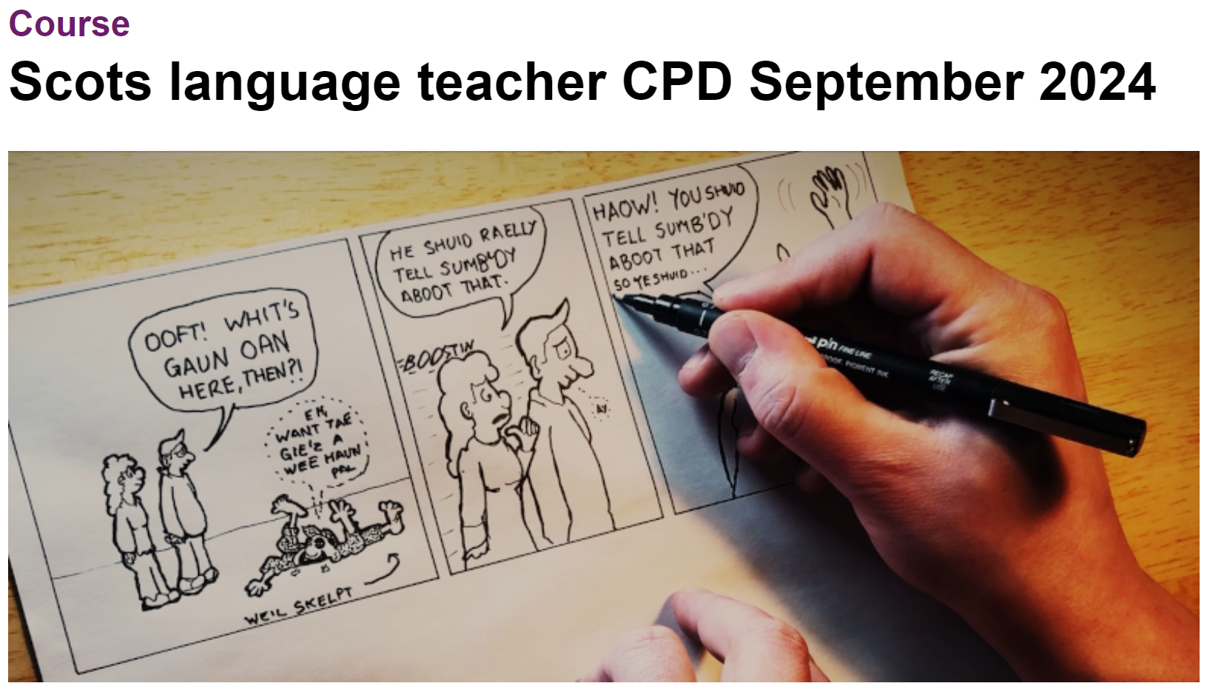

Scots Language CPD Course
You might remember me saying that I’m doing a CPD course this year all about using Scots Language in learning and teaching.
Please can you help me with my homework for unit 2? ☺

Slide 5
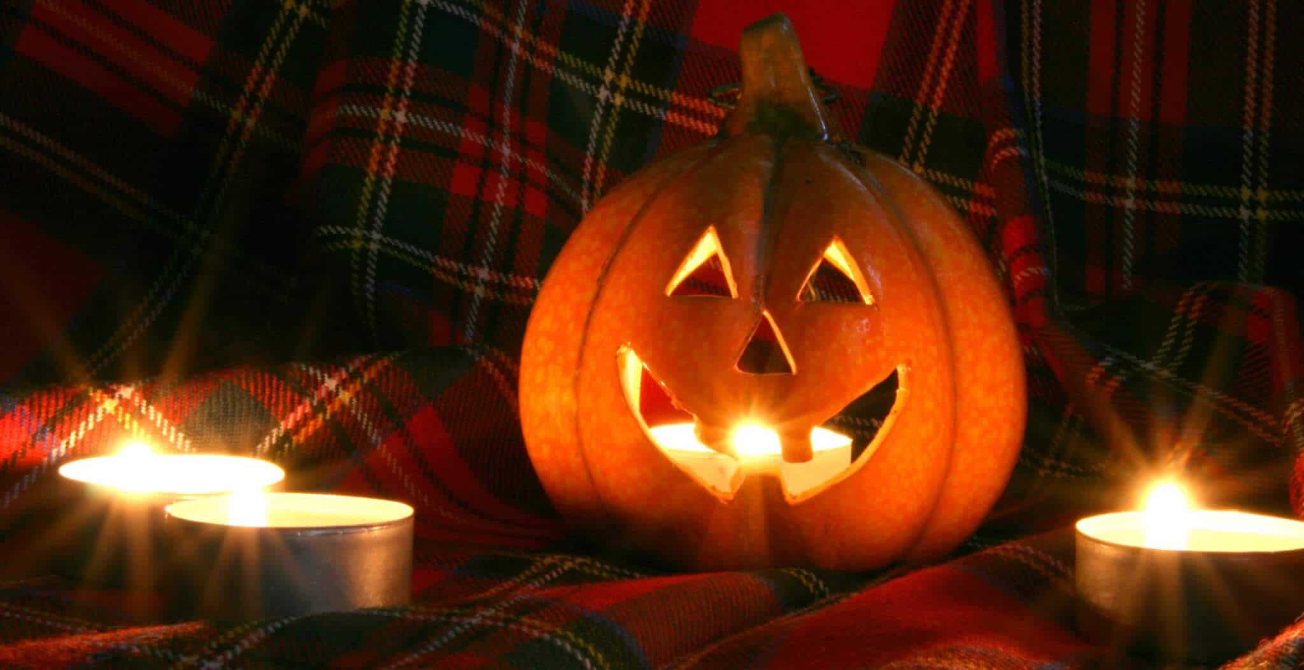
Scots Language and Literacy
Literacy is not just found in your English lessons, all teachers use literacy in their lessons and, hopefully, support you by helping you to become more confident with your literacy.
Today, we will combine literacy with Humanities by learning about the origins of Halloween in Scotland and listening to a ghost story told in modern Scots.

Slide 6
Your Literacy Confidence Levels
Answer the anonymous poll in the chat to show how confident you feel with your literacy.
Remember, literacy can include:
Reading
Writing
Listening (to videos or audio stories)
1 = Literacy is challenging for me
5 = I am really confident with literacy
Try to remember what number you chose, we’ll be checking in about this again at the end of the lesson ☺

Slide 7
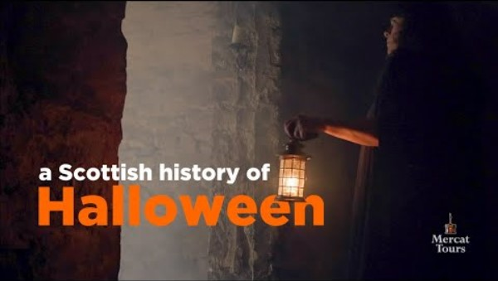
History of Halloween in Scotland
Notes:
https://www.youtube.com/watch?v=d0YBdc-W8q8 – 7 mins 30

Slide 8
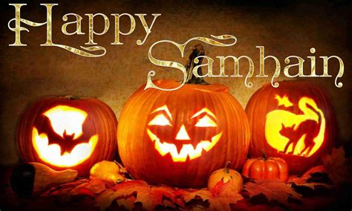
History of Halloween in Scotland
Task: In the chat (or using the mic), send through one fact about the history of Halloween that was mentioned in the video
Where does the festival of Halloween originate?
What is it celebrating?
What types of rituals or practices were done at Halloween traditionally?
Which groups of people first celebrated Halloween?
Etc….

Slide 9


Break Time
We will now have a five minute break.
Use the time to move around, have a drink, maybe get some fresh air, whatever will help you feel refreshed before we continue with the session.
I will post the time we
Will start again in the
chat

Slide 10
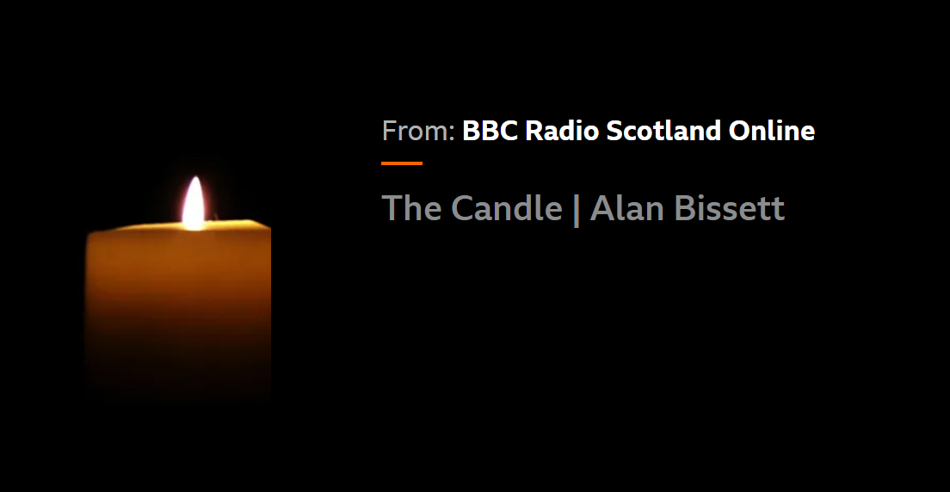
‘The Candle’ by Alan Bissett
Listen to the audio book of ‘The Candle’, a ghost story by Alan Bissett.
The story is set in modern day and written (and read) in Scots.
Task: After we have listened to the story, let me know what you thought in the chat or by using your mic
Notes:
https://www.bbc.co.uk/sounds/play/p029pz2p

Slide 11
Reading in Scots
The witch had a cat and an awfie lang hat and gingery hair that she pit in a plait. Hoo the cat purred and hoo the witch grinned as they sat on their bizzum and fleed through the wind. But hoo the witch peenged and the cat fuffed and aw when the wind wis sae wild that the hat blew awa. Doon! cried the witch, and they fleed tae the grund. They riped and they reenged but nae hat could be fund. Then oot fae the bushes (and this is the truth) there breeshled a dug wi the hat in his mooth.

Slide 12
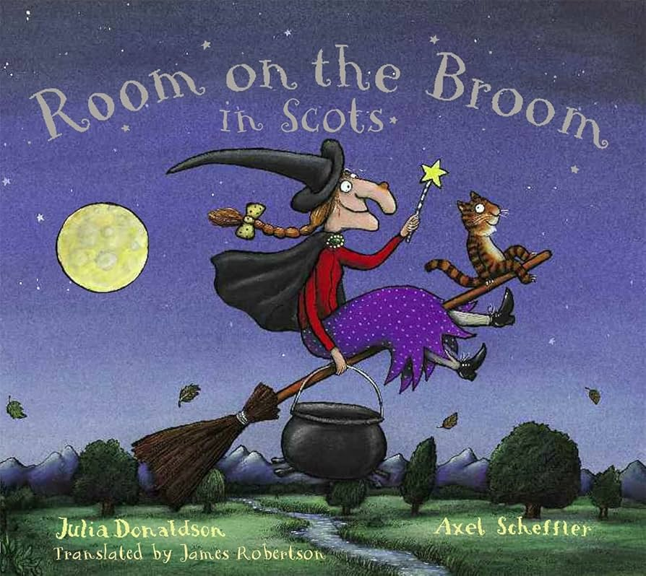
Room on the Broom
We’ve listened and read in Scots today – did you find either easy or more challenging?
Why could this be?

Slide 13
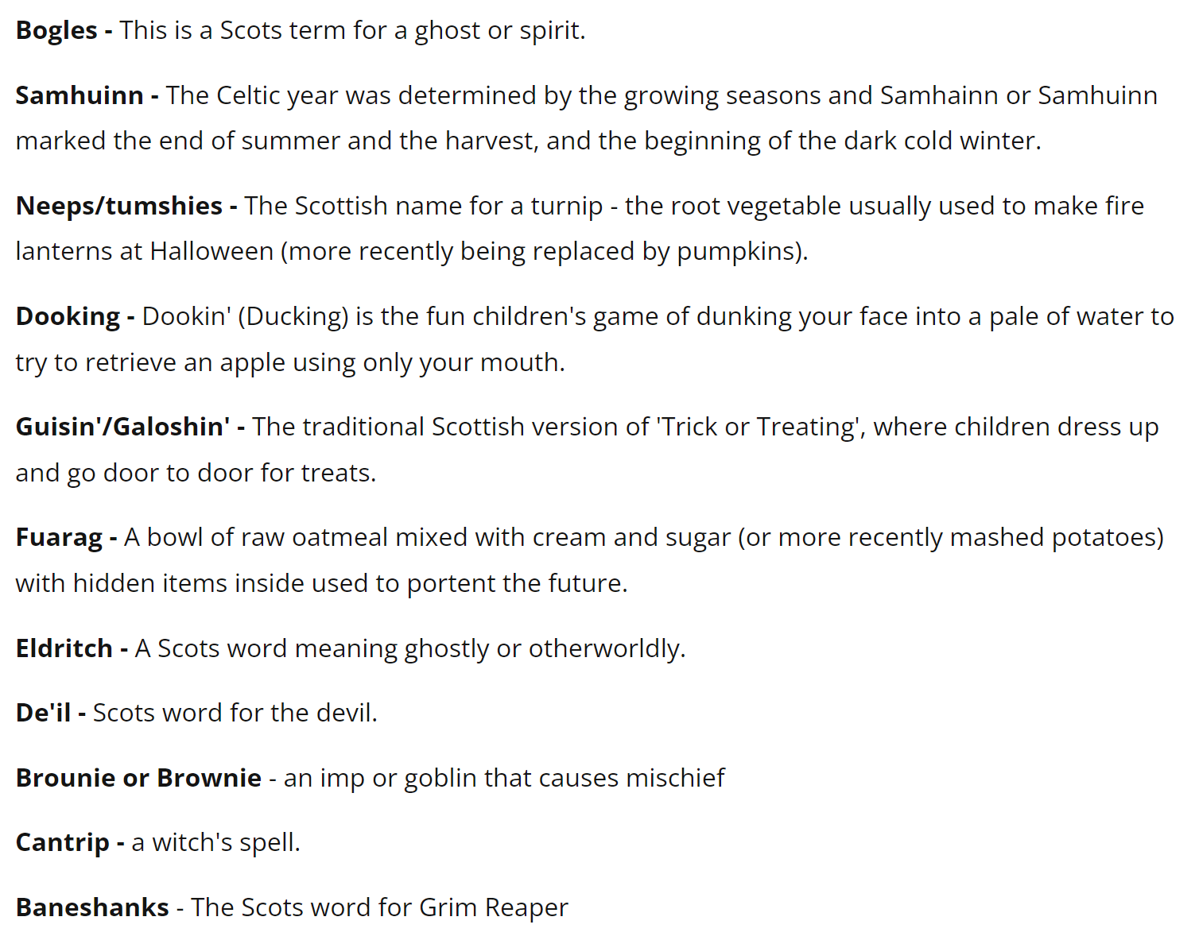
Writing in Scots
Task: Complete the worksheet in the assignment
Use some of the words in the box below (or any other Scots words you know) to write a paragraph about how Halloween has traditionally been celebrated in Scotland.
Try to use at least 3 Scots words in your paragraph 😊

Slide 14
Your Literacy Confidence Levels
Answer the anonymous poll in the chat again to show how confident you feel with your literacy.
Did using Scots language today help you feel more confident or less confident with your literacy?
1 = Scots language made the tasks harder for me
3 = Scots language didn’t make the tasks harder or easier
5 = Scots language made the tasks easier for me

Slide 15
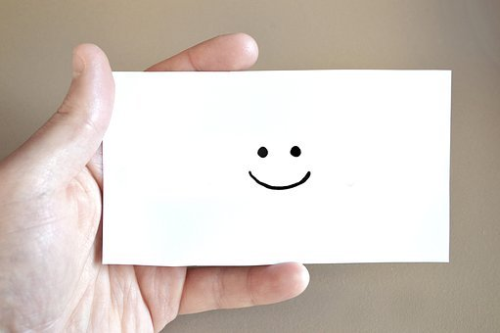
Well Done!
Thank you so much for your time and participation today!
See you next time ☺

