Slide 1
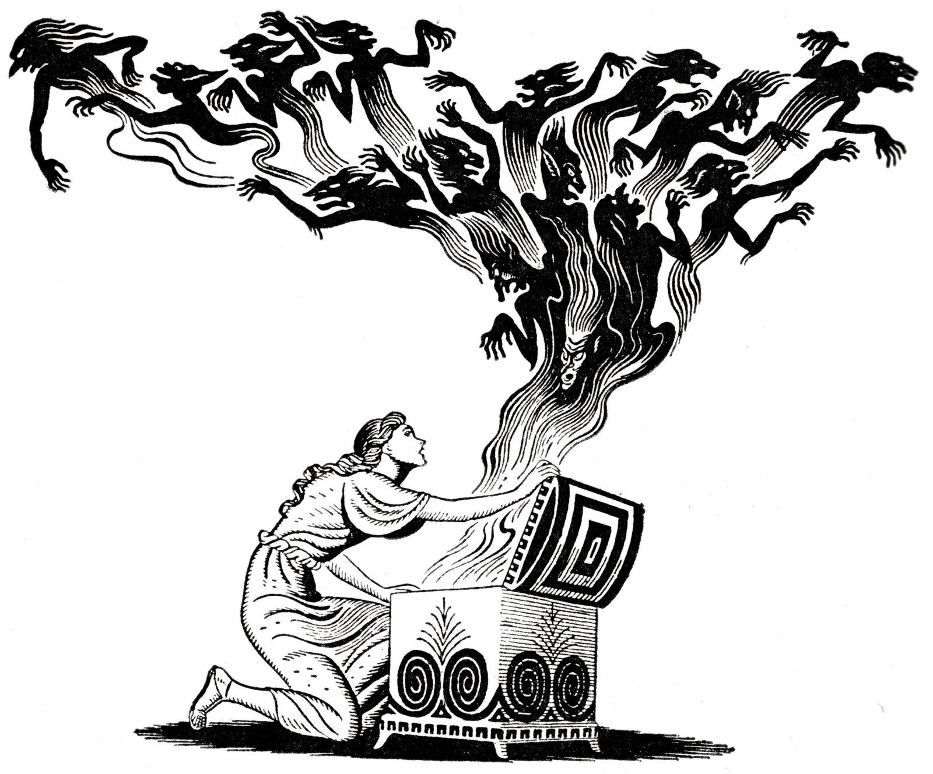
Pandora’s Box

Slide 2

Daily Review
Last Lesson
1. What is a storyboard?
Last Week
What did the drink that Zeus gave Cronus do?
Last Month
1. What is concrete poetry?
Last Term
1. What is a clerihew?

Slide 3
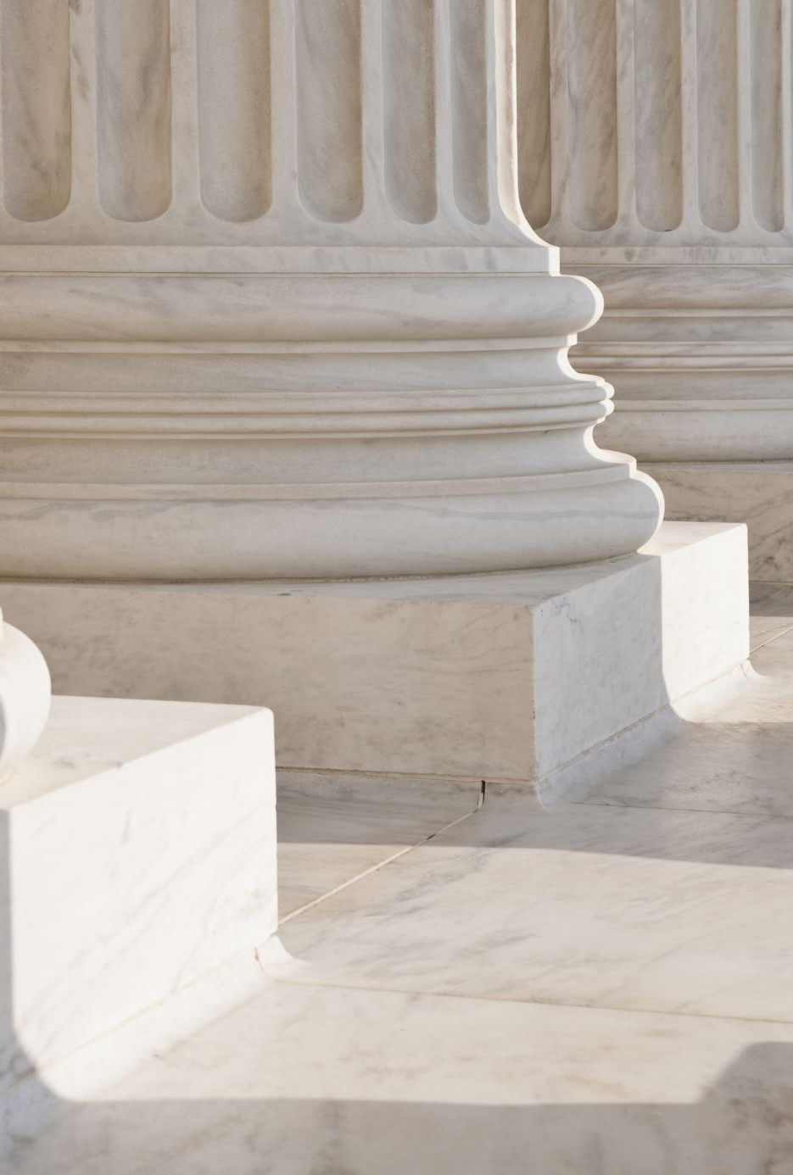
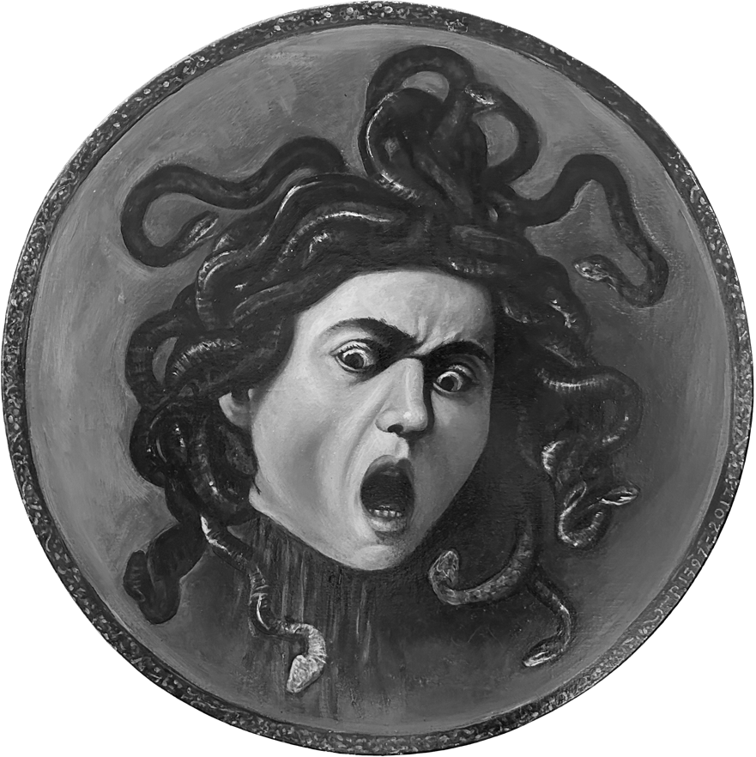
S1 Introduction to Greek Mythology
Plenary: What is the message of this myth
Learning Intention: To understand the story of Pandora’s box
Success Criteria: Answer questions accurately; contribute to discussions

Slide 4
Reading: Pandora’s Box
How does the writer’s use of sentence structure get the reader’s attention at the start of the passage?
What did Prometheus do to upset Zeus?
How was Pandora created?
Why did Pandora open the box?
What happened when Pandora opened the box?
What do you think is the lesson or moral of this story?

Slide 5
Reading: Pandora’s Box
Find examples of each of the three elements Pandora’s Box
The myths helped the Ancient Greeks to make sense of their world and the things that happened.
Many of the myths have a moral message to show the difference between right and wrong
The myths formed part of the Greeks’ polytheistic (multi-God) religion and told them about the things their Gods got up to, and often how mortals were selected for tasks by the Gods themselves.

Slide 6
Plenary: Moral of the story?
What is the overall message in the story of Pandora’s box?

Slide 7
S1 Introduction to Greek Mythology
Plenary: Favourite Scots Words
Learning Intentions
Knowledge: Of Greek myths and Scots words
Understanding: That Scots is a valid way to express ourselves
Skills: Using Scots dictionary
Success Criteria
Knowledge: Storyboard Pandora (Scots)
Understanding: Use Scots words confidently
Skill: Using Scots dictionary confidently

Slide 8
Daily Review
Last Lesson
1. Who is Pandora?
Last Week
How many Titans were there?
Last Month
1. Name a type of poem?
Last Term
1. What is a metaphor?

Slide 9
Dictionary Race – Pairs/Threes
Task 1: Use the Scots dictionaries to find the English word for the following:
Coup (verb)
Girn (verb)
Yowe (noun)
Keeker (noun)
Footery (adjective)
Task 2: In your pair/group discuss these words – which ones did you know, do you or your family have other words that mean the same thing? Note any down. (don’t worry about spelling)

Slide 10

Listening
Listen to this version of Pandoras Box.
Discussion
How easy was it to understand?
Words you recognised
New words – try to look them up
Writing
Storyboard “Scots Pandora” – Try to use Scots words in telling the story.

Slide 11
Plenary
Favourite Scots Words. Write your favourite two on the whiteboard
Homework
Create a colourful/eye-catching poster for your two favourite Scots words

