Slide 1
Scots Language
S2 Jeelie Piece

Slide 2
Starter - discuss with your partner
What do you think a ‘Jeely piece’ might be?
Can you think of any other Scots words for food or that describe food?
Look at the picture on the next slide and discuss with your partner where and when you think the photos are from.

Slide 3
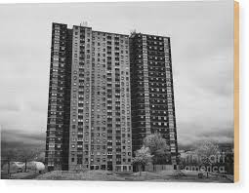
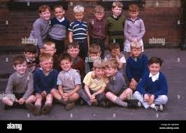
Where and when?

Slide 4
Learning Intentions
In our first Scots language lesson, we are learning to:
Become familiar with the Scots language
Translate words from Scots to English and English to Scots
Research words for Scots food and drinks.

Slide 5
Success Criteria
I can:
Understand the words of a song in Scots and the story behind it.
Research and remember words in Scots for food and drinks.
Use what I have learned to create the idea of my perfect snack.

Slide 6
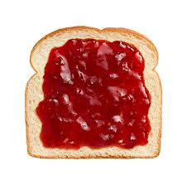
Scran: n. Food in general, especially in odd or miscellaneous pieces, provisions, “grub”.
Piece: a piece of bread and butter, jam, or the like, a snack, usually of bread, scone or oatcake, a sandwich.
Jeelie piece: bread and jam; the most common kind of piece in Scotland, often provided as a snack between meals. By extension, a piece came to mean the sandwich lunch carried to work by the working man.

Slide 7
Song
In parts of Glasgow, mothers would sometimes throw a piece out of the tenement window for a child to catch. When high rise flats were built to replace the 3-storey tenements in the 1950s, this became a little more challenging! The song writer Adam McNaughton produced his response to this in his ‘Jeelie piece sang’ in the 1960s.
Skyscraper wean

Slide 8
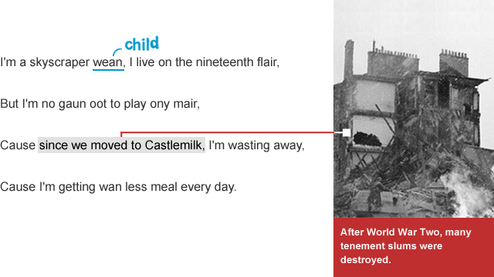

Slide 9
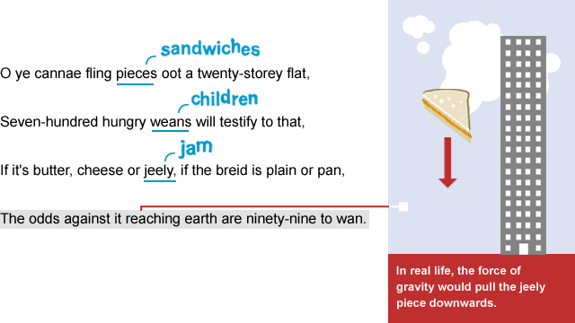

Slide 10
Verse 1
I'm a skyscraper wean…
What does "wean" mean?
What is a skyscraper?
'

Slide 11
Verse 1
It's the Scots word for "child". This means it's a word that some people in Scotland use that probably isn't used anywhere else.
What word do we use for child in Aberdeen / Aberdeenshire?
Looking at foreign languages - what is the word is for "child" in French, Spanish or Mandarin?

Slide 12
Verse 1
Cause since we moved tae Castlemilk...
This is a reference to the slum clearance that happened after the war - millions of people moved from tenements, in areas such as the Gorbals in Glasgow, to blocks of high rise flats.
What is a tenement?
Why do you think the councils were keen for high rise flats rather than replacing tenements?

Slide 13
Chorus
Ye cannae fling pieces oot a twenty-storey flat

Slide 14
Chorus
If it's butter, cheese or jeely, if the breid is plain or pan
Looking at Scots language and history, what's the difference between a plain and pan loaf?

Slide 15
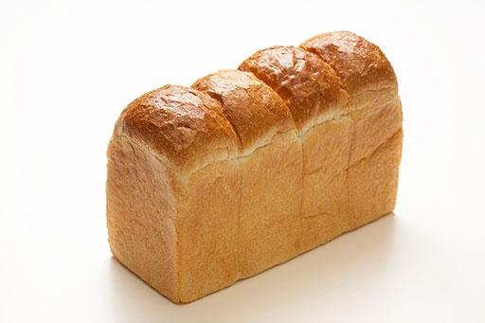
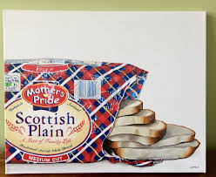
Plain or pan loaf?
Plain or Pan – The old “Jeely Piece” song brought together the comparison of plain or pan. Basically, plain bread is batch bread, meaning loaves are cooked together, leaving the crust on the top and the bottom. Pan bread is bread made in a bread tin.

Slide 16
Chorus
The odds against it reaching earth are ninety nine take wan….
What does this mean?

Slide 17
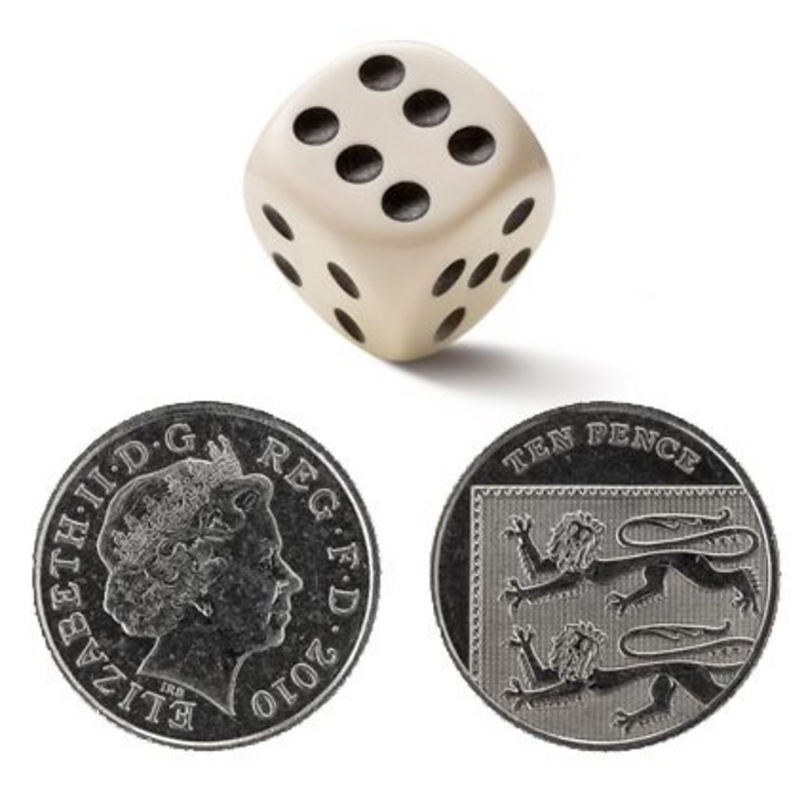
Odds
The chance of rolling a six is one in six but the chance of heads or tails is 50:50

Slide 18
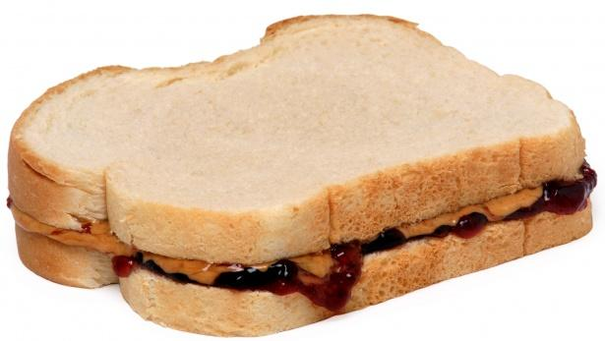
The odds of something
Out of a hunner (100) throws, how many times will the ‘piece’ reach earth if the odds are ninety nine tae wan?

Slide 19
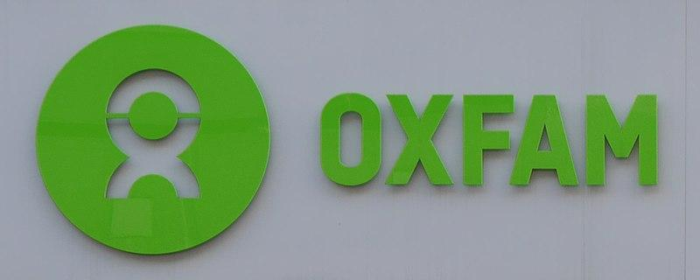
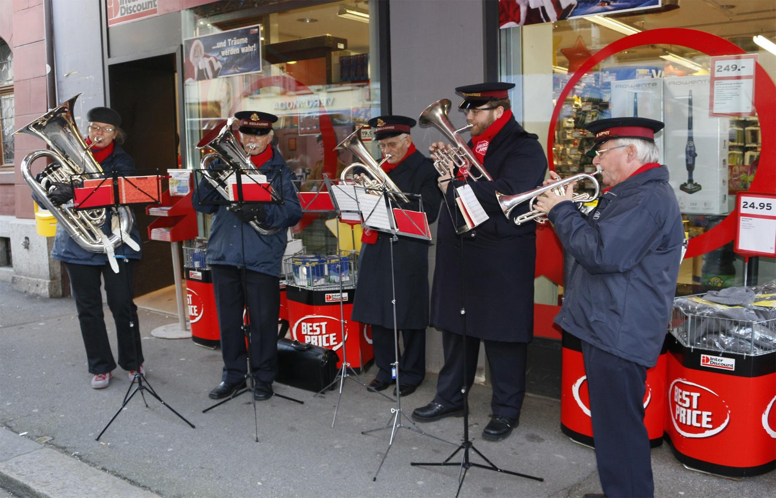

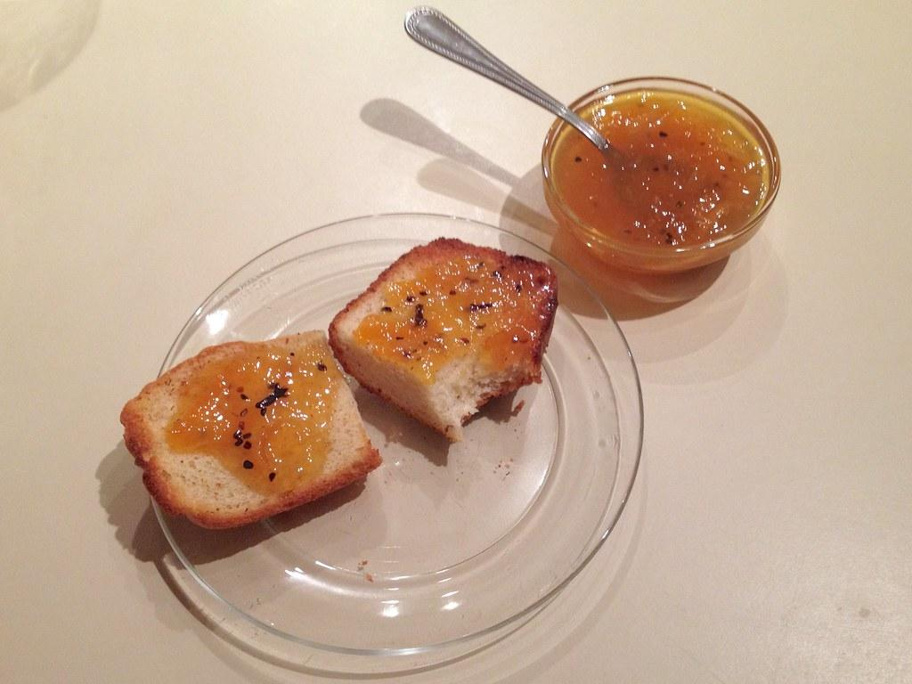

The rest of the song…
Now watch and listen to the song again.
Translate as much as you can from verses 2 to 5.

Slide 20
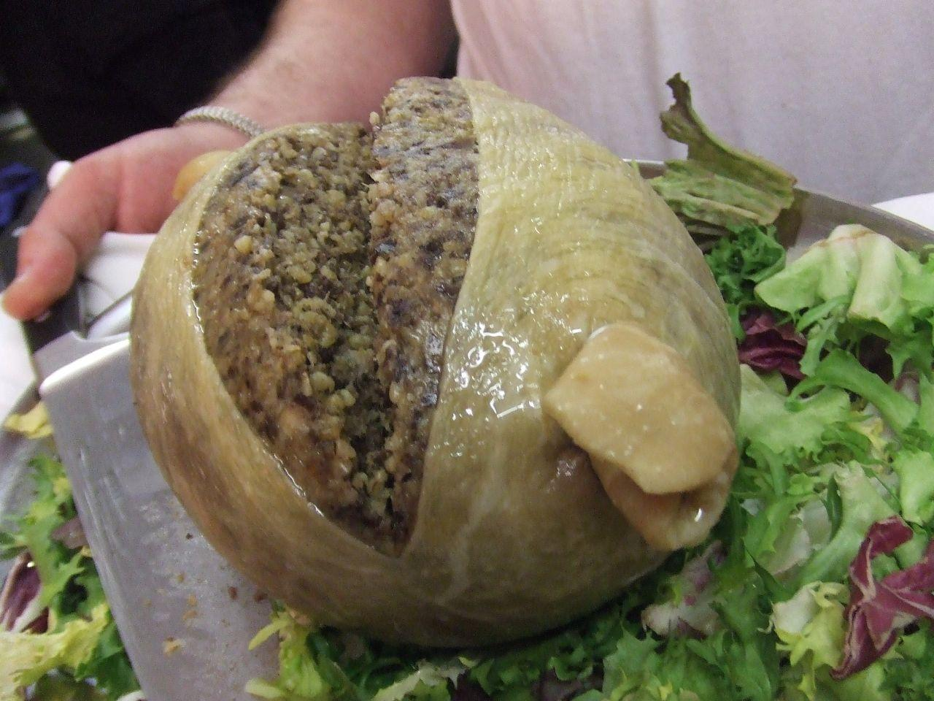
Activity
What are the foods on the list that you have been given? You can use Google or the Scots dictionary online to help.
https://docs.google.com/document/d/1rwcHG8gZvCsIym0kGCwNfMzkZavkOHy5uweqS3UlpEE/edit?usp=drive_link
https://dsl.ac.uk/
Now create a recipe for a meal using these foods.
Use as many Scots words as you can.

Slide 21
Plenary - feedback
Is Scots something you would like to learn more of?
Why? / Why not?
What would you like to learn about in Scots in the future?
What did you like about this lesson?
What would you change about this lesson?

