Slide 1
Lesson Objectives
At the end o this lesson I will be able to -
Understand and explain the context ahint the poyum Address tae a Haggis.
Understand, describe and explain the language and main argument o Address tae a Haggis.
Mak ae pom-pom Haggis. A skill that can be taken into a care setting.

Slide 2
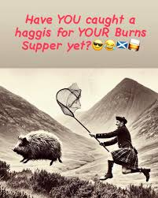
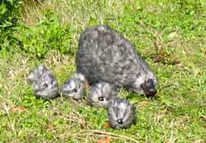
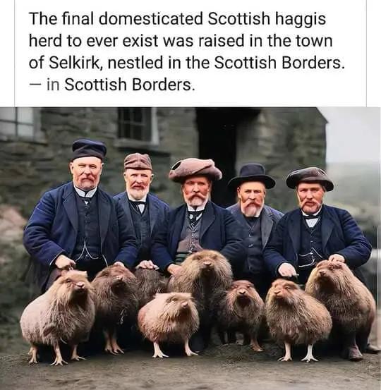
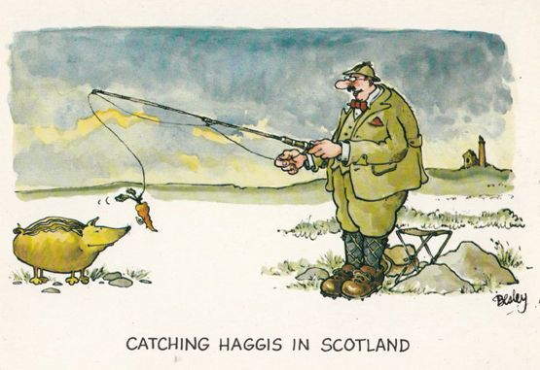
A 2003 poll (via The Guardian) of 1,000 U.S. tourists in Scotland revealed that one-third believed haggis was a wild animal, and the majority of these came to Scotland thinking they would catch one.
SUMMON THE HAGGIS! #Staged #iPlayer

Slide 3
What is Haggis?
How to Make Haggis

Slide 4
Who invented the Haggis?
The Greeks?
The Romans?
The Vikings?
The French?
The English?
The Scottish?

Slide 5
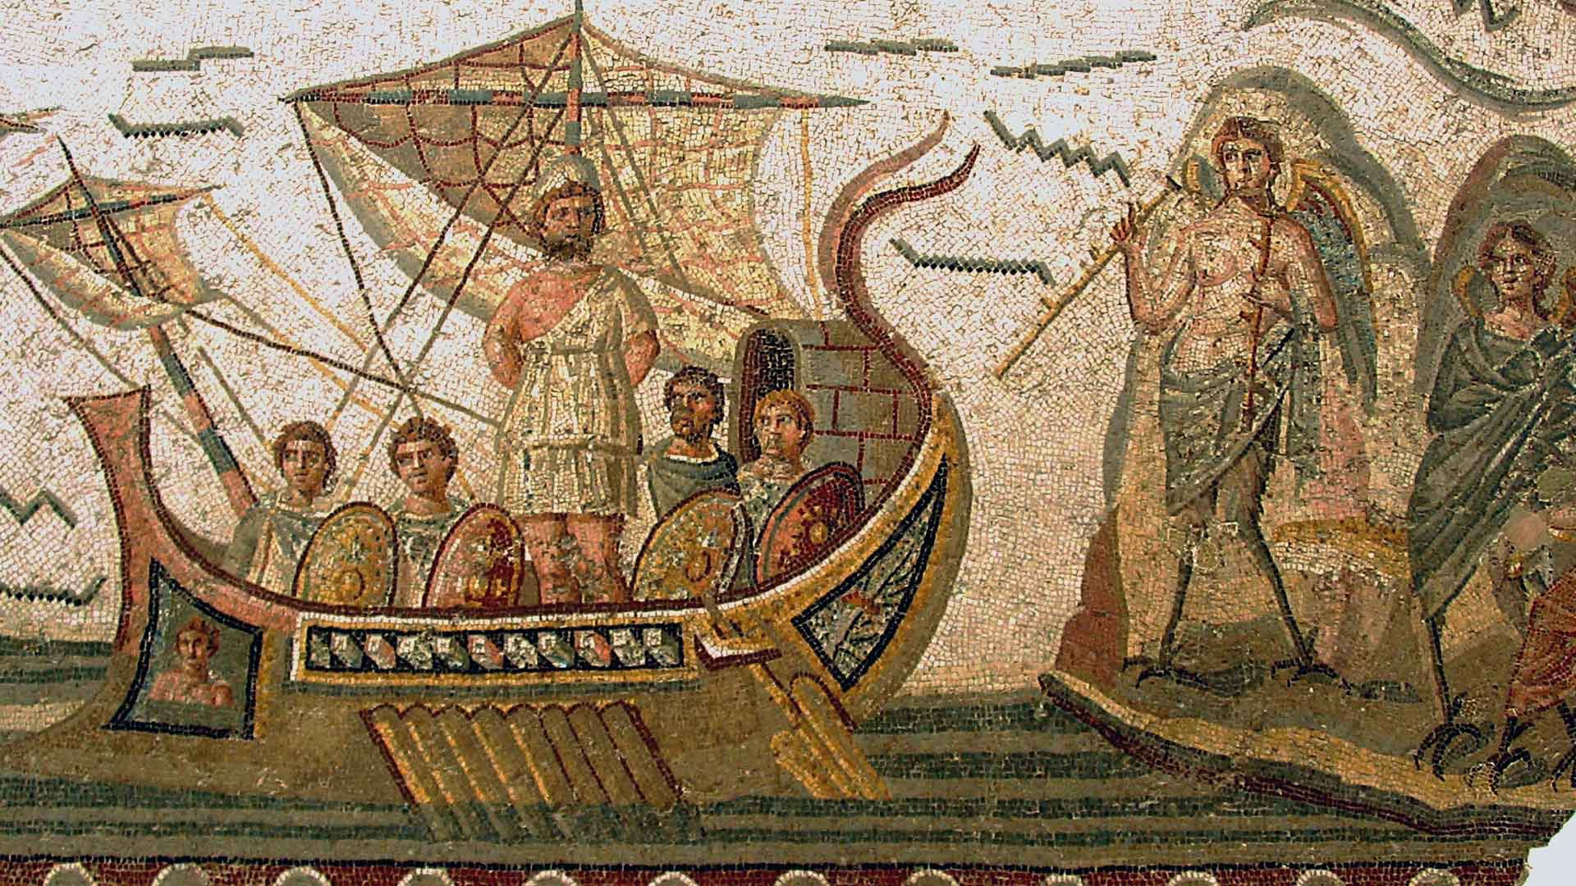
The Greeks – Homer’s Odyssey describes Odysseus watching a haggis being made.

Slide 6
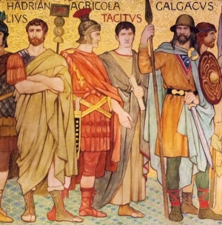
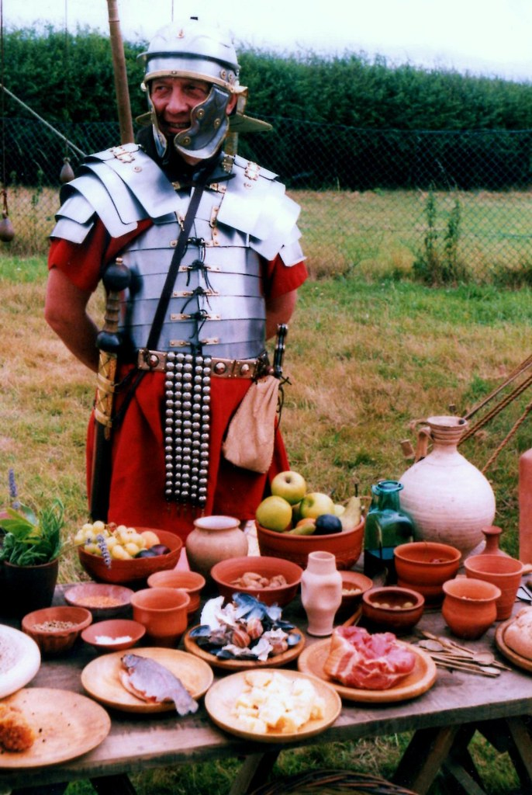
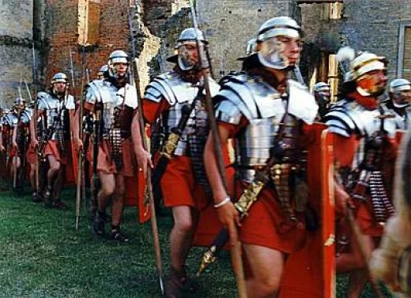
The Romans?
The Romans prepared their meat in a style similar to a haggis to keep it fresh for longer while they were on the march.

Slide 7
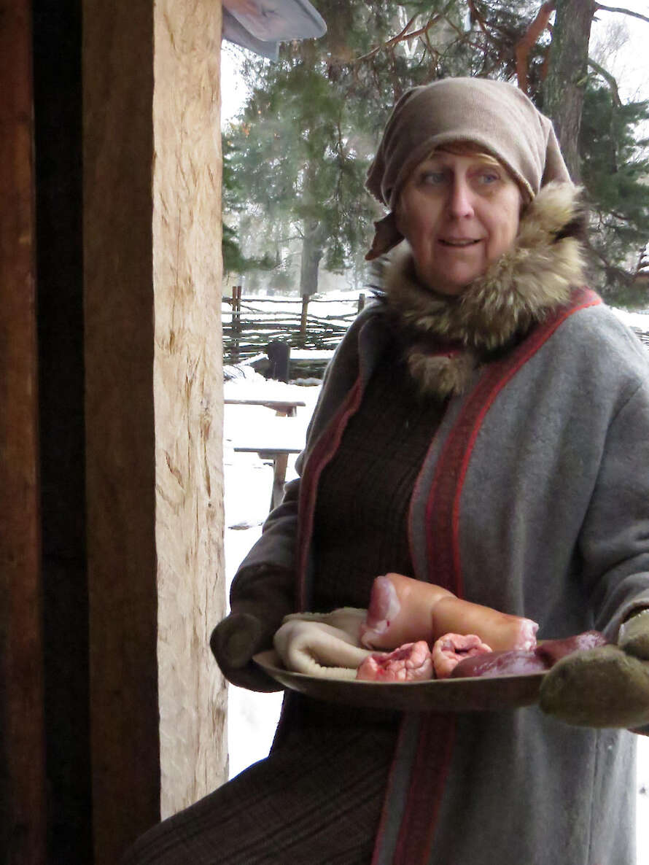
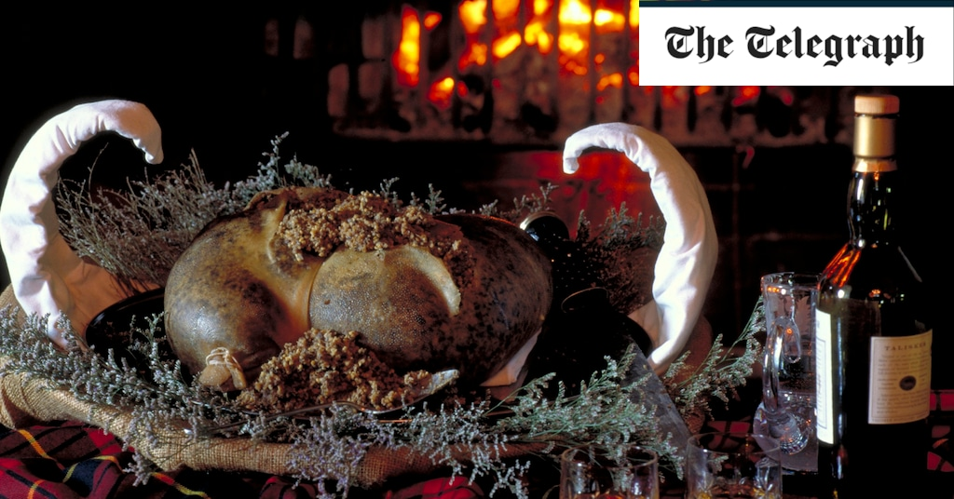
The Vikings?
Some historians have suggested that the word haggis is derived from the Old Norse haggw which means ‘to chop’. Therefore haggis would originally have meant ‘chopped up stuff’ and referred to the method of preparing the offal before it was stuffed into its stomach casing.

Slide 8
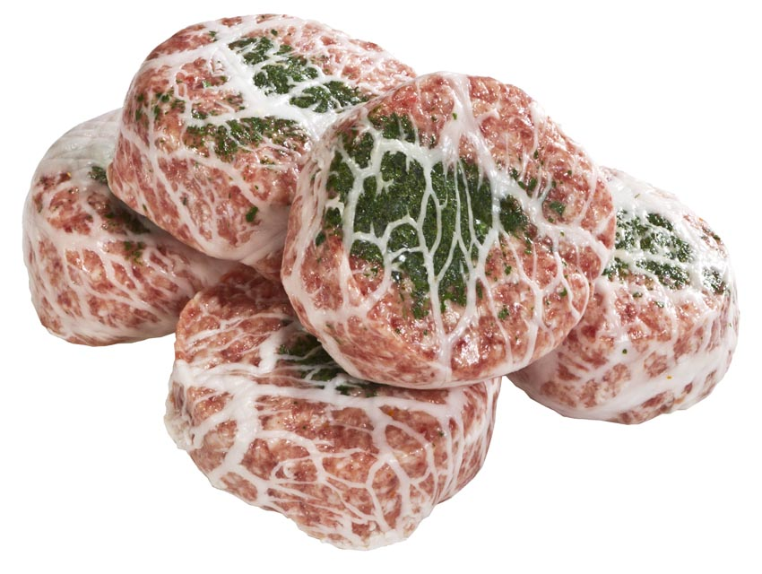
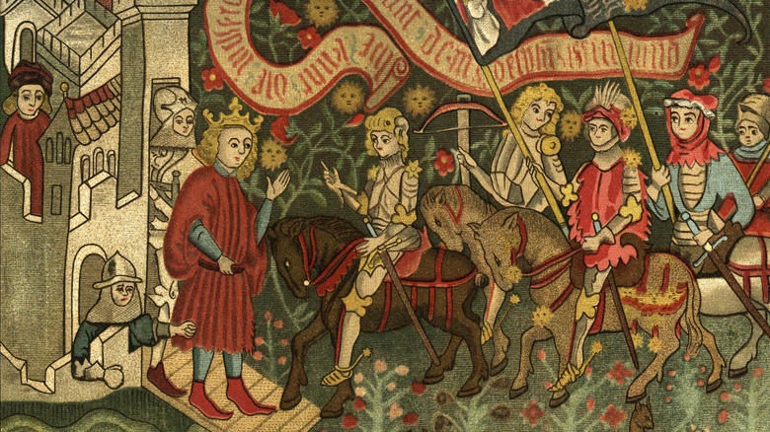
The French?
Hag is similar to the French verb hacher, which means ‘to chop’. Given the Auld Alliance between France and Scotland it is possible that some sort of precursor – not dissimilar to the modern crépinette – might have been brought over at some point after c.1295.

Slide 9
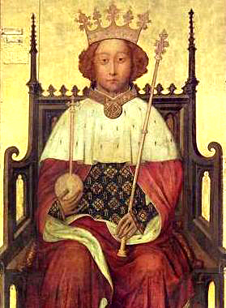
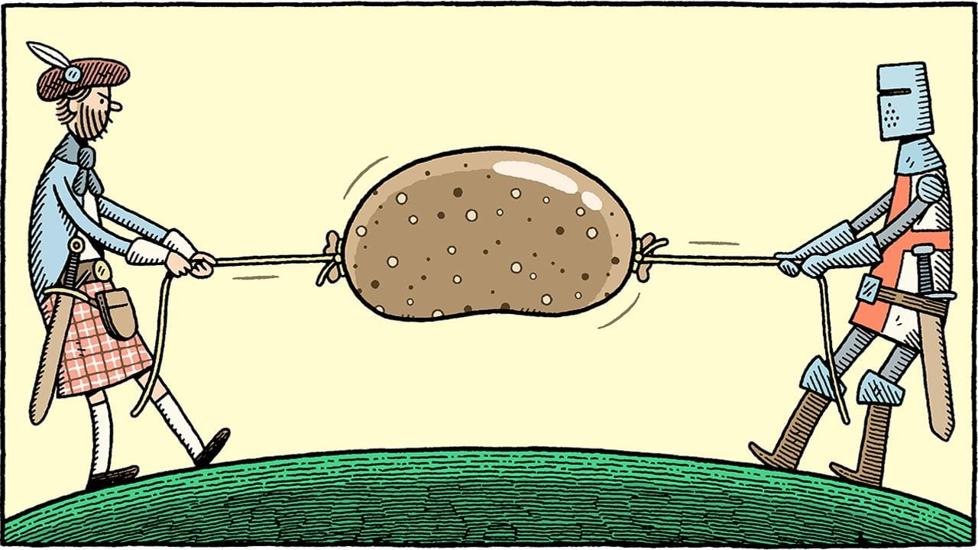
The English?
The earliest references to a dish recognisably similar to haggis come from England. There is a recipe for it in The Forme of Cury (c.1390), a rudimentary cookery book written by ‘the Chief Master Cooks of Richard II’.

Slide 10
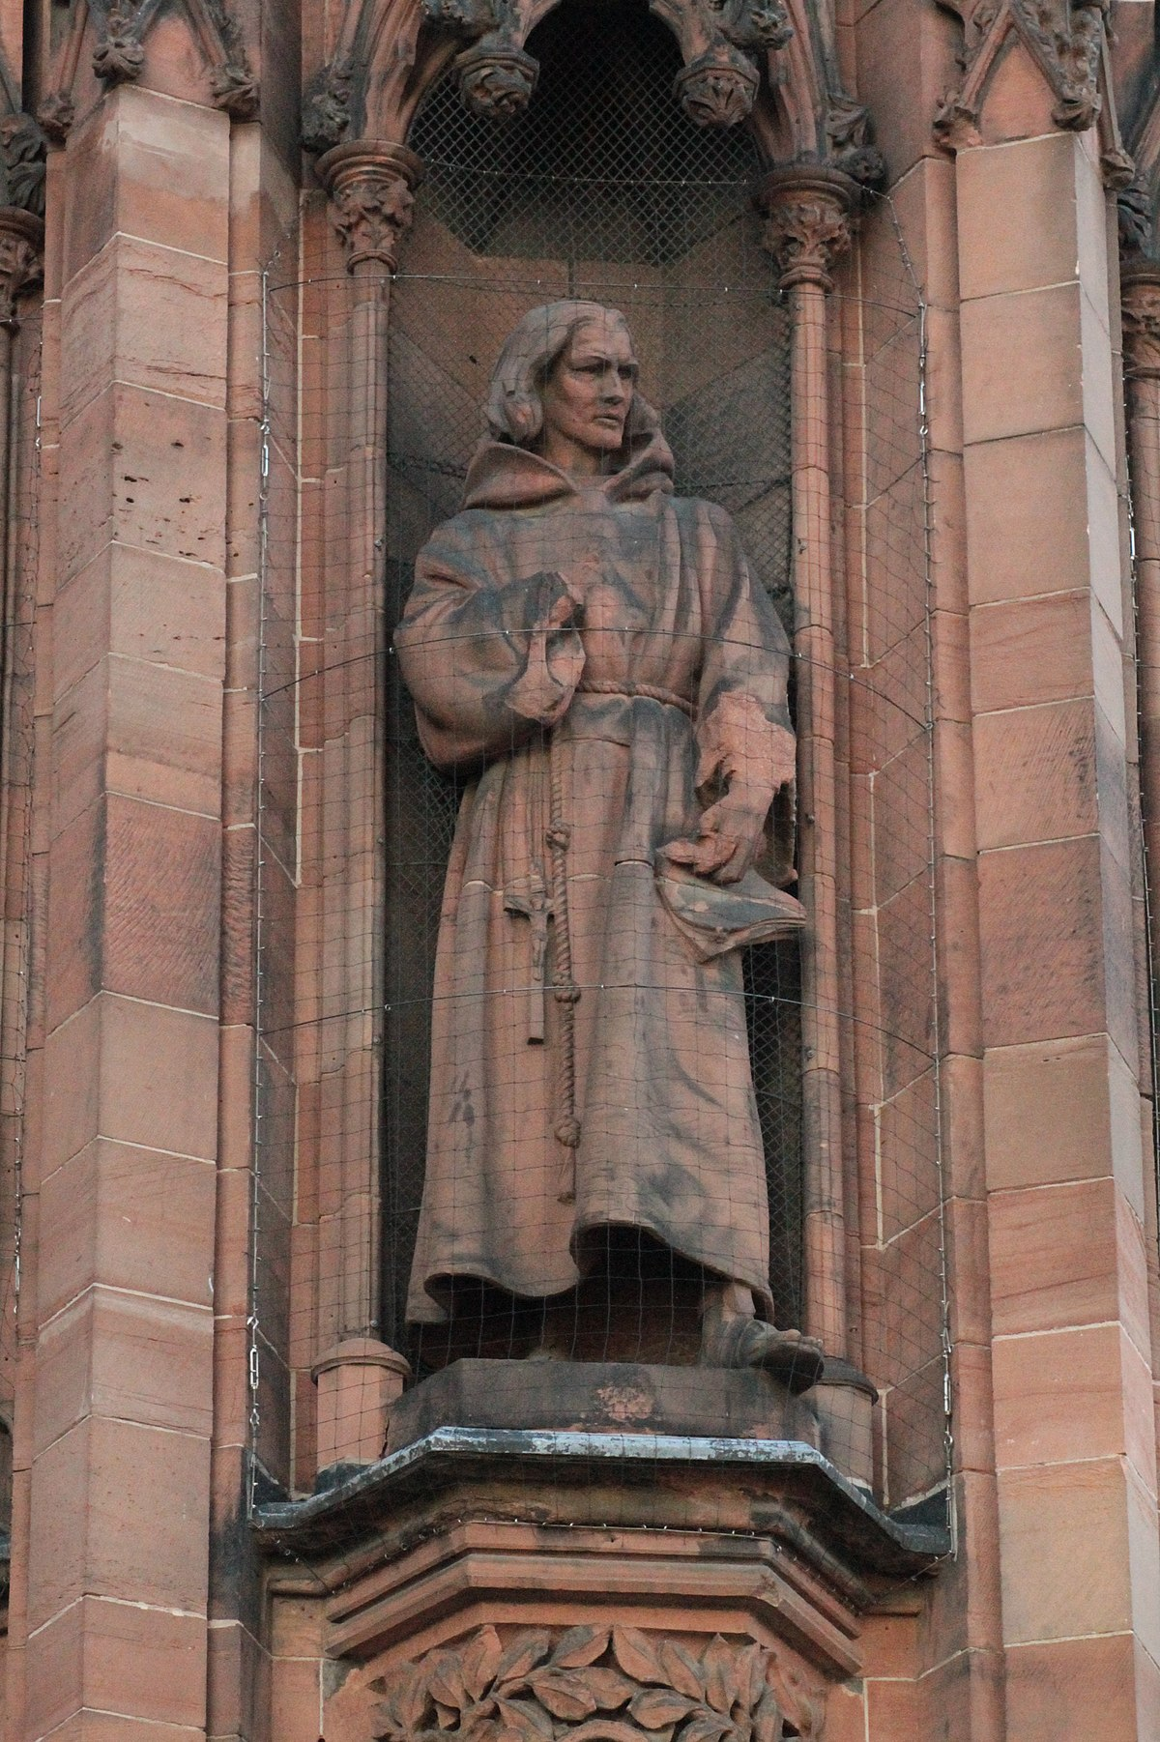
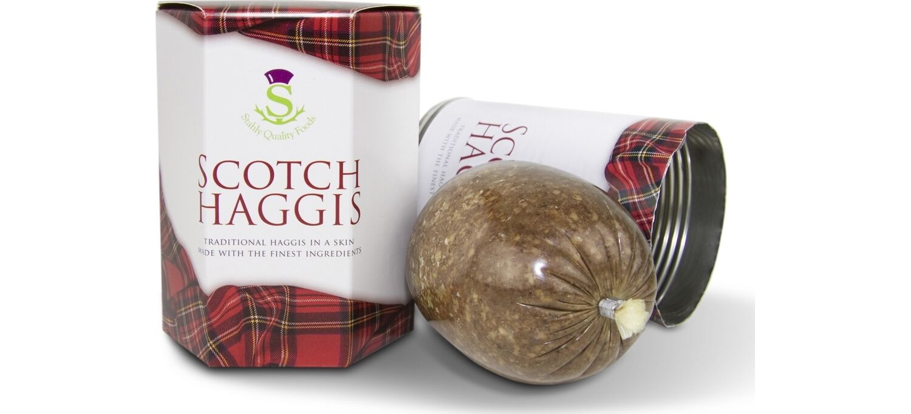
The Scottish?
The first mention of Haggis in Scotland appears c.1513 in a verse by William Dunbar, a makar at the court of James VI. His poem does not claim haggis as a distinctively Scottish dish. It is just described as something people ate.

Slide 11
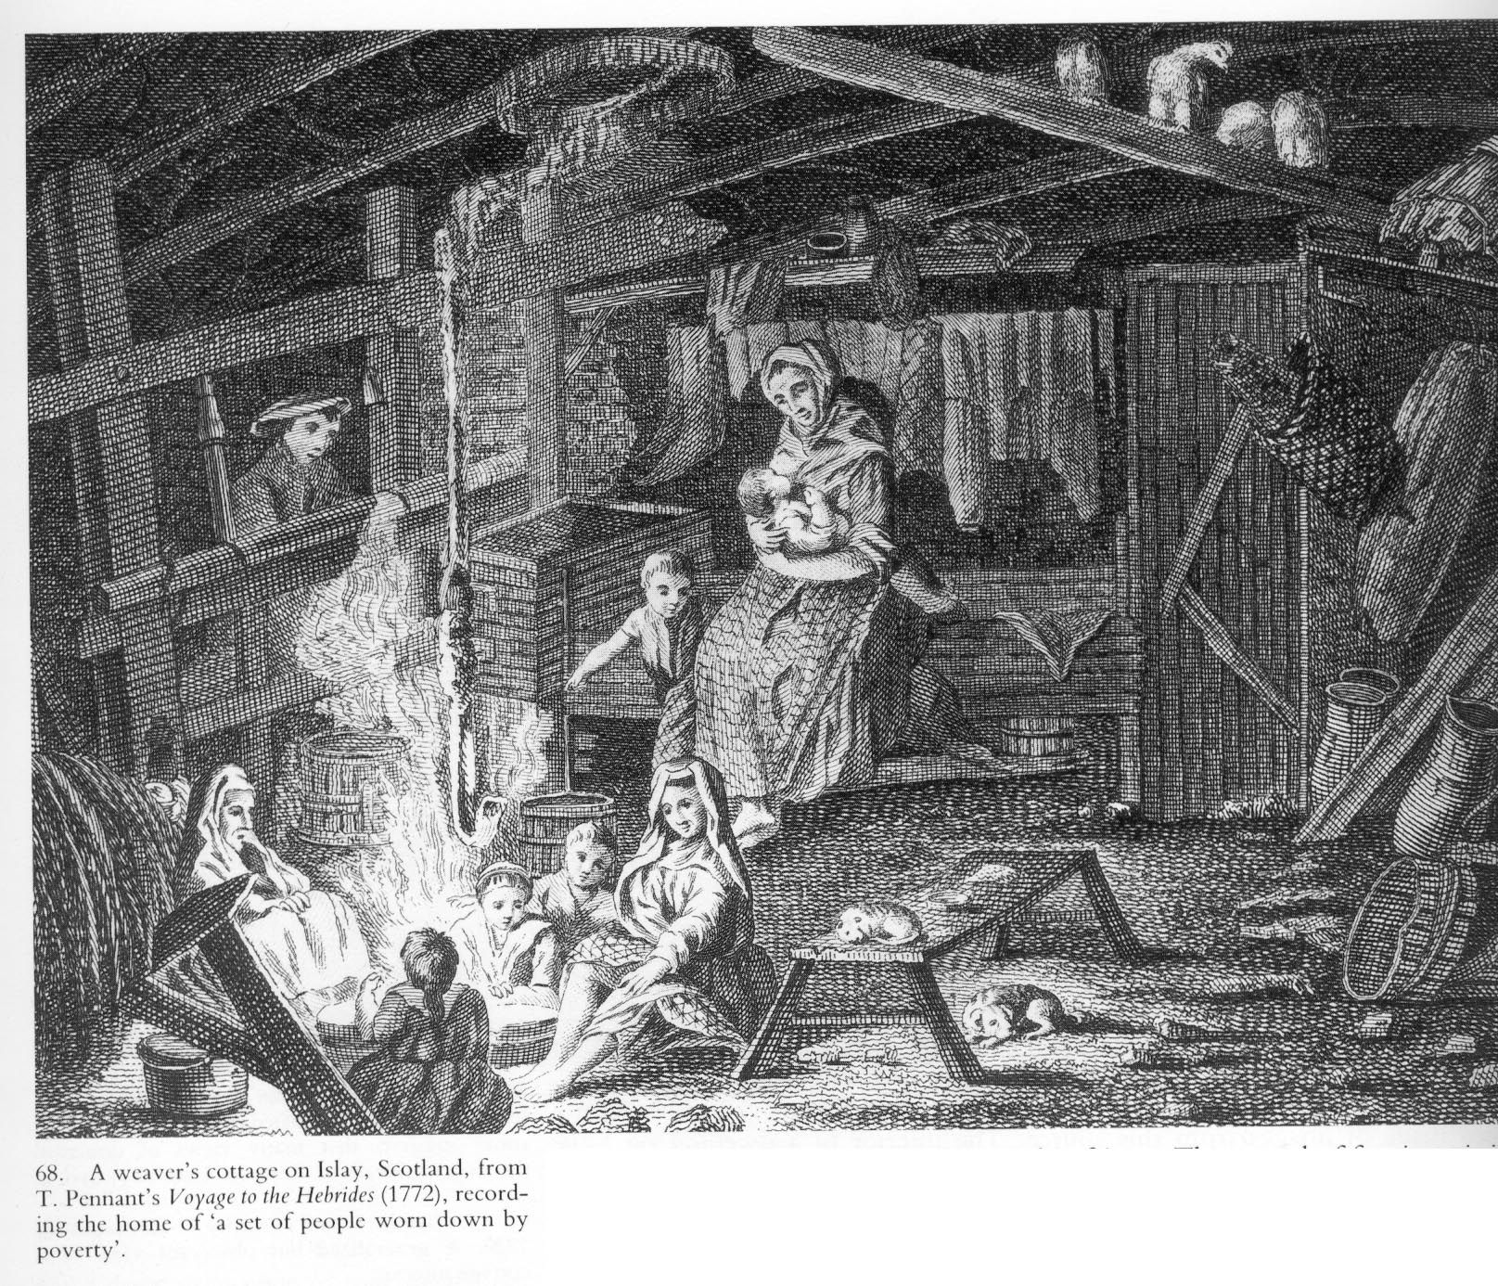
How did Haggis become Scottish?
In the eighteenth-century living conditions in England improved as the Industrial Revolution took hold. As the English started eating better quality food they stopped eating haggis. However, Scotland remained a poor country where haggis was still eaten.

Slide 12
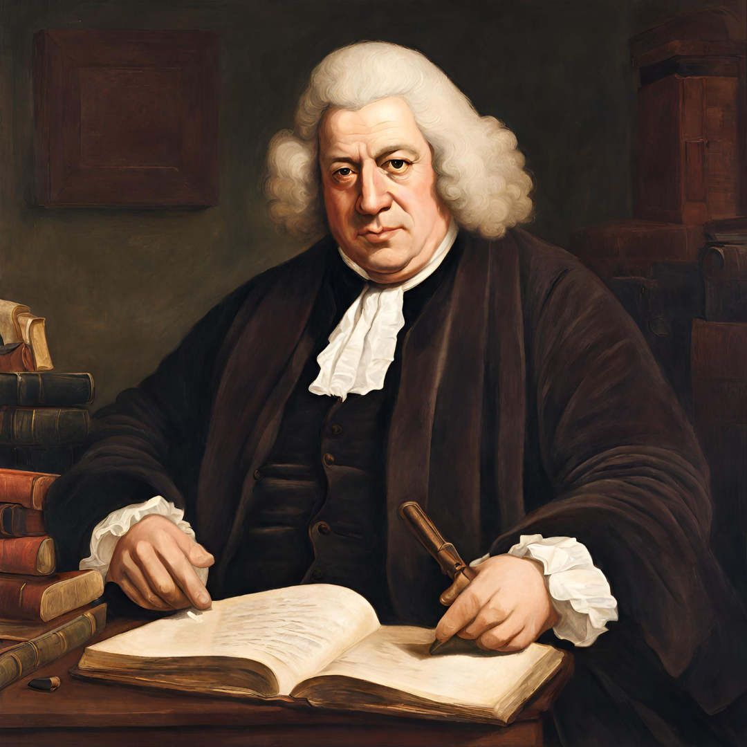
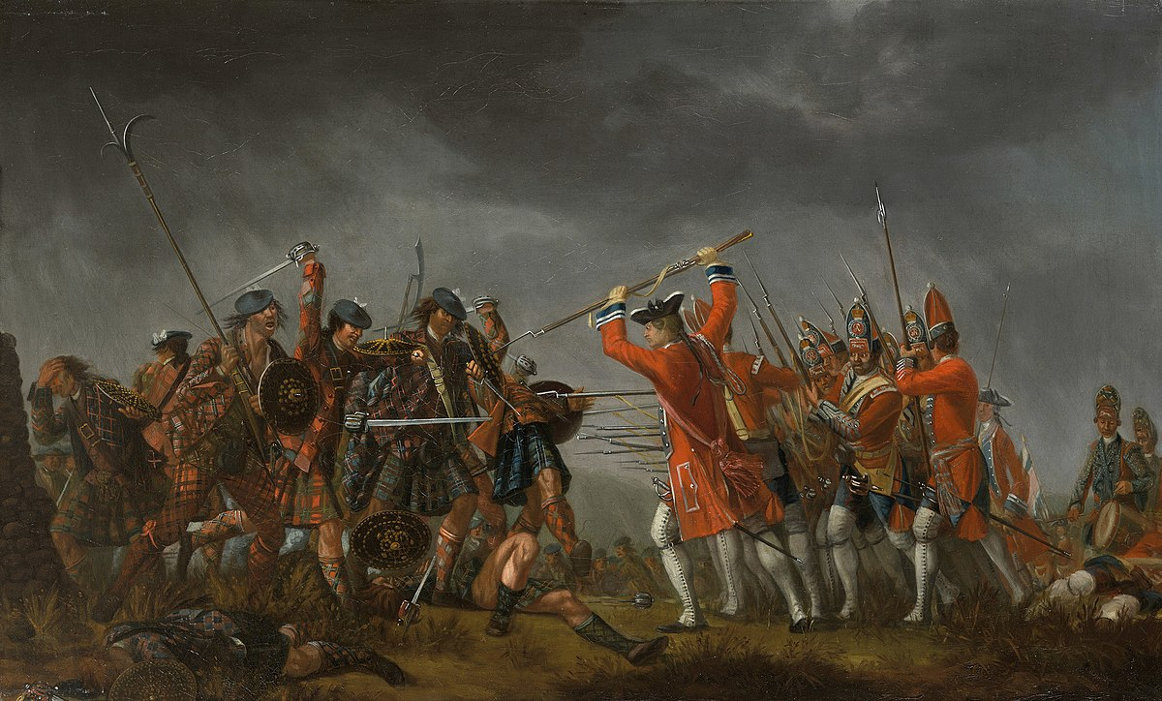
Haggis Eaters!!!
The Jacobite Risings in 1715 and 1745 had made the English resentful of Scots. Vitriolic attacks were published in the press. Food was a common focus. The perceived poverty of Scottish fare was used to deride the manhood – and even the humanity – of Scottish people. In his Dictionary published in 1755, Samuel Johnson defined oats as: ‘A grain, which in England is generally given to horses, but in Scotland supports the people.’

Slide 13
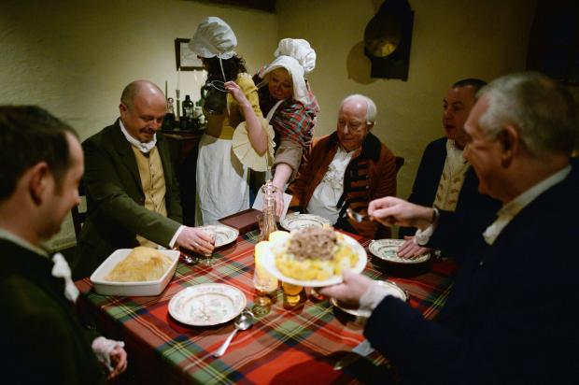
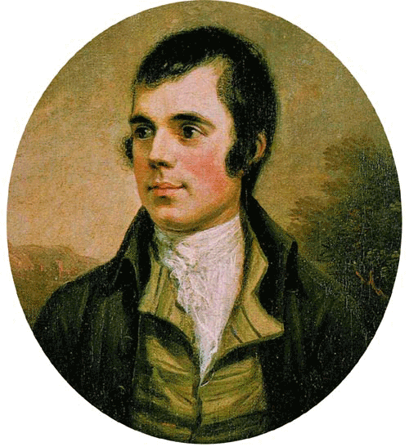
Address tae a Haggis
In response the Scots made a conscious effort to define themselves as ‘different’ from the English and to claim haggis as their own. In Robert Burns’ ‘Address tae a Haggis’ (1786) Burns acknowledged that there was a connection between food and character, but turned it to the Scots’ advantage. Other nations might have their ragout, olio, or fricassees, he argued; but that sort of food only turned a man into a weakling, Haggis, by contrast, was the sort of food real men were made of. If the English wanted to sneer at it, that was their business – but they’d better watch out!

Slide 14
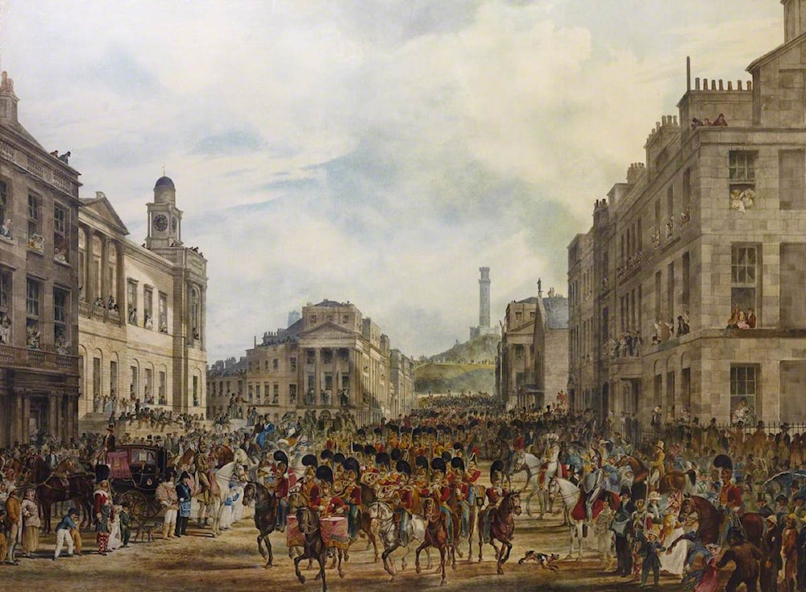
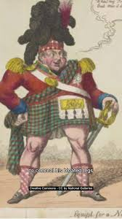
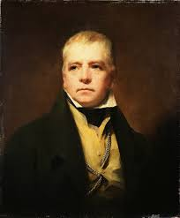
Sir Walter Scott – the man who invented Scotland
In 1822 George IV visited Scotland. His stay in Edinburgh was choreographed by Walter Scott, who was so anxious to make Scotland attractive that he invented a new ‘tradition’ of Scottishness.
At the banquet thrown in the king’s honour, everyone was decked out in tartan (previously only worn in the Highlands and Islands); and care was taken to select foods that reflected ‘Scottish’ identity – including haggis.
George IV’s visit ignited a craze for all things Scottish and Haggis started to be eaten in England again.

Slide 15
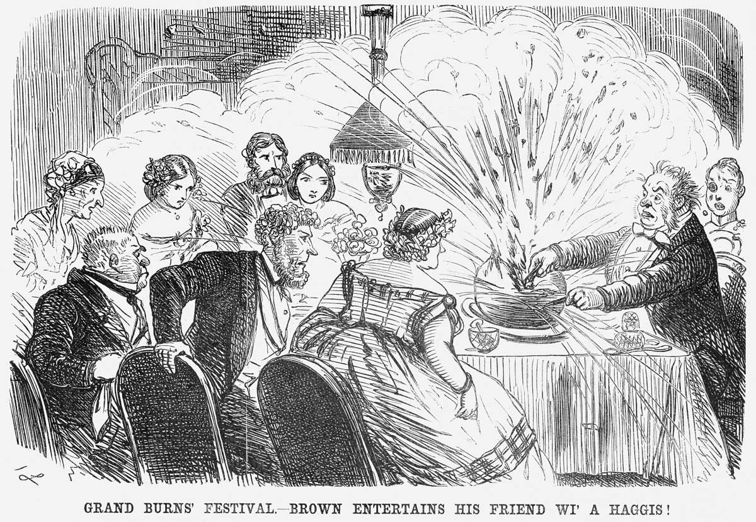
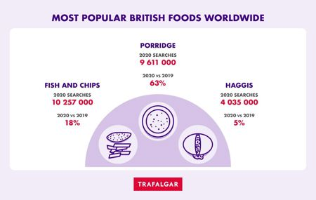
Haggis goes global!
With the renewed interest in Scottish culture Burns suppers became major events; and haggis was eaten in ever-growing quantities. Scots living abroad took haggis with them. By the late 19th century, haggis was widely recognised as the ‘national’ dish of Scotland.

Slide 16

Robert Burns, Address tae a Haggis 1786
Robert Burns 'The Address to the Haggis' Explained

Slide 17
Scottish Actors n ithers perform Address tae a Haggis
Address to a Haggis | Burns Night 2024 - YouTube

Slide 18

Hamish the Haggis Pom-Pom

