Slide 1


The Scottish Witch Trials
Copy doon the title and write the day’s date
Lesson 6

Slide 2
Stairter Task
Freeze Frame Challenge
As a group choose ae aspect o a witch trial.
You must create a freeze-frame tae show this. It’s like the mannequin challenge!
Abody in your group (table) needs a character.
Each character must hae at least one thoucht aboot fit’s gan on in your scene – your teacher will spier at you at random!

Slide 3


Learning Intentions:
To investigate foo witches were pit on trial and punished in 17th century
To explore a Scottish case study
Success Criteria
To be able to identify the key events in an Aiberdeen Witch Trial
To work thegither to mak a judgement aboot fit verdict should hae been made in the trial
To be able to explain fit happened at the trial

Slide 4
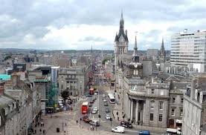
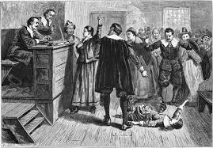
Aiberdeen Witch Trial
Between 1597 and 1669 records show that at least 34 witches were tried in and around Aiberdeen.
Mony o these were foond in Inverurie or Kirriemuir and were caught by the local witch finder Dean Dun
The maist famous Aiberdeen witch trial was een that saw sivven witches tried for using magic to murder others!

Slide 5
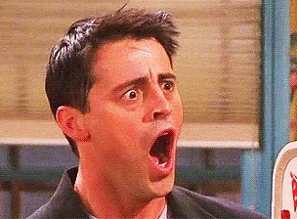
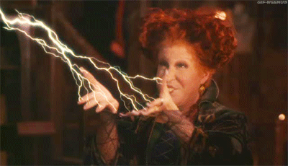
Ither charges included:
Raising storms
Casting love spells on young loons fae roonaboot
Poisoning meats
Casting spells on beasts
Killing hairsts
Makkin wax figures and torturing people wi them.

Slide 6
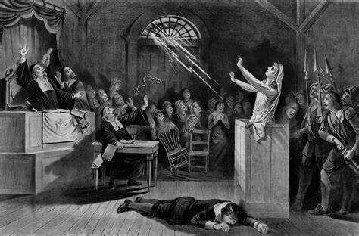
Trial Re-enactment
We are noo gan tae re-enact een o these Aiberdeen Witch Trials.
Main characters:
Janet Wishart – The Accused Witch
Margaret Ogg - The Accuser
Tam Leslie - Deputy Sheriff o Aiberdeen
Andra Clark – toon Prosecutor
John Milne – wife dees after being cursed by Janet
Kate Sutherland – bairn died at birth

Slide 7
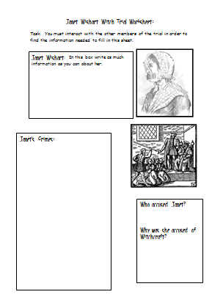
Trial Re-enactment
The rest o the class are gan tae act as the crowd, gaithering information fae these main characters tae fill oot your witch trial worksheet.
Activity 1 – hae a blether wi each o the main characters, spier at them in order to fill oot your worksheet.
As a class you will be able tae spier 5 questions in total, choose wisely.
Notes:
Select 6 pupils to volunteer for the role and give them a role card each

Slide 8
Activity: We’re gan tae re-enact een o these Aiberdeen Witch Trials.
Trial Re-enactment
Noo the characters are gan tae explain their sides o the story and try tae prove fit happened here by re-enacting the trial.
Activity 2 - Fit crimes was Janet Wishart accused o? – Listen during the trial and see if you can list aa o Janet’s crimes on your worksheet
Activity 3 – Fit wye div you think Janet was accused o these crimes? Fa do you think was responsible for accusing her and fit wye did they dee this?
Notes:
Ask pupils with cards to stage the trial using the cards with teacher as facilitator and roles in place. The rest of the class become the jury.

Slide 9
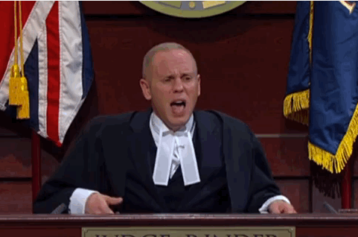
Final Verdict
Is Janet Guilty or nae?
Jury will vote and the judge gets the final say
Notes:
verdict

Slide 10
Source A is details of the Trial of Janet Wishart, Accused of Witchcraft and is taken from the Aberdeen city council record written on the 17th February 1597
The Ootcome…
Name: Janet Wishart
Dates of the Trial – 2/2/1597 – 12/2/1597
The accused Janet Wishart has been named another witch by the name of Margaret Ogg. Said trial was held in the Toolbooth, Aberdeen. It is accused that Janet Wishart is guilty of the following crimes; delaying the birth of a child and causing said child to be born stillborn, casting spells and cantrips, taking the shape of a dog, meeting with other witches and the devil in Fittie church yard, spoiling ale, trying to poison a child, causing storms in the North Sea.
Janet Wishart has been duly found guilty of all charges and the court has sentenced her to execution. The sentence will be carried out on the 17th of this month, the accused will be burned at Gallowgate.
Signed
Thomas Leslie (Sheriff – depute)
James Stewart (Chancellor – Aberdeen)

Slide 11
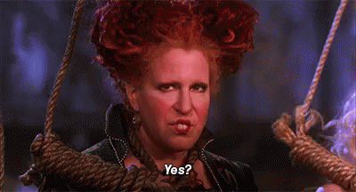
Aiberdeen Witch Trial
In the end mair than 20 weemen and ae mannie were foond guilty o witchcraft.
They were punished by burning at the stake
If they werena foond guilty they were branded as a witch onywye and banned fae living nearhand.

Slide 12
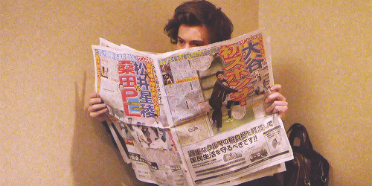

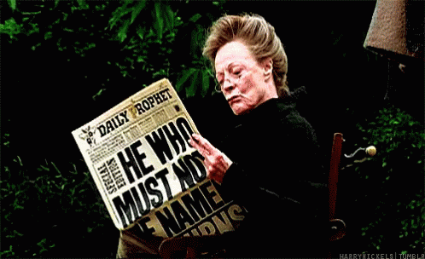
Final Task
Imagine you are a news reporter at the time o Janet’s trial and execution. Skrieve a newspaper heedline aboot the events.
CHALLENGE:
Mak a judgement: div you hink fit happened tae Janet was fair or unfair? Fit wye div you hink is?

