Slide 1

S3 Humanities
Mrs C Macleod
Scots Language and
Self-Expression

Slide 2

Welcome!
Fàilte don turas inntinneach seo!

Slide 3


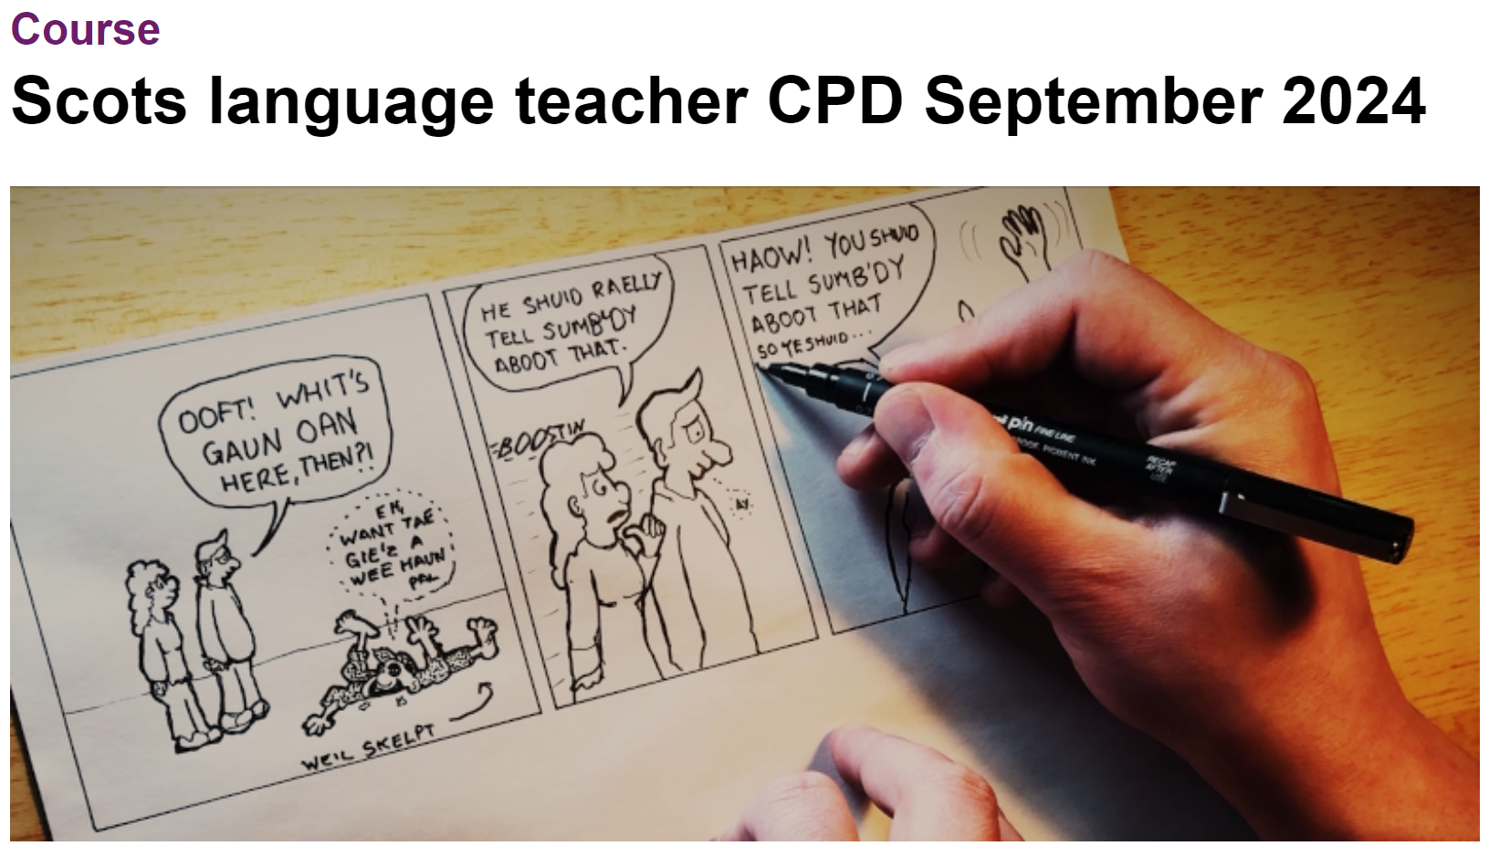

Scots Language CPD Course
You might remember me saying that I’m doing a CPD course this year all about using Scots Language in learning and teaching.
Please can you help me with my homework for unit 6? ☺

Slide 4
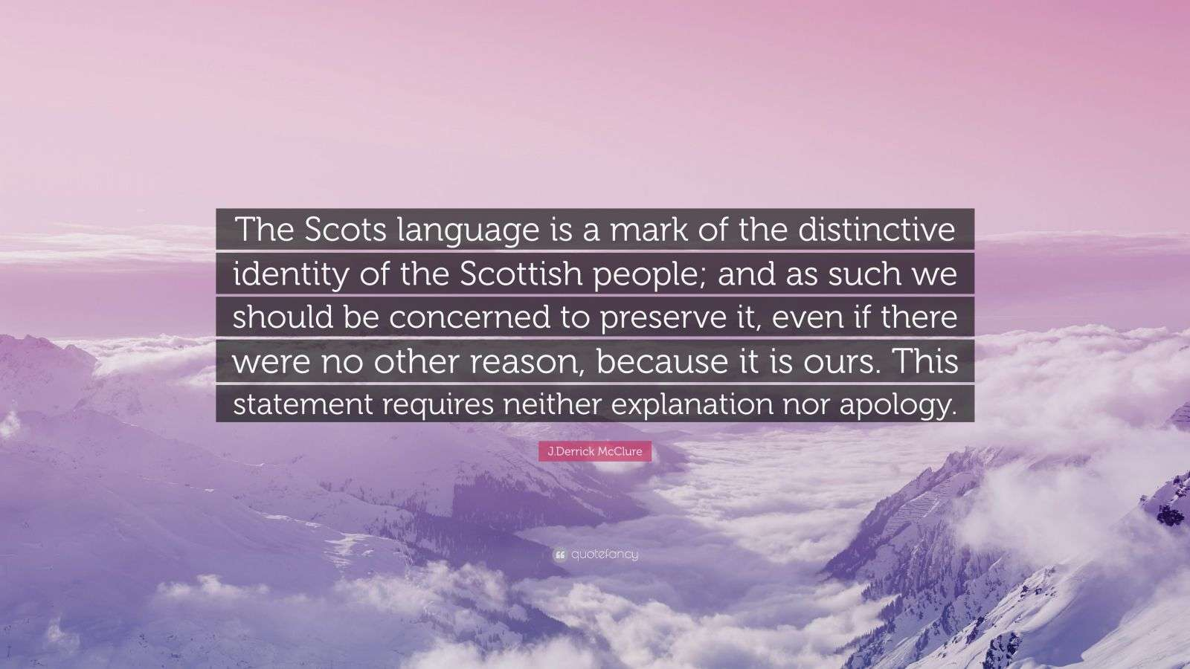
Scots Language in the Creative and
Expressive Arts
Today we will think about how Scots language can be used as a form of self-expression and how, for some, Scots is an important part of their identity.
At i-Sgoil, we put a huge importance on individuality and inclusivity – we want everyone to be able to express themselves authentically.
This could include using Scots if it is a language that you have grown up with or around.

Slide 5
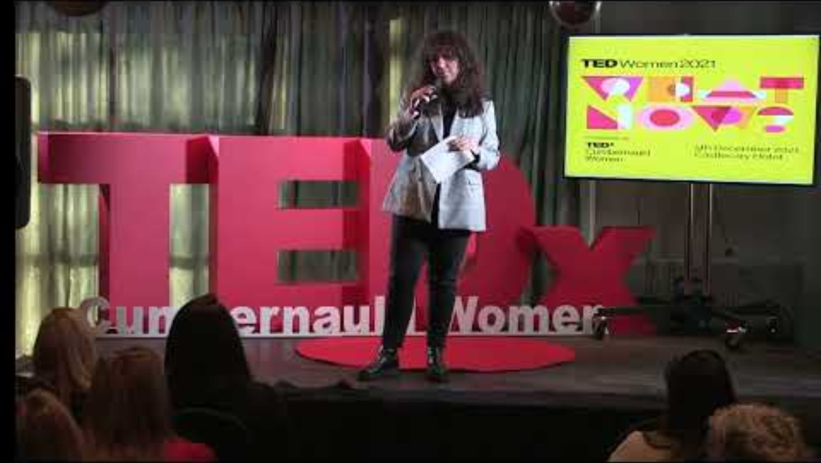
‘Whit Noo?’ Lisa Kennedy
Notes:
https://www.youtube.com/watch?v=v1rIkumy4cQ – 2 min 41

Slide 6
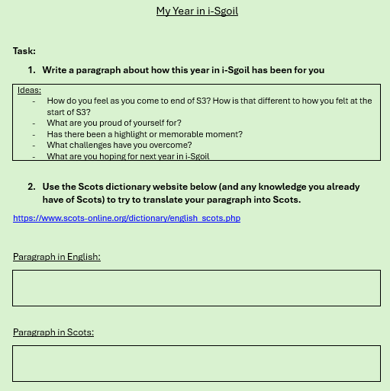
Your Year in i-Sgoil
Task:
Write a paragraph explaining how this year at i-Sgoil has been for you
Use the Scots dictionary (and any knowledge you already have of Scots) to try to translate your paragraph into Scots.
https://www.scots-online.org/dictionary/english_scots.php

Slide 7
My Year in i-Sgoil
I have enjoyed this year in i-Sgoil more than any other so far. I have loved getting to know learners more and seeing their journeys. I am constantly amazed at the bravery and resilience of the young people I am lucky enough to work with. I have also loved teaching RMPS, a subject I am really passionate about.
I hae enjeyed this year in i-Sgoil mair than any ither sae far. I hae luved gitting tae ken the i-Sgoil bairns mair and see efter them on thair ferd. I am ayeweys dumfoondert at the kempy and resilience of the bairns a am lucky eneuch to wirk with. I hae also luved tae teacht RMPS, a subject I am affa passionate aboot.

Slide 8


Break Time
We will now have a five minute break.
Use the time to move around, have a drink, maybe get some fresh air, whatever will help you feel refreshed before we continue with the session.
I will post the time we
Will start again in the
chat

Slide 9
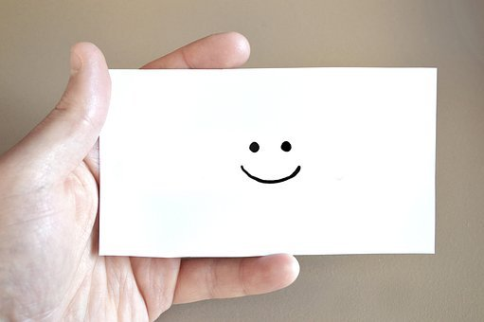
Well Done!
Thank you so much for your time and participation today!
See you next time ☺

