Slide 1
The story of Half Hangit Maggie
S2 Scots Lesson
Learning Intentions
We are translating a poem using Scots vocabulary
We are using this to create a visual of how we imagine the story

Slide 2
The story of Half Hangit Maggie
S2 Scots Lesson
Success Criteria
I can listen to a poem being read in Scots
I can work with a partner to understand the story in a Scots poem with the help of a vocabulary list
I can create a visual using my imagination and the information I read in a piece of Scots writing

Slide 3
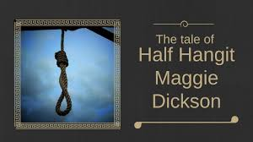
https://maggiedicksons.co.uk/maggies-story/

Slide 4
Maggie’s story - vocabulary
What do you think these phrases from the video mean?
Discuss with your partner.
a tale eh a lass hauled her back
gardy loo folk jostlin’
fish hawker brought oot
doon tae Kelso the tale’s nae ower
afore ye ken it couldnae keep
her belly started tae swell we’ll never ken
the bairn tak a wander doon

Slide 5
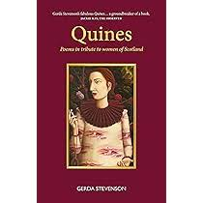
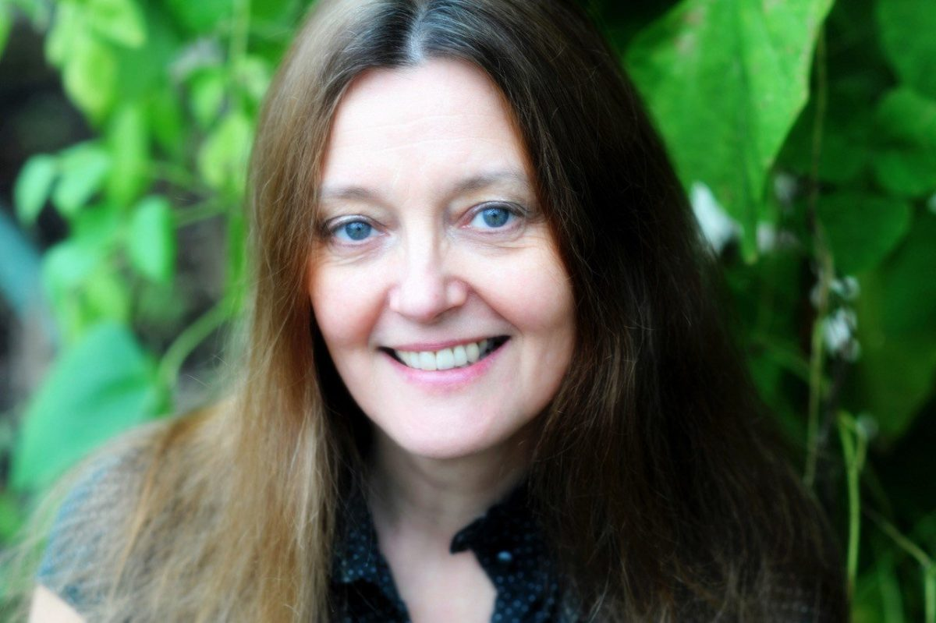
Quines: Poems in tribute to women of Scotland - Gerda Stevenson
https://m.youtube.com/watch?v=prIkufZugA0&pp=ygUiZ2VyZGEgc3RldmVuc29uIGhhbGYgaGFuZ2l0IG1hZ2dpZQ%3D%3D

Slide 6
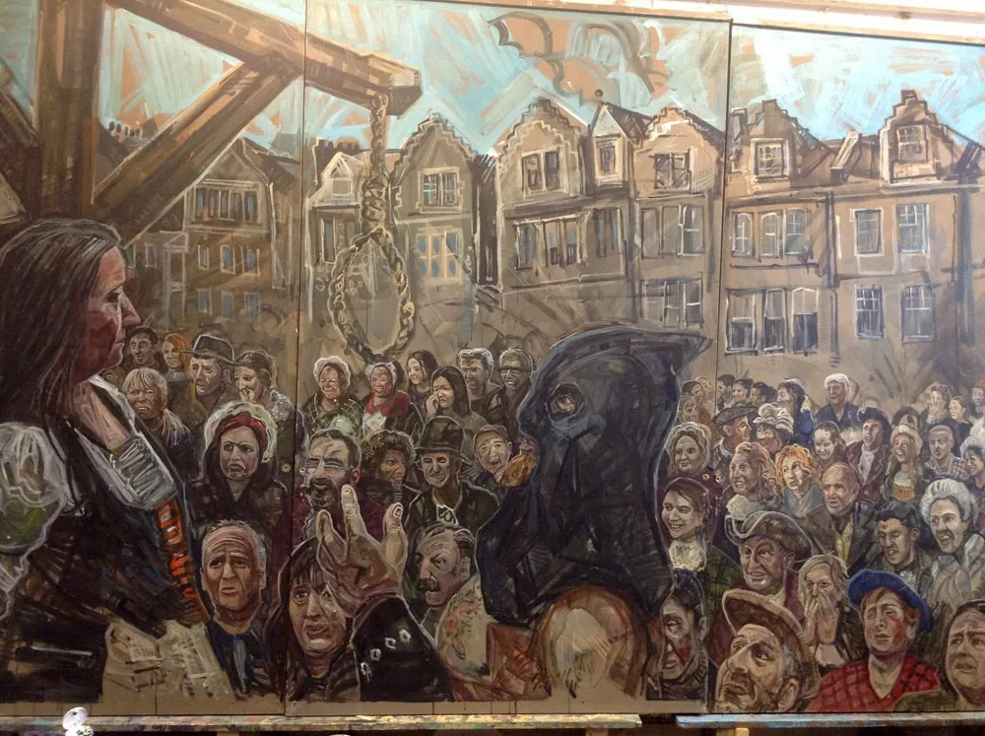
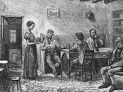

Slide 7
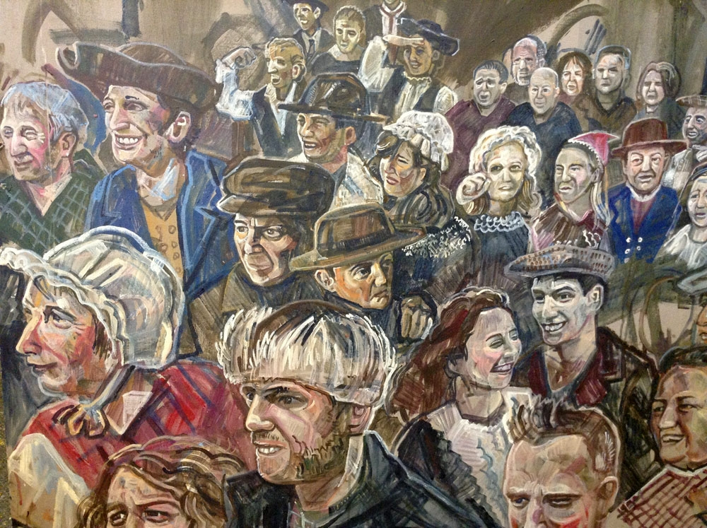
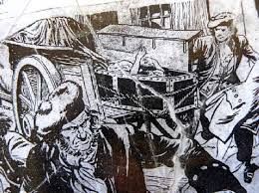

Slide 8
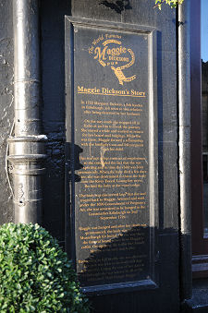
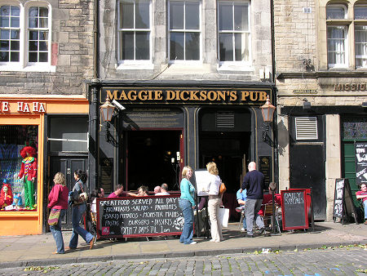

Slide 9

Scots language task
Each pair will translate one verse of the poem using the vocabulary sheets provided.
We will then come together as a class and work out the meaning of the whole poem together.

Slide 10

Creative task
Using the ideas you have heard and read about in the poem, you will create a poster to show a scene from Maggie’s story.
Include a phrase from the poem in Scots.
You can do this individually or with a partner.

Slide 11

Plenary
Thinking about this lesson:
Give 2 Scots words that you recognised from daily use or hearing your family/friends use.
Give 2 Scots words that you remember from previous Scots lessons.
Give 2 Scots words that you saw for the first time in this lesson.
What do you think of the poem, was the punishment too harsh for the crime?
Do you believe that Maggie ‘came back to life’?

