Slide 1
An introduction tae th Scots Leid

Slide 2
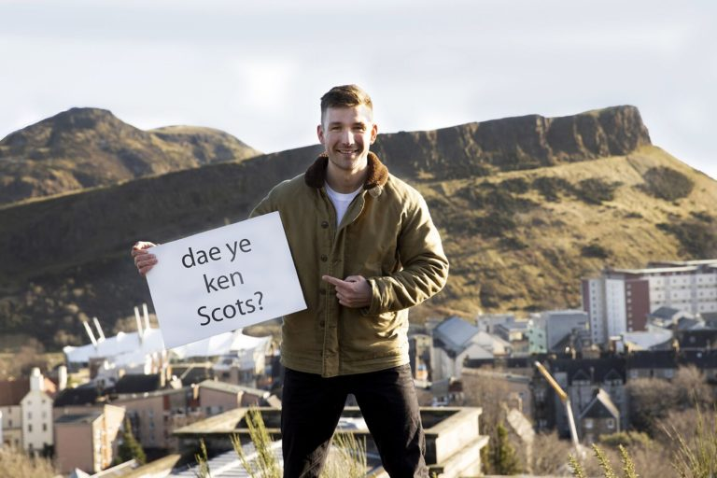
Whit is th Scots Leid?
BBC - The Social, Whit's Scots Language?

Slide 3
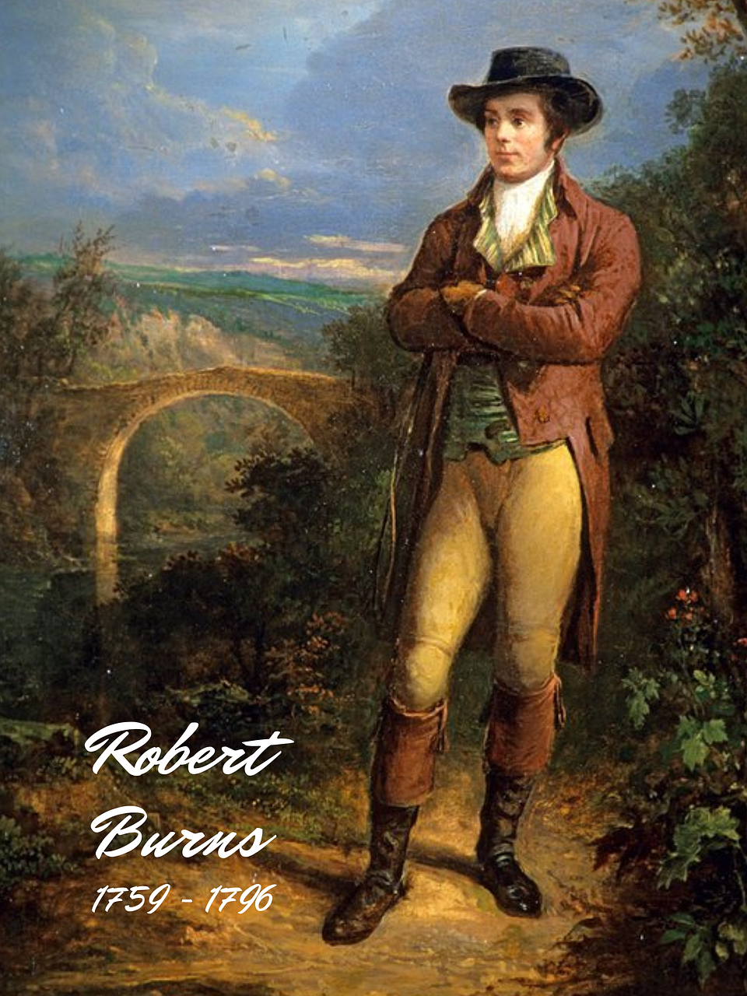
Robert Burns
Scotland’s maist well kent Scots spekker?

Slide 4
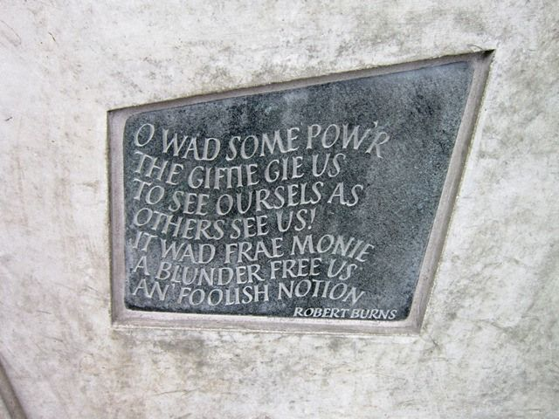
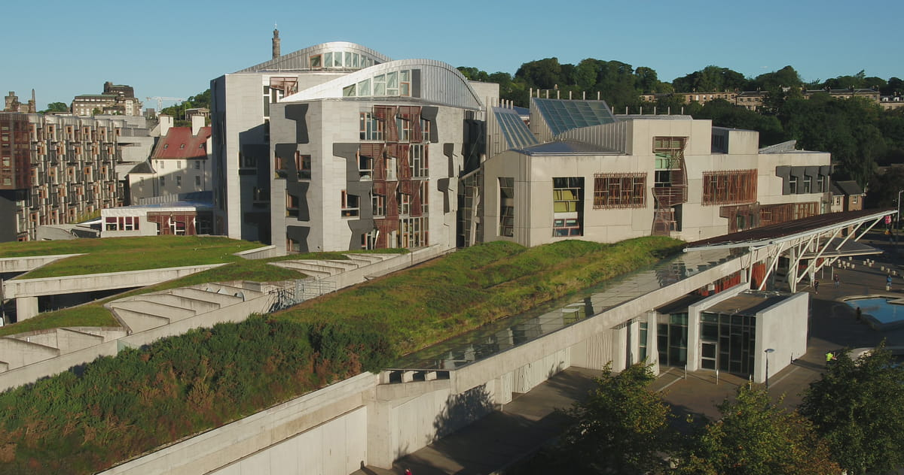
Th Scots Leid an th highheidjans
Gary Tank Commander tells people to 'stay in the hoose’
The Broons and NHS Highland - Get Up, Get Dressed, Get Moving

Slide 5

Th Scots Leid oan th Television
Moira’s Sassiest Moments | The Scotts | BBC Scotland
Chewing The Fat "Will I come back and see you"

Slide 6

Th Scots Leid an Social Media
STV News - Scots Language - Iona Fyfe and Len Pennie
James McAvoy Translates Your Scottish Tweets!

Slide 7
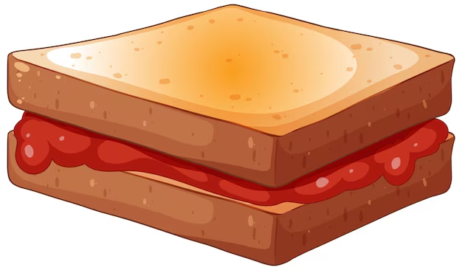
Funny Sangs
Matt McGinn- Jeely Piece Song Lyrics [Scottish song]

Slide 8
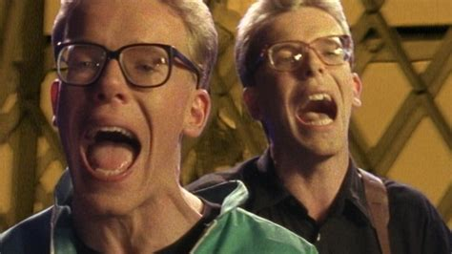
Scots Leid an pop sangs
David Tennant performs 500 Miles by The Proclaimers with the help of a few famous faces... | BAFTA

Slide 9


