Slide 1
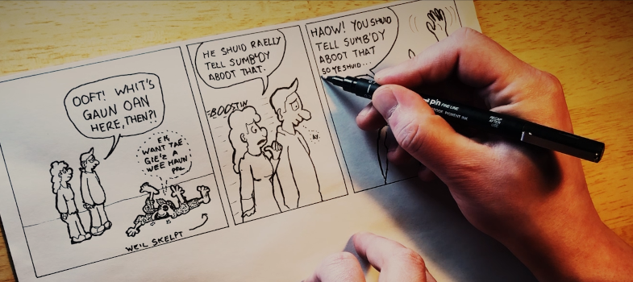
Scots language and culture Teacher CPD tutorial
Bruce Eunson, Education Scotland
Jamie Fairbairn, Banff Academy
Sylvia Warnecke, The Open University

Slide 2

Unit 7: Scots as a language learning option in schools In this final unit written by Michael Dempster, you will explore Scots as a potential subject area in its own right within schools, where pupils can learn the language, or improve their already existing skills in Scots further. This unit also revolves around multilingual practices in the classroom and what that could mean with regard to Scots in your own teaching context to ensure you create a safe space for learners to use their own voice and language. In addition, you will find out more about the complexities such an approach brings not only because of the different levels of confidence and proficiency of pupils and teachers, but also due to the negative image that still exists around Scots in educational contexts.
Whaur wir been…

Slide 3

Unit 7: Scots as a language learning option in schools Post 1
I started by reviewing what we had been learning about and thinking about why i undertook the course (encouraging learners to learn Scots). The lesson contains an introduction to Scots, and it's origins (proving it's a leid an no jist slang). The lesson contains a slide looking at the table developed by Michael, which I discussed with learners. This started a blether aboot hoo Scots appears ti hae lots o Germanic similarities - which relates to previous slide with the language tree on it. I used Tam o Shanter as a piece of text to carry out a translation activity - from Scots to English. We also discussed how we might say these words in Dundonian. Building on a series of lessons that developed all four aspects of literacy gave the pupils in this S2 class a lot of confidence. It was gratifying to see how much information they had retained. For this lesson, I researched how many language trees there were and, as we have a recently arrived Nigerian pupil, I included the Yoruba-Congo family tree and sent them on a hunt to find it on that tree too. They could see links for sister languages there – that really impressed me! I am including some writing in Scots from the pupils here, in the attachments, as it is amazing to see what they can do when their confidence grows. One of these exemplars is from a ‘challenging’ pupil. It would seem he is not so much challenging as just being taught in the wrong language. He only speaks English in school in lessons. Everywhere else he is a native Scots speaker. It is only one anecdotal example but it really does prove the point that literacy improves when the language it is taught in matches that spoken by the pupil.

Slide 4
Unit 7: Scots as a language learning option in schools Post 2
I've really enjoyed reading the posts discussing spelling in the Scots language and it really added to the language learning in Unit 20 by Michael Dempster. Without doubt, the children in my class enjoy the freedom of Scots being a non standard language and that spelling can be synthetic. For a lot of children, spelling is an intrinsic barrier to extended writing in English. Insisting on consistent spelling was a top tip. The interconnectedness of the course units always strikes me: In unit 2, we read the Scots language in the Curriculum for Excellence (2017) report looking at how Scots can enhance writing skills. As a result of unit 5, our class novel continues to be Geordies Mingin Medicine and engaged in our recipe writing; familiarity does in my class breed engagement.
Post 3
Learners doing research into Scotland's forgotten heroines was well received. The girls were understandably appalled at how little was known about the women of history in Scotland, along with modern day inequities in the fame of men vs women. Many of the boys had never considered this had been an issue and it was fun to see the girls challenge the boys' thinking about this. It allowed learners to lead learning well. Next steps are to undertake the creative writing part of my lesson, writing a story about, or from the point of view of one of the women from Scotland they had researched. We will need to do some preparation on how to use vocabulary and language structures they are unfamiliar with. Next year, in S4, we will study a text which uses Scots as part of their Scottish text.

Slide 5
Unit 7: Scots as a language learning option in schools Post 4
I decided that I would create a lesson that I could use with my higher English class who are studying the Scottish play ’Men Should Weep’. We have done a lot of work on Scots and I have used many ideas from this course to explore Scots language and its use in the text. I have taught this text many times but I can easily say that I have approached it this year with a more confidence in how we explored the use of Scots language. On reflection, I recognise that this was previously explored in a superficial way with elements of rote learning and basic translation/copying. Whilst there are clear areas that you must focus on to ensure learners are exam-ready for the set text element, I really feel that my planning and teaching of this text this year has been underpinned by the language. In future I would introduce this lesson earlier in the year, as I really feel that the learners in my class demonstrated a better appreciation of the use of Scots Language that any other year I have taught this text. They comfortably discuss the importance of language to setting and the ideas and issues explored. They are confident speaking and reading the parts of the play, understand what they hear and most importantly are developing a confidence writing in Scots. Also, by introducing this lesson earlier in the course I would be able to restructure the lesson to allow for group/pair work as I feel collaboration is an effective way to inspire creativity. The class are now peer marking first drafts and this has allowed opportunity for group work and discussions, however due to the nature of the course I feel this would be more effective if more time was allocated as I could only allocate one period for this to allow other course work in the build up to the prelim.

Slide 6
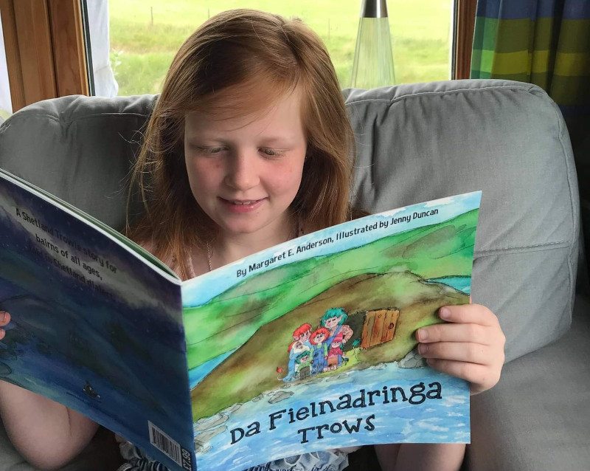
Time in Breakout Rooms to discuss how you are finding Unit 7

Slide 7
Sharing the discussions from Breakout Rooms

Slide 8
Whaar wir gaan tae nixt…
Unit 7: Scots as a language learning option in schools | 3. Tutorial 4. Planning
 | 5. Application 6. Community Link | Submit Unit 7 Application task in the course forum by 23/6/25
 | 7. Research on teaching Scots language 8. Professional Recognition Reflective Task | Submit Unit 7 Professional Recognition post in your reflective blog by 5/7/25

