Slide 1


Literature 1 (FA58 12)
Encounter 7a:
Assessment Preparation continued; All That Glisters, Scots Focus

Slide 2
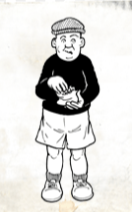
Talking Scots
Love it or Hate it !!!
A technique we haven’t discussed so far is word choice. Clearly the author’s word choice is an important part of the structure and style to draw upon.
We have the added dimension of the use of Scots.
Exploring an author’s use of Scots is a valid route for you to go.
Jings, crivens and help ma Boab!

Slide 3

There is a variety of reliable sources
They vary on their usefulness.
Many are aimed at younger people
They do provide a worthwhile excursion.
There is no need to prove that Scots is a language in your essay; simply use it, however, this is worthwhile asserting (see Robinson below).

Slide 4

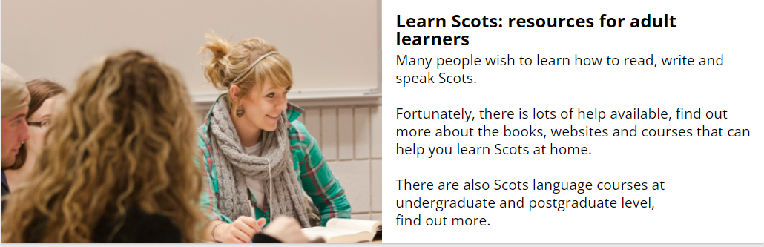
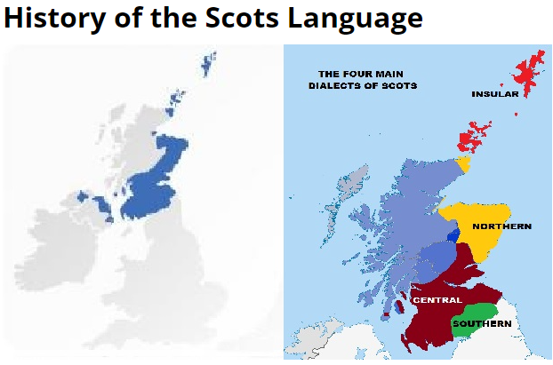
Has lots of resources. Some of the events are way past their sell by date but, nonetheless well worth a visit.
Link in image

Slide 5


They also provide suggested resources
These include;
Links
Text titles
Open University course for Scots
University courses (under and post grad)

Slide 6
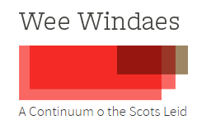

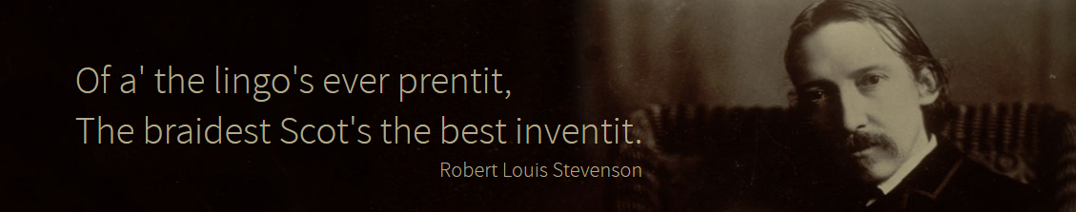
Wee Windaes provides
An historical mix of material

Slide 7

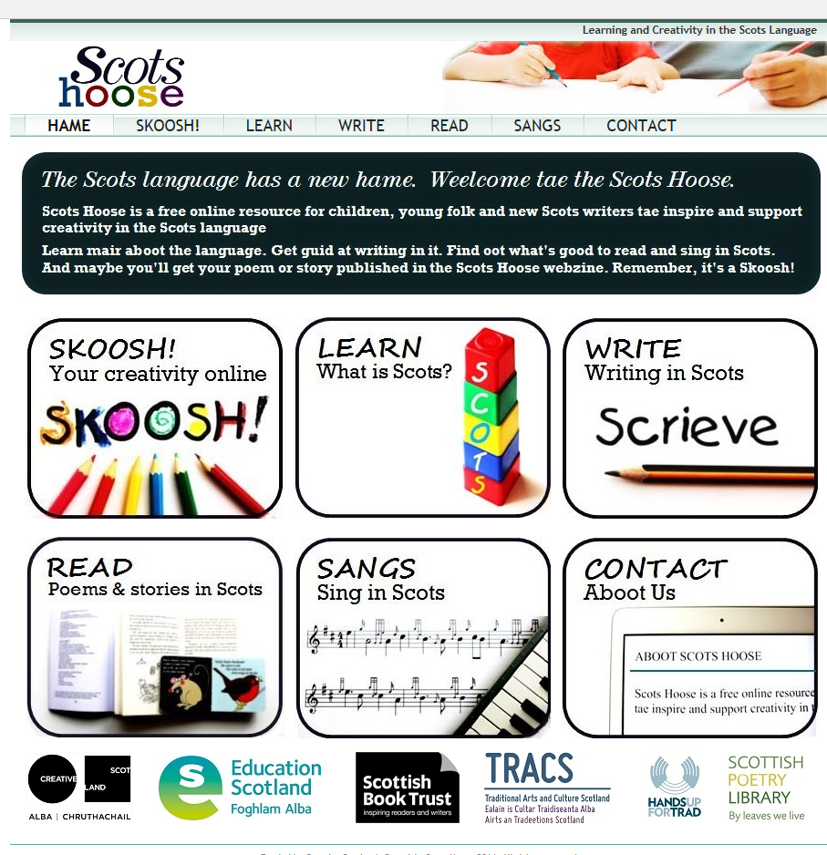

The link in the image will take you to the Homepage, click on the Archive to view the image content.
Lots of resources, worth reading to find stuff to back up your argument.
Have a wee read of

Slide 8
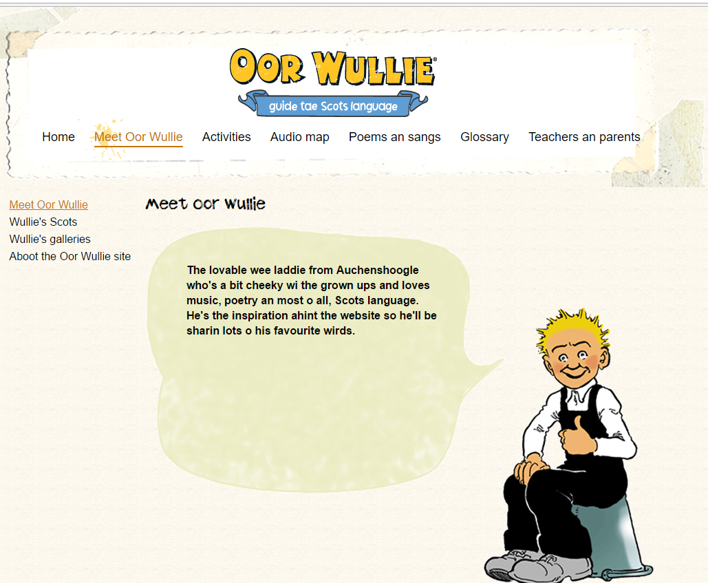
Best of all
The boy himsel

Slide 9
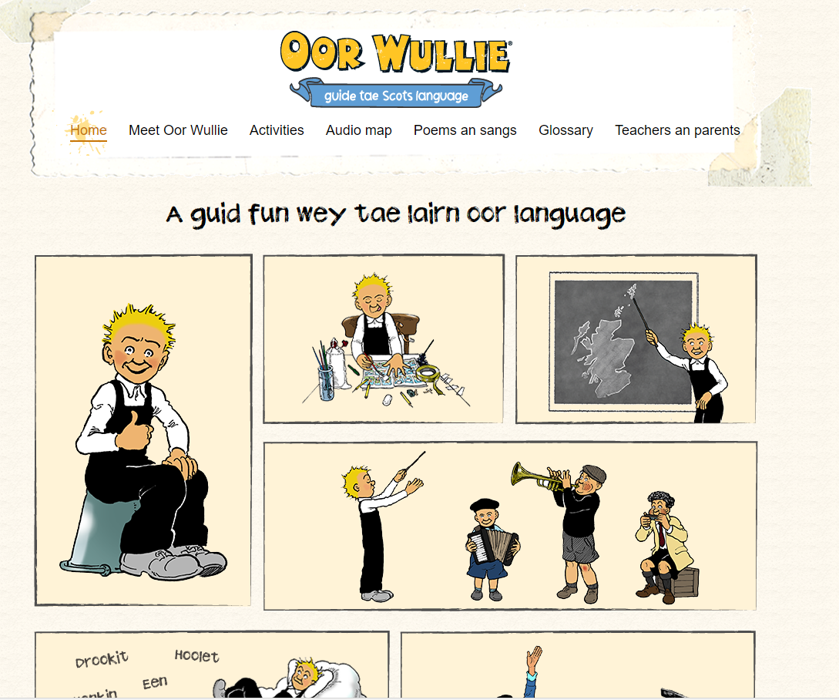
Let’s visit the site and try some of the interactive stuff
Notes:
http://digital.nls.uk/oor-wullie/

Slide 10

Provides access to two dictionaries and a video showing how to use the online version(s).
You can even sponsor a Scots word and send to a friend.

Slide 11
Scots
We could spend a lot of time arguing about Scots; is it a valid language, the remnants of a dead language or just plain slang?
Robinson asserts ‘The language of contemporary Lowland Scotland can fairly be described as fluid. It is marked by a wide and almost infinitely variable range of speech-styles.

Slide 12

She continues
Ranging from the full Scots of some fisher-folk and farming people in the North-East, through various intermediate ‘mixtures of Scots and English’, to a variety of Standard English spoken in a Scottish accent’ (1991, pxii)

Slide 13
Other Agencies
Assert the validity of Scots as a language
http://www.scotslanguage.com/articles/view/id/4049
Association for Scottish Literature.
Scots Kist
Open University; both Scots language and culture
And University of Glasgow to name but a few

Slide 14
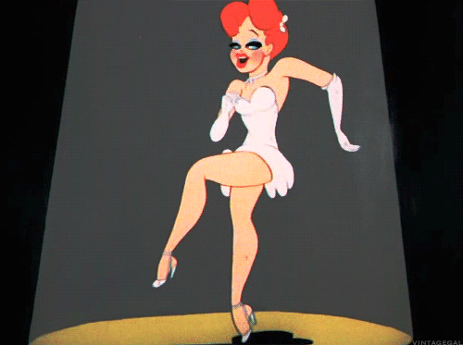
I can recall
When I learned that Scots was a valid language, albeit with similar roots to English English, it was a very liberating discovery.

Slide 15

All That Glisters
Has lots of use of Scots should you decide to draw upon how Donovan uses Scots.
The Scots in All That Glisters, especially if read out loud, is probably quite familiar to many of us.

Slide 16
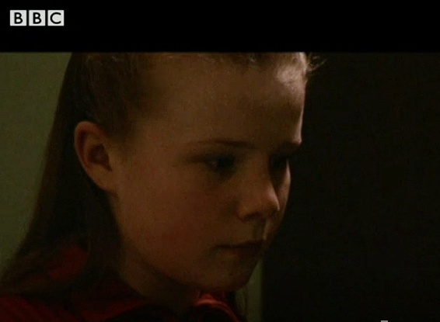
Clare Examples
‘And when ah’d finished something amazing hud happened. Ah canny explain whit it wis but the glitter jist brought everythin tae life, gleamin and glisterin agin the flat cardboard. It wis like the difference between Christmas tree skinklin wi fairy lights and wan lyin deid an daurk in a corner’ (p 1).

Slide 17

Both
‘gleamin’
‘glisterin’
Have been used in Scots texts from thew 18th Century to today.
‘skinklin’ likewise has been used across the same time-frame but, I must admit, was new to me.

Slide 18
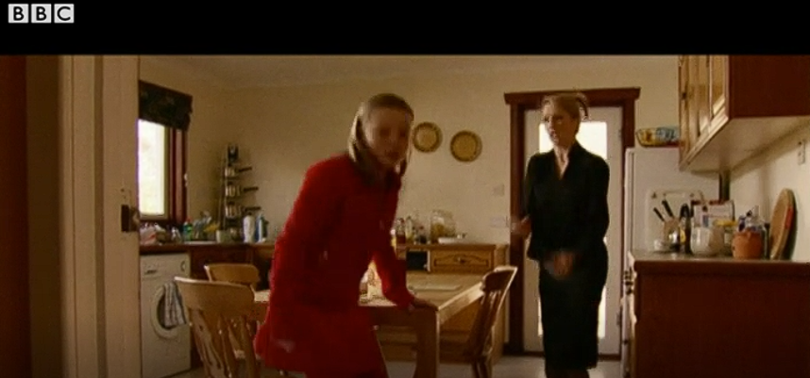
‘Ah hear him coughin in the night sometimes and it’s different fae the way he used tae cough, come fae deeper inside him somehow, seems tae rack his hale body fae inside oot’ (p2)
Activity 3

Slide 19

Clare’s examples continued
‘Sometimes when you think somthin’s brilliant it disny last, you get fed up wi it dead quick an don’t know why you wanted it in the first place. But the pens wereny like that, it wis even better than the first time cos ah knew whit tae dae wi them’ (p 2).

Slide 20

‘That night ah lay awake fur as while imaginin aw the things ah could dae wi the glitter pens. Ah really wanted tae make sumpn fur ma daddy’s Christmas wi them’ (p 3)

Slide 21
Whit dis Donovan’s yuise o Scots dae?
Some readers feel that Scots allows the characters to be more expressive
Some readers feel that the characters are more real
Some readers feel it allows intimate knowledge of the character
Some feel they can identify with the words
Wit dae you hink?

Slide 22
So
The use of Scots might be a feature you want to explore.
It is a technique available to the author and used throughout the text of All That Glisters, it is woven throughout the story
Do you feel you know Clare better for hearing her talking in a guid Scots tongue?

Slide 23
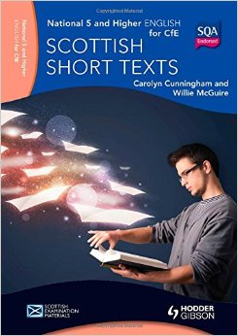
Resources
I’ll provide a Photocopy of the relevant pages, if we don’t have enough books.
BBC Bitesize http://www.bbc.co.uk/education/guides/zbbmn39/revision/2
You really ought to have opened your account with BBC Bitesize by now.

Slide 24

Essay
If you intend to write your essay about All That Glisters try writing up a plan using the template in your Support Pack.
We have a presentation next time, however, the meeting after that we can go over plans.

Slide 25
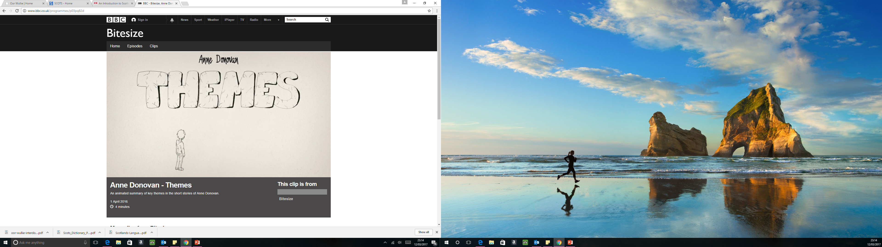
To finish off
This clip doesn’t mention All that Glisters but it does talk about themes Donovan explores and ends with a consideration of her use of Scots. Next time we shall explore The Letterbox further. NB our exposition revolves around the issue of domestic abuse.

Slide 26
End

