Slide 1


Intro Slide Title 2
Whit (we hink) we ken aboot Scots
Language ideologies and minoritized languages
Linda Bruce
Postgraduate Researcher
School of Languages and Applied Linguistics
December 2023

Slide 2
Slide Title 5
Whit’s a language ideology?
Whit language ideologies affect Scots?
Wha spicks Scots an why for?
Whit can we dae tae support Scots?
Notes:
Introduction to the talk. I’ll cover these areas: a brief introduction to the concept of language ideologies; some language ideologies about Scots in Scotland; a look at who speaks Scots in Scotland and why they do (or don’t); and finally some thoughts about how we can recognize potentially negative language ideologies and maybe think about addressing and challenging them.

Slide 3


Slide Title 16
[Language ideologies are] sets of beliefs about language articulated by users as a rationalization or justification of perceived language structure and use.
Silverstein, 1979, p. 193
Notes:
Let’s begin with a definition of language ideologies as “sets of beliefs about language articulated by users as a rationalization or justification of perceived language structure and use” (Silverstein, 1979, p. 193).
I like this definition because it highlights the links between language ideologies and language structure and use.
So these beliefs are not just abstract ideas but they actually affect and are brought into practically every language choice we make.

Slide 4
Slide Title 16
Ideology [is] derived from, rooted in, reflective of, or responsive to the experience or interests of a particular social position even though ideology so often (in some views, always) represents itself as universally true.
Woolard, 1998, p.6
Notes:
We might think of ideologies as set, unchanging and in the background, but are reminded here that just as they are not abstract, language ideologies are not fixed: although one of the interesting and most fundamental things about them is that they often represent themselves as fixed, immovable, natural, age-old or common-sense beliefs about language. In other words, as an idea about language is presented as a fact and repeated and re-worked over and over it becomes as ‘taken for granted’ and seemingly unchangeable.

Slide 5
Slide Title 16
One of the essential features of ideologies is that they work at an unconscious level… It seems implausible that people should adhere to an ideology while recognizing it as such.
Armstrong and Mackenzie, 2013, p.2
Notes:
In other words…
Now let’s see if we can attempt the implausible and try to recognize some ideologies about languages in Scotland.

Slide 6
Slide Title 8
What do YOU believe about Scots?
Notes:
Take a moment to think about what you believe about Scots.
You might want to think about for example, a definition of Scots and how it relates to English in Scotland; the status of Scots in Scotland; and what kind of language policies, especially in education, you know about regarding Scots in Scotland, anybody you know who speaks or uses Scots. Who are they? How do they use Scots? In what contexts?

Slide 7

Language Ideologies: “Scots is/was…”
e.g.
Scots is a language.
Scots is Gaelic.
Scots is a dialect of English.
Scots is just how some people speak.
Scots was a language but isn’t now.
Scots was invented by the SNP for political reasons.
Scots is spoken by old folk in the countryside.
Scots should only be spoken by Scottish people.
Notes:
Here are some of views about Scots that researchers (not just me!) have encountered. Maybe you thought of one or two similar ideologies.
Some of these are more tongue-in-cheek than others and at least one is a complete misconception. However, when I speak to people about it – Scottish, English, European, people from other parts of the world – it’s very rare that the very idea of Scots as a language is not encountered with curiosity, confusion, surprise, suspicion, humour or (sometimes) incredulity or hostility.
So how do these ideas come up?

Slide 8

A linguistic variety’s constructed relationship with another in the same region (autonomy vs. heteronomy)
The official status of a variety within a nation-state
Language and educational policies
”powerful language ideolog[ies] of modern nation-states”
(Van Rooy, 2020, p. 288)
Notes:
According to Van Rooy (2020, p. 288), there are three common factors that affect what is believed about language and languages, at least in the West. These include a linguistic variety’s constructed relationship with another in the same region (autonomy vs. heteronomy); the official status of a variety within a nation-state; and language and educational policies applying in that nation-state.
These factors form “powerful language ideolog[ies] of modern nation-states” which profoundly influence the way they are labelled and perceived by society, and then, as Silverstein suggested, actually affect language structure and use – like how much, how often and where we use particular languages and particular forms of language.

Slide 9

Notes:
Let’s briefly investigate each of those three factors with regard to Scots.

Slide 10
Slide Title 8
Scots and its relationship with English in Scotland

Slide 11
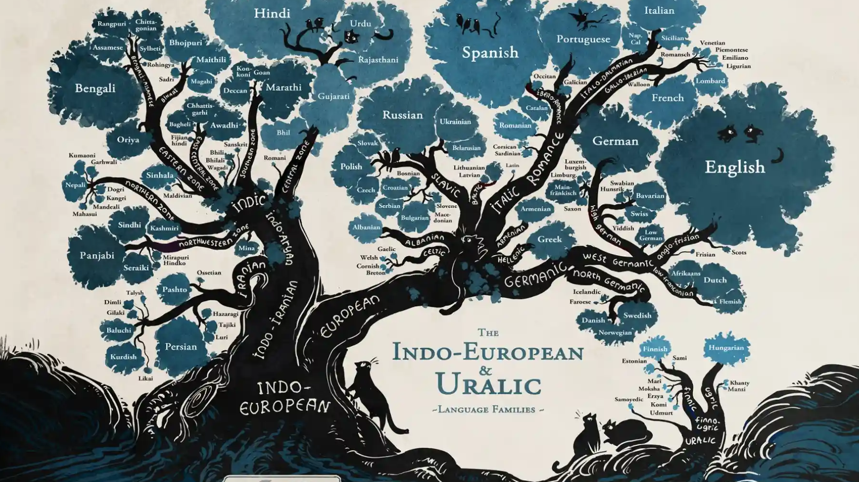
Image: Minna Sundberg
Notes:
You might have seen something like this. A language tree showing language branches or families.
This raises the question, is Scots a language? And if so, where does it come from and how does it work? What's it like? What's it not like?

Slide 12
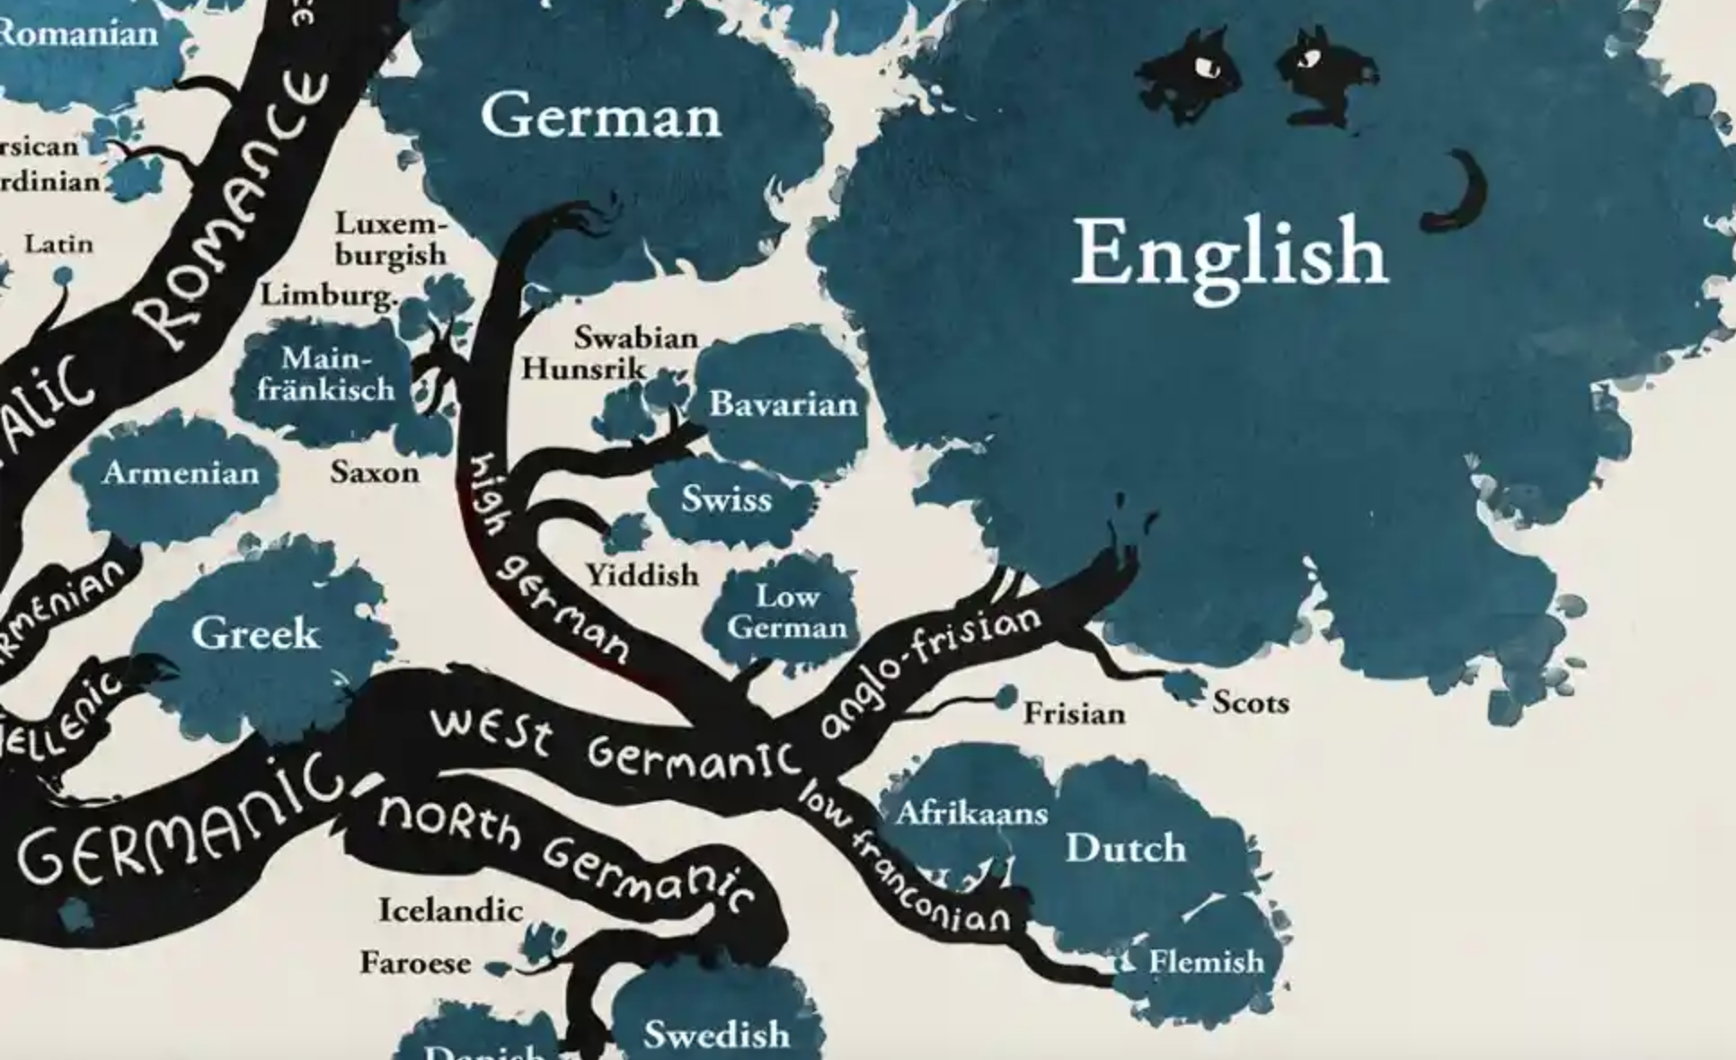
Notes:
Here’s a closer look in case you didn’t spot Scots initially.
Some people talk about definitions of languages and relationships between language varieties in terms of how alike they sound, or in linguistic terms, how much ‘mutual intelligibility’ there is. Let’s see how Scots rates with mutual intelligibility for you. How much of this reading from the Scots New Testament* can you understand on the first listening?
You’ve probably noticed that Scots here is positioned right underneath the massive English branch of the tree. While yes, we know that Scots is a West Germanic language from Northumbrian English from the 13th century onwards and it has far fewer people speaking it than English, it’s also good to remember that this sort of ‘family tree’ image of languages in itself reflects certain constructed relationships and hierarchies that are actually ideological and reasonably recent. Thomas Bonfiglio traces back these sorts of representations of language related to the natural word, genealogy, families and maternity (think of the expression ‘mother tongue’) as originating in the 18th and 19th centuries, reminding again that they are ideologies that ”reinforce ethnolinguistic nationalist prejudices” – or in short, beliefs that language equals race equals nation.
* Translation: “If your brother or sister^{[a]} sins,^{[b]} go and point out their fault, just between the two of you. If they listen to you, you have won them over. ¹⁶ But if they will not listen, take one or two others along, so that ‘every matter may be established by the testimony of two or three witnesses.’^{[c]} ¹⁷ If they still refuse to listen, tell it to the church; and if they refuse to listen even to the church, treat them as you would a pagan or a tax collector.

Slide 13
Slide Title 16
Never let constructions of language and tradition masquerade as cartographies of the real.
Baumann and Briggs, 2003, p.316-7
Notes:
In other words…

Slide 14
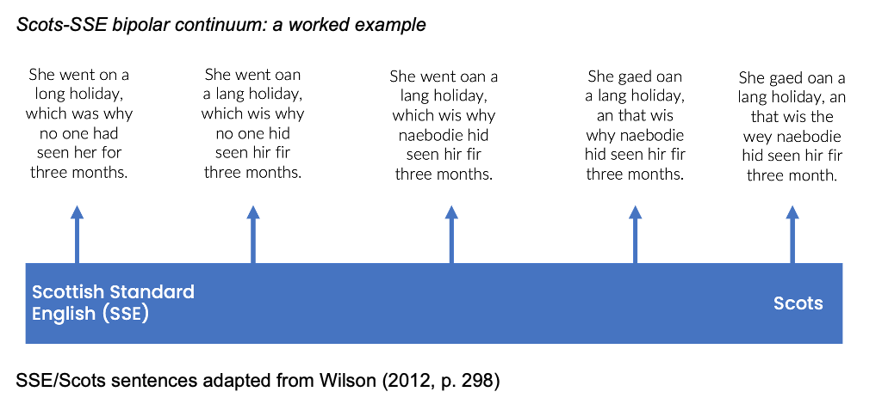
The constructed relationship of Scots and English in Scotland
Notes:
It might be useful to consider how some recent and not so recent research on Scots considers the constructed relationship between English and Scots in Scotland.
As sociolinguistic interest in Scots started to gain momentum around the end of the twentieth century, a bipolar continuum (Johnston, 2007, p.111) was suggested as a representation of this constructed relationship of Scots and English in Scotland, with Scots and SSE at opposite poles of a cline along which speakers shift according to function, register, or for style purposes. This model was based on the influential work of Aitken et al. from the 1970s and 80s. There was also suggested, here, a class dimension, associating middle and upper classes with SSE and Scots with working class. This was ideological as well.
This is an example of how the bipolar continuum might work with speakers choosing a place on the cline depending on their linguistic repertoire, knowledge, class(?) preferences and the speaking situation – again all of these influenced by, and constituting, complex and changing language ideologies. The closest to Scottish Standard English comprising Standard English mostly with a Scottish accent, and the most Scots option featuring Scots phonology, vocabulary and syntax.

Slide 15

Notes:
But sociolinguistics has more recently moved away from focusing mainly on class as the key motivator behind language choice and use.
The bipolar continuum model was more recently imagined as a “multi-dimensional sociolinguistic variation space” by Maguire (2012, pp.2-3), where speakers select more, or less, Scots forms with the purpose of indexing a much broader range of social meanings than just class (Eckert, 2008; Silverstein, 2003)
Examples being “Scotland-but-not-England; working-class; educated; local; Glasgow-and-not-Edinburgh; cool; different; old-fashioned; Catholic” (Maguire, 2012, p. 5). (Give example of weans vs bairns).

Slide 16
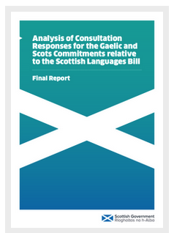
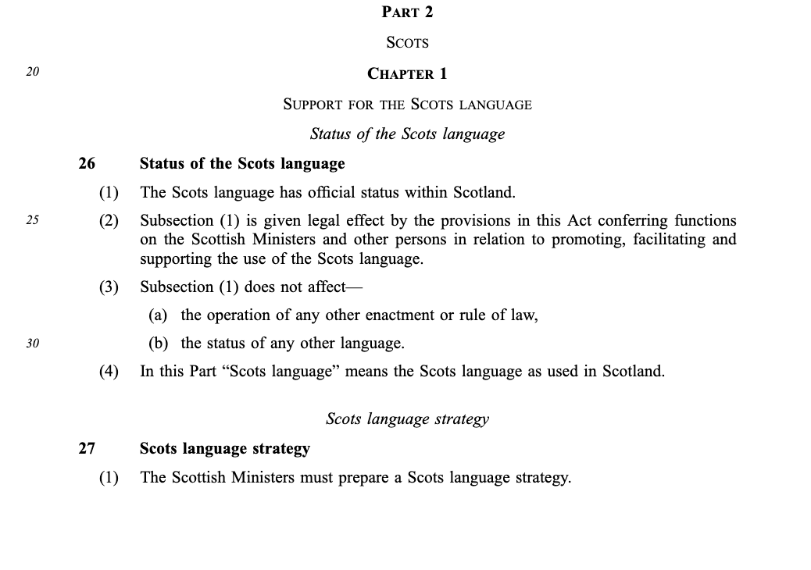

The official status of a variety within a nation-state
Scots’ official status in Scotland
Notes:
The second factor in creating language ideologies, according to Van Rooy, is a variety’s official status.
This is an interesting one because to be clear, Scotland currently has no legal ‘official language’, although English is defacto the official language – stated as the ‘main language by custom and usage’.
But this is set to change. Just weeks ago, the Scottish Government introduced the Scottish Languages Bill - the first piece of major legislation regarding languages in Scotland for almost 20 years. As we can see here, the first point of the Scots section gives official status to Scots within Scotland.
However… Part 4 here becomes a little more tricky. The Scots language as used in Scotland, as I’ve just suggested, is not necessarily something that can be easily delineated. So does this mean ‘anything written in Scots’? ‘any spoken Scots’? And if so, given how Scots works in Scotland in a continuum or variation space with Scottish Standard English, how much Scots is enough to be officially considered to be Scots? I don’t have the answer to these questions.

Slide 17
Slide Title 16
The Bill gives the Gaelic and Scots languages official status in Scotland and makes changes to the support for the Gaelic and Scots languages in Scotland.
https://www.parliament.scot/bills-and-laws/bills/scottish-languages-bill/introduced
Notes:
Nonetheless, this is a positive step for the general perception and awareness of Scots as a language. If you want to read the Bill or find out more about it, you can go to the Scottish Parliament website and find it there.

Slide 18
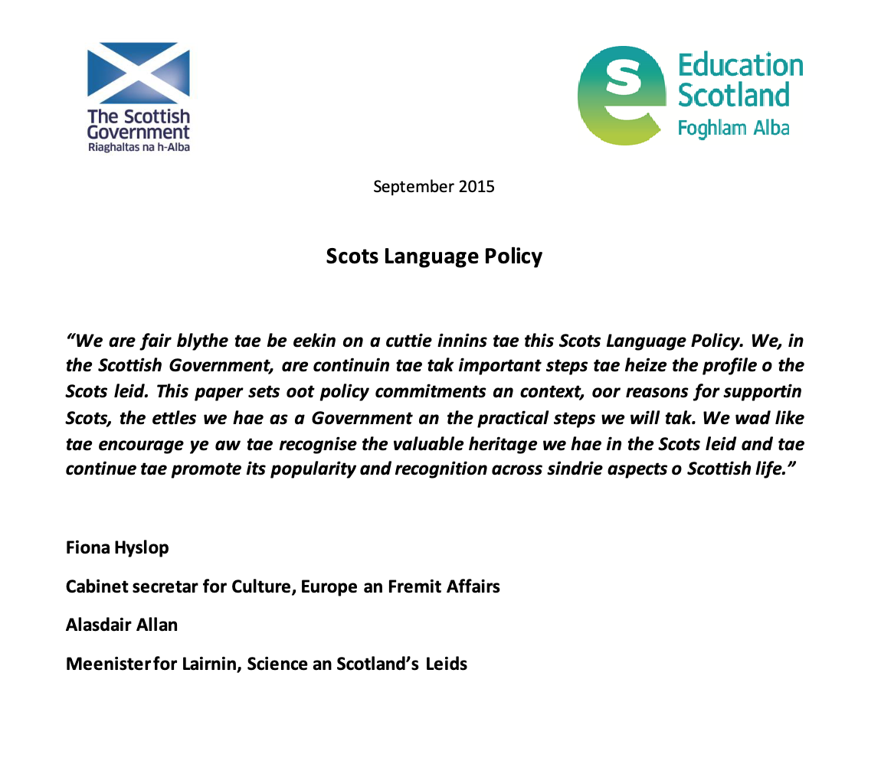
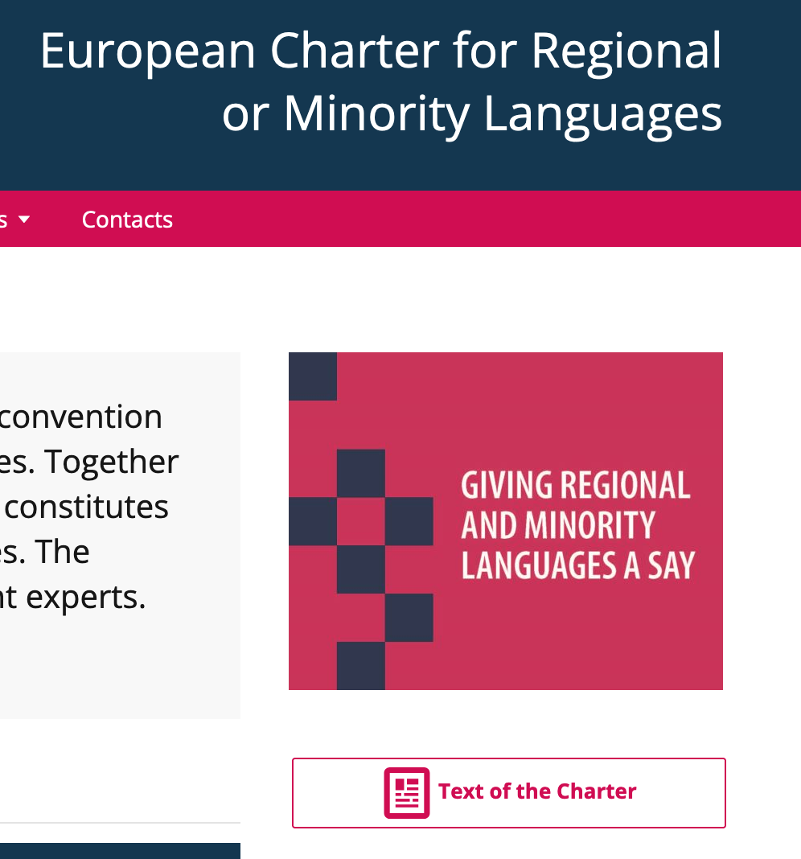
The official status of a variety within a nation-state
Language policy in Scotland
Notes:
Now the third area that contributes to what we think we know about a language is state policy concerning languages and education.
On the one hand, Scots is (soon to be) an official language in Scotland and is also protected with language status in the European Charter for Regional or Minority Languages (Council of Europe, 2019). The Scots Language Policy was published by the Scottish Government in 2015 and will now be updated and strengthened into a Scots language strategy as part of the new Scottish Languages Bill.

Slide 19
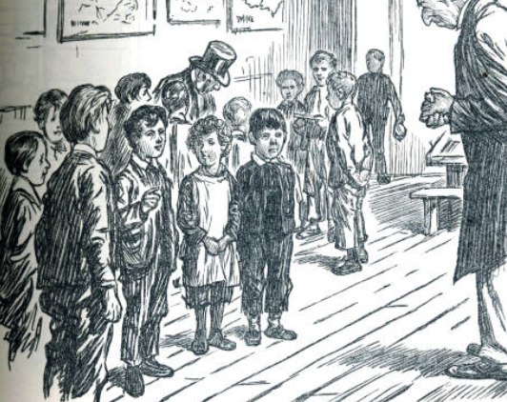
Education policy in Scotland
Notes:
The other side of this policy coin is Scots in education in Scotland. This is another area where ideas about language, originating more than a century ago, have had a lasting effect on what we think about Scots.
When compulsory universal education was introduced to Scotland in 1872, both Scots and Gaelic were simply excluded from classrooms (Bailey, 1987). The suppression or separation of indigenous languages in education systems is a familiar scenario worldwide, of course. Tales of children being punished and berated for the use of indigenous languages litter history, especially in a colonial context.
For at least 150 years, Scots was considered wholly inappropriate for education.
However, Scots is being slowly introduced and accepted as part of the Scottish school curriculum these days thanks to the 2012 introduction of a ‘1+2’ approach to learning languages which allows for Scots as an optional additional language taught from age 9. Overall, in recent years, it seems that, in part thanks to a grassroots movement among some Scots-aware teachers who were ahead of, and went further than, the 1+2 approach, it has become more acceptable for teachers to include Scots in the classroom; especially for younger pupils for whom it is a significant variety in their home or community. However, even though the number of Scottish schools offering Scots language teaching almost doubled from 59 in 2018 to 100 in 2023 (Scottish Government, 2022, p.7), and the number of students achieving the Scots Language Award increased from 100 to 418 in just one recent year, Scots is still neither a standalone nor compulsory subject . I would also mention that Scots language teacher training has not been widely available nor mandatory, so the teaching of Scots, while sometimes excellent, can be patchy and ineffective (Eunson, 2017; Niven, 2017). The OU has made progress in this area, recently launching a dedicated Scots Language CPD programme for teachers.
We haven’t even considered higher education yet. Suffice to say that any undergraduate degree in Scots language does not exist in any Scottish university and seems to be a long way off.
And returning to our new speakers – that’s adults looking to learn some Scots who don’t happen to have access to a family member willing and able to teach it – the resources available are minimal.
So, to return to the discourse around language and educational policies, it’s fair to say that Scots is still very much presented ideologically as optional, extra, additional, and nice to have, for children being schooled in Scotland. For university students and adult learners, it’s almost invisible. This ideology still tells us that English is best, the one that will get children ahead in education and career. It reflects an emphatically monolingual ‘one-nation, one-language ideology to languages which the countries of Great Britain, and the US, unfortunately don’t seem to be able to shake off.

Slide 20
Slide Title 8
How do new speakers of Scots experience language ideologies?
Notes:
So I’ve provided a few thoughts about how what we think we know about Scots is and has been constructed by the nation-state and reflected in widespread beliefs about minoritised languages in general.
I’d like to finish by considering how new speakers of Scots (the group I’m researching – that’s adults who didn’t grow up with Scots who make a conscious decision to learn and use it) experience and sometimes perpetuate language ideologies.

Slide 21
John: A feel within the UK
Linda: mm
John: Scots (.) isn’t recognised but actually within Europe it was
Linda: uhu
John: it’s eh (.)
Linda: why why dae ye say that?
John: (.) because they recognise languages like Sicilian and Catalan and (.) you know an they don’t call thum dialects they call thum languages
Linda: uhu
John: dialect to me is a horrendous wurd (.) because it it’s when people socially and culturally position therselves above you (.) we speak (.) this language
Linda: mmm
John: you speak that language
Linda: mm mm
John: an A don’t like that
Notes:
The official status of Scots, its relationship to other language varieties and the importance of language/dialect labels in terms of language ideologies is clearly traceable, as for example with this research participant manifesting this very ideology.
(play clip)
So for this person, how a linguistic variety is named appears important. Their desire for the use of the label ‘language’ over ‘dialect’ allows the participant to align with an identity of someone invested in social justice through and beyond language use and forms a strong acknowledgement that he is siding with a minoritized or disadvantaged group when they call Scots a language and uses it themselves.
They refer here to both the constructed status of Scots in the UK and Europe, comparing it with other varieties, as well as directly to the official status (or lack of) of Scots. Both strong factors in the linguistic ideologies I highlighted earlier.

Slide 22
Martha: an A did use to see maself as an activist, A A don’t engage in the social media side of it now erm
Linda: mm
Martha: A had too many negative experiences an it's usually with men aged sixty plus who are very gatekeeping, and will argue an troll you, erm until you’re in tears.
Linda: mm
Martha: erm so A A’ve found a group of peo-ple now in the <place of work> who - we can make a practical difference by allowin other people to speak in a safe environment without necessarily you know ( ? ) wrong an pickin apart what they’ve said, an so A feel as though just in a more practical level A'm an activist, but A’m no longer personally able to do that without it being damagin
Linda: mm
Martha: erm to ma self-esteem basically eh cos ye can get pile-ons from certain elements of the community
Linda: yeah yeah that’s yeah that’s a real shame
Notes:
This second clip is perhaps a little bit more emotional and potentially upsetting, just to warn you.
In this account of a speaker’s withdrawal from being a Scots activist on social media, they talk about the reasons why they took particular actions, contrasting the past when they publicly supported the use of Scots with now, when they don’t.
First of all, we can see here evidence of ideologies about what it means to be a learner of, user of, and advocate of a minoritised language. In this case it means being visible, public and online.
It also suggests language ideologies of prescriptivism – a set of constructed rules that aim to govern who can and cannot use the language, and in what forms and situations they can and cannot use it. This group, described as gatekeeping, who are themselves Scots users and language activists, polices and excludes, and is in contrast to the group the interviewee now aligns with, which is descriptive and inclusive, and is described as a ‘safe environment’.
It’s pretty clear here that choosing to learn and use a minority language like Scots involves more than just doing some ‘book learning’, but there are personal and emotional efforts to go through that would not be necessary in learning a majority language.

Slide 23
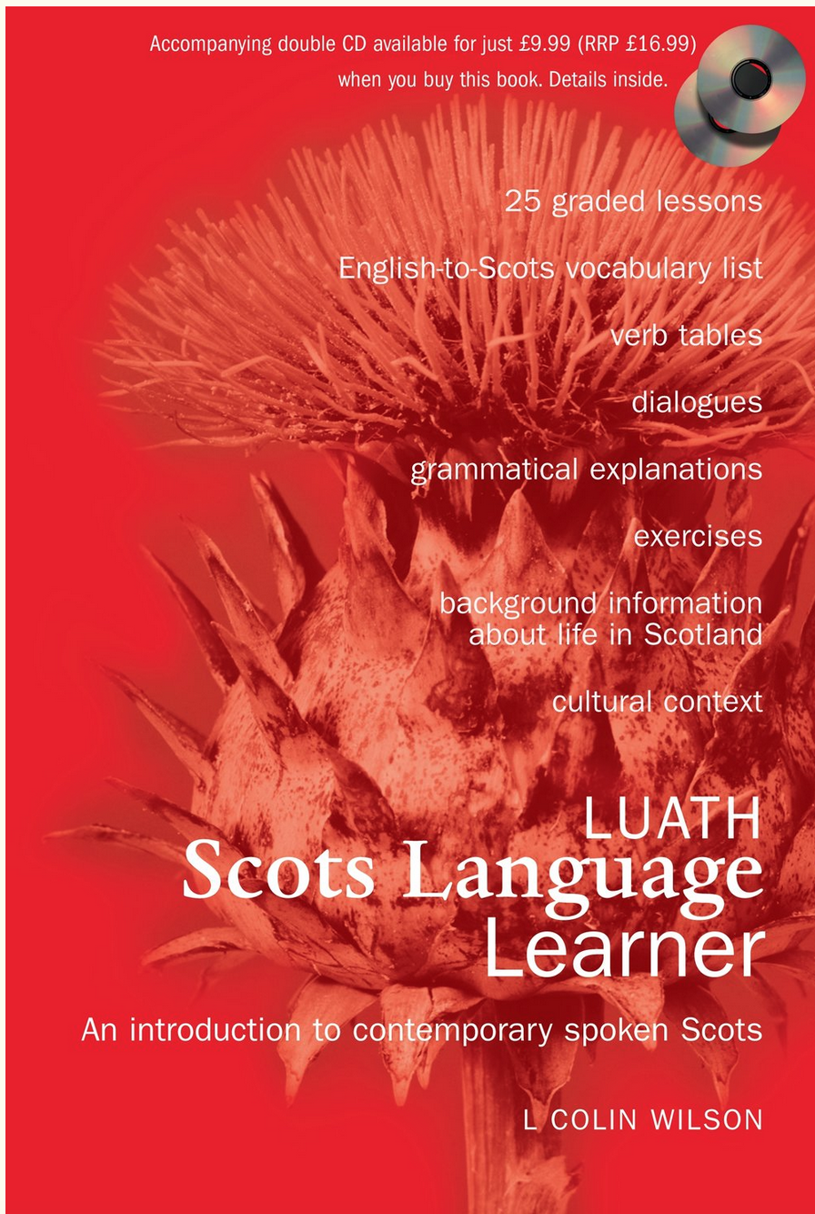
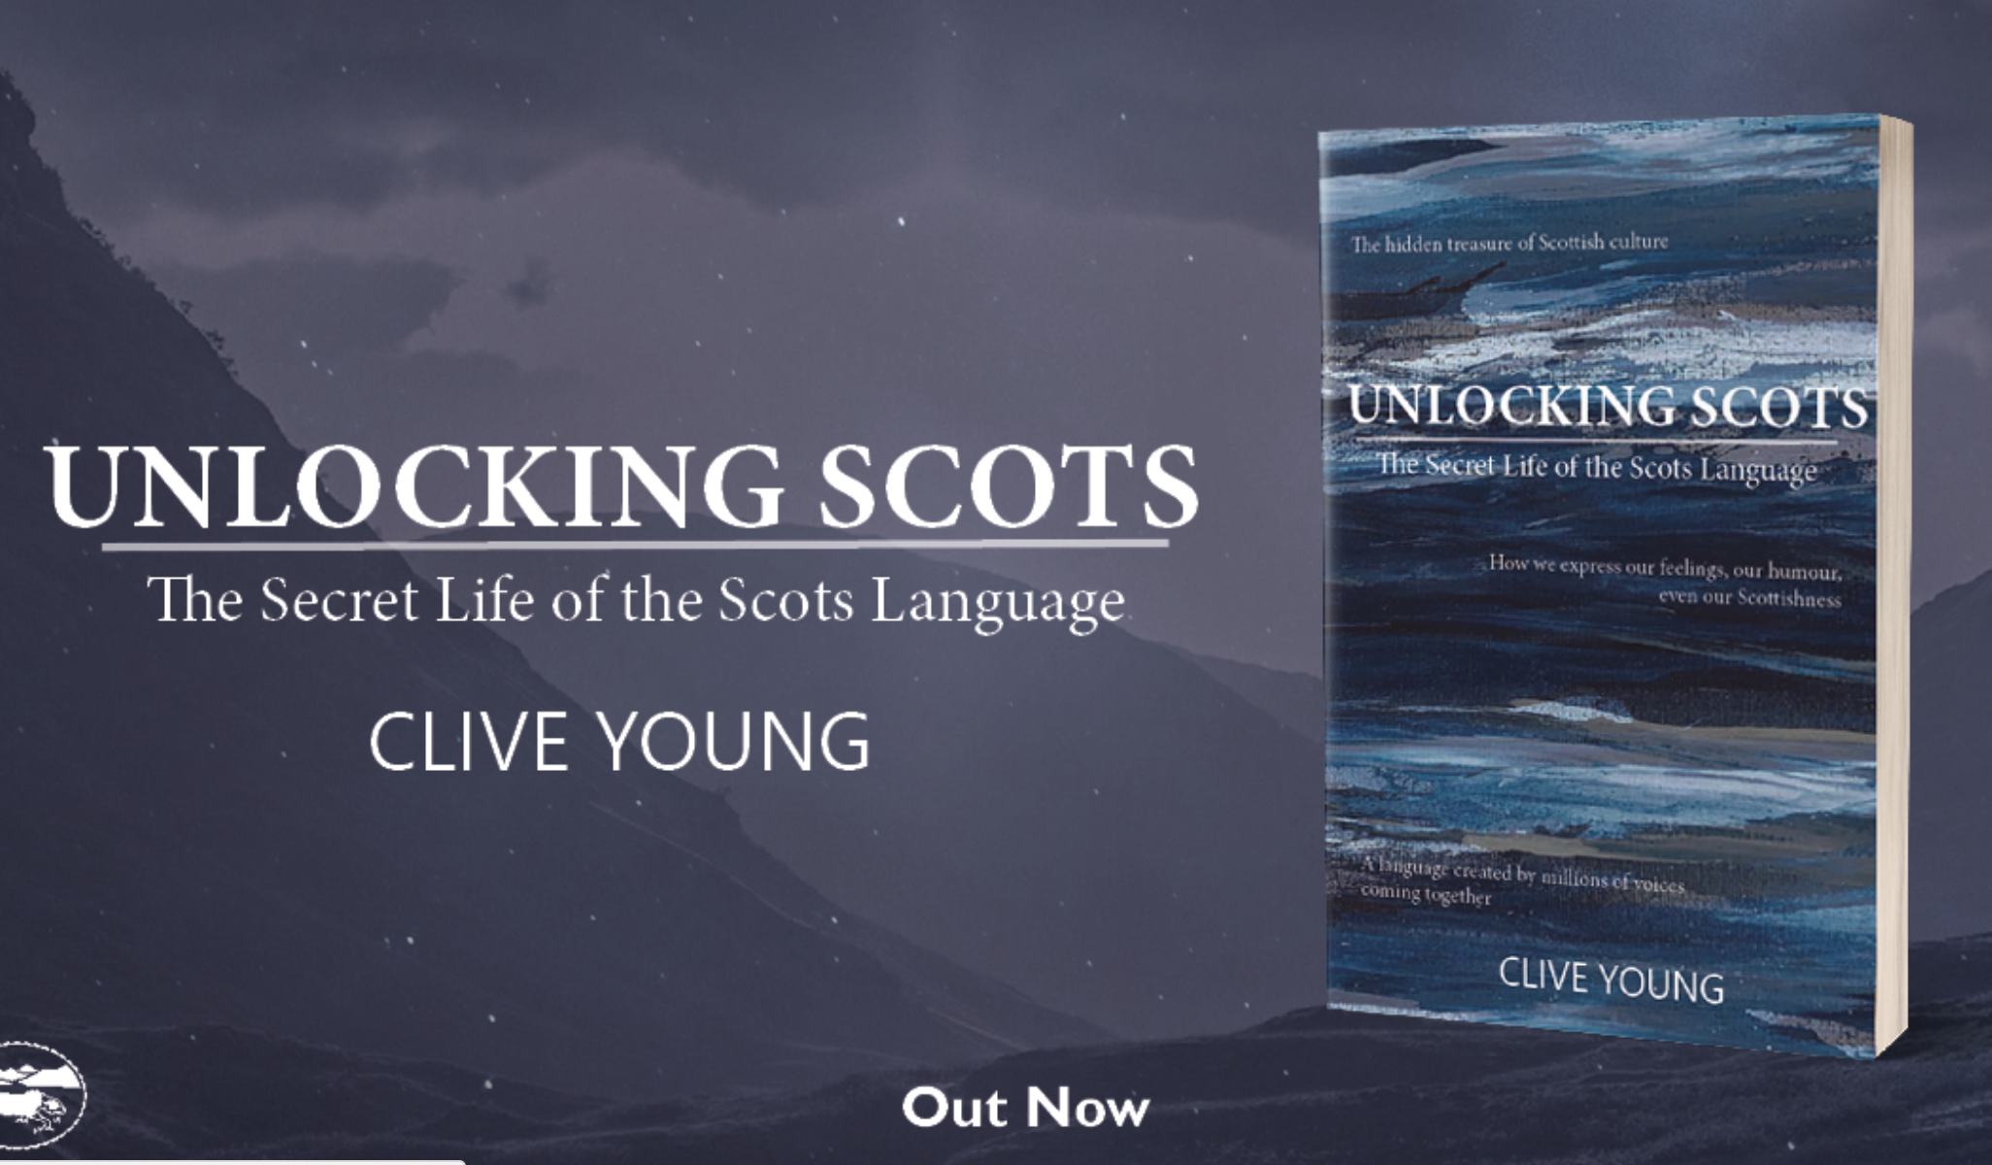
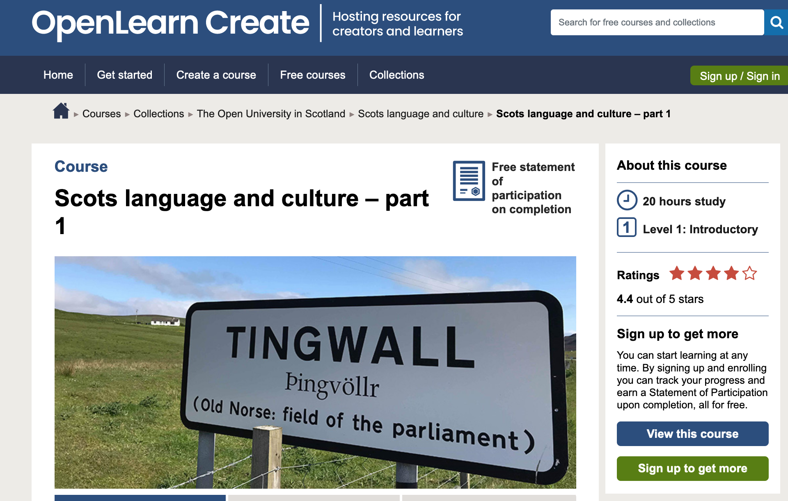
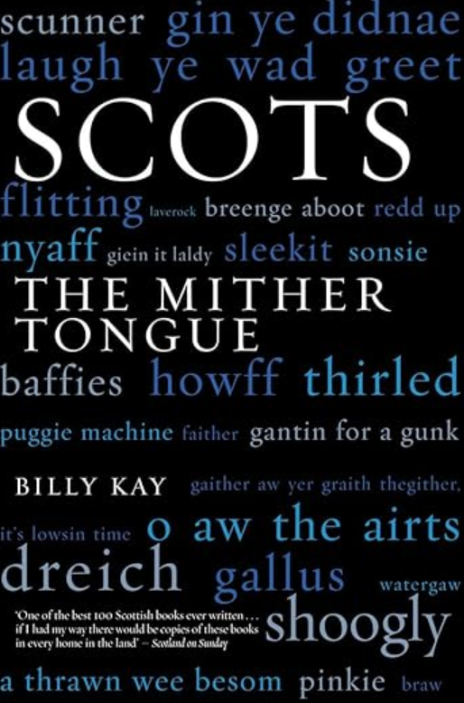
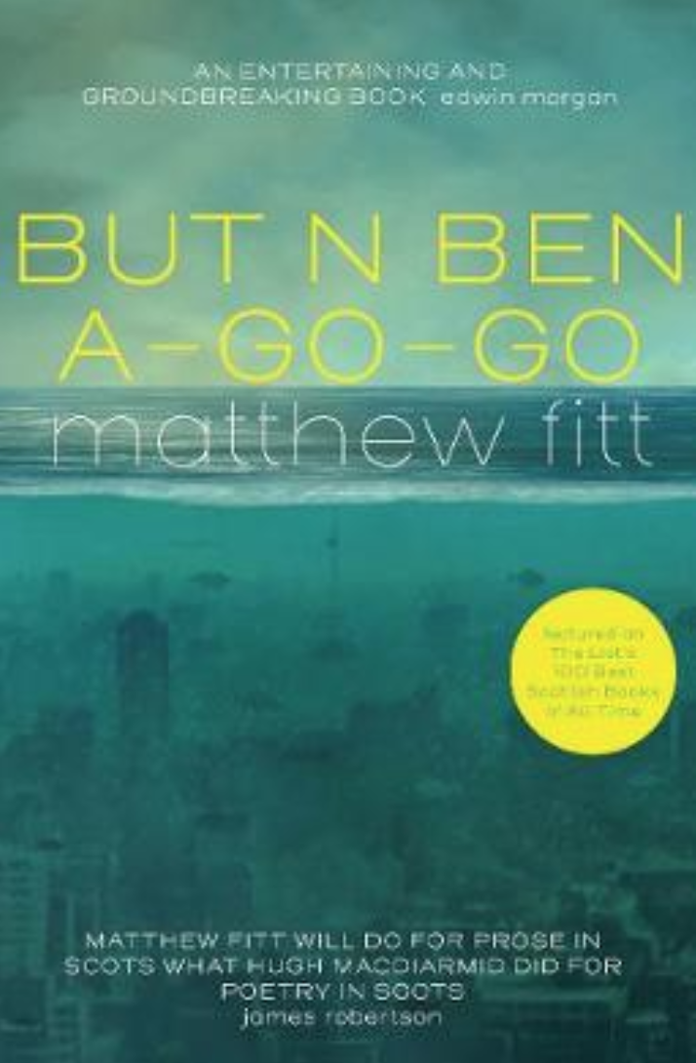
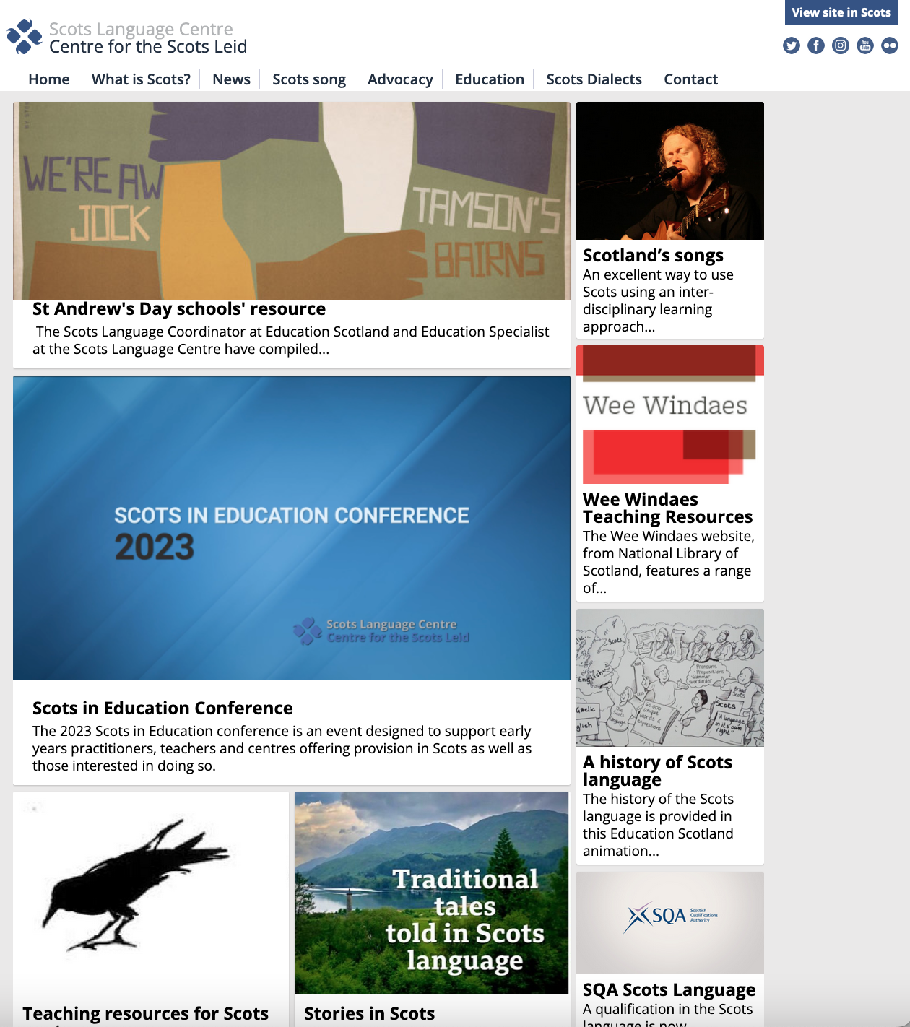
Slide Title 8
Whit we can dae
Recognise language ideologies aboot the Scots leid
Hink aboot whit you believe aboot Scots
Lairn mair aboot Scots
Yaise Scots if ye ken it awready
Heeze up ithers tae yaise Scots an aw,
biggin a safe an sicker space fir yaisin Scots

Slide 24
Slide Title 30
Thank you
linda.bruce@open.ac.uk
@LindaBrucePGR

Slide 25
References
Armstrong, N., & Mackenzie, I. E. (2013). Standardization, ideology and linguistics. Palgrave Macmillan.
Bonfiglio, T. P. (2010). Mother tongues and nations the invention of the native speaker by. De Gruyter Mouton. https://doi.org/10.1515/9781934078266
Bauman, R., & Briggs, C. L. (2003). Voices of modernity: Language ideologies and the politics of inequality. Cambridge University Press.
Council of Europe. (2019). Details of Treaty No. 148: European Charter for Regional or Minority Languages. Retrieved 25 November 2021 from https://www.coe.int/en/web/conventions/full-list?module=treaty-detail&treatynum=148
Johnston, P. (2007). Scottish English and Scots. In D. Britain (Ed.), Language in the British Isles (pp. 433-514). Cambridge University Press.
Maguire, W. (2012). English and Scots in Scotland. In Areal features of the Anglophone world (pp. 53-78). De Gruyter Mouton.
Scottish Government. (2022). 1+2 Languages Policy. https://www.gov.scot/publications/12-languages-policy-findings-2021-survey-local-authorities/documents/
Silverstein, M. (1979). Language structure and linguistic ideology. The elements: A parasession on linguistic units and levels, 193, 247.
Silverstein, M. (2003). Indexical order and the dialectics of sociolinguistic life. Language & Communication, 23(3-4), 193-229.
The Scottish Government. (2015). Scots language policy: English version. Retrieved 25 November 2021 from https://www.gov.scot/publications/scots-language-policy-english/
Van Rooy, R. (2020). Language or dialect? : The history of a conceptual pair (First ed.). Oxford University Press,. http://www.ezproxy.is.ed.ac.uk/login?url=https://dx.doi.org/10.1093/oso/9780198845713.001.0001
Wilson, L. C. (2012). Luath Scots language learner : an introduction to contemporary spoken Scots (Revised ed.). Luath Press Limited,.
Woolard, K. (1998). Language Ideology as a Field of Inquiry. In B. B. Schieffelin, K. Woolard, & P. V. Kroskrity (Eds.), Language Ideologies: Practice and Theory (pp. 3-47). Oxford University Press.

Slide 26
Images
www.pexels.com
Google Images
Minna Sundberg. More information at www.openculture.com.

