Slide 1


How to install the Zimbabwe Disability Toolkit App
https://students.open.ac.uk/candc/zimbabwe_disability_toolkit/

Slide 2
About the App
The Disability Toolkit App is a progressive web application (PWA) - a web site that can be downloaded to your device which will appear alongside your other apps on your phone, tablet, laptop or desktop computer, for convenient access. The App can be used like any web page when you are connected to the internet – but you can also download it and use all of it offline without an internet connection.
The installation process to download it to your device varies depending on your operating system and web browser. On the next pages you will find instructions on how to download and install the Zimbabwe Disability Toolkit App onto your PC or phone or tablet using Google Chrome, Microsoft Edge or Safari on iOS. Other browsers and systems will work in similar ways, just look for the Install icon on the browser.

Slide 3
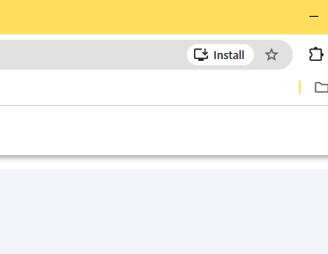
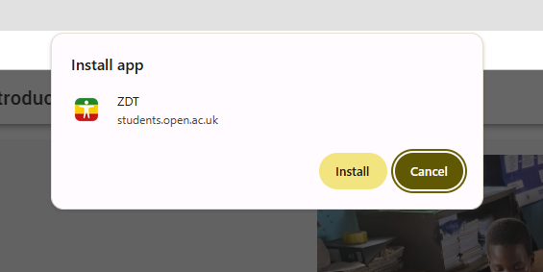
Installing the App using Google Chrome
Open up Google Chrome.
In the address bar copy and paste the following link, then press Enter https://students.open.ac.uk/candc/zimbabwe_disability_toolkit.
On the right hand side of the browser bar you will see an ‘Install’ button:
Click on the Install button and
you will get a
confirmation screen
4. Click on Install and follow the instructions. The PWA is now installed and available on your home screen.
You can also pin the app to your start-up menu.

Slide 4
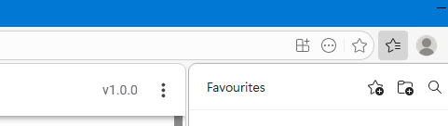
Installing the App using Microsoft Edge
1. Open up Microsoft Edge
2. In the address bar copy and paste the following link, then press Enter
https://students.open.ac.uk/candc/zimbabwe_disability_toolkit
3. To install the App on your computer click on the Install icon in the Address bar
4. An ‘Install this App’ prompt will appear, select your preferred options for how the app will appear on your computer, then confirm the installation. Follow the on-screen instructions to download the App onto your PC.

Slide 5
Installing the App on iOS with Safari (Apple)
A PWA can only be installed on iOS using the Safari web browser.
Open up Safari
In the address bar copy and paste the following link, then press Enter https://students.open.ac.uk/candc/zimbabwe_disability_toolkit.
Press the "Share" button and select "Add to Home Screen" from the popup.
Tap "Add" in the top right corner to finish installing the PWA.
Follow the instructions to get the App on your home screen.

